Slide 1
Making a sewing machine cover
With Jackie Pettit

Slide 2
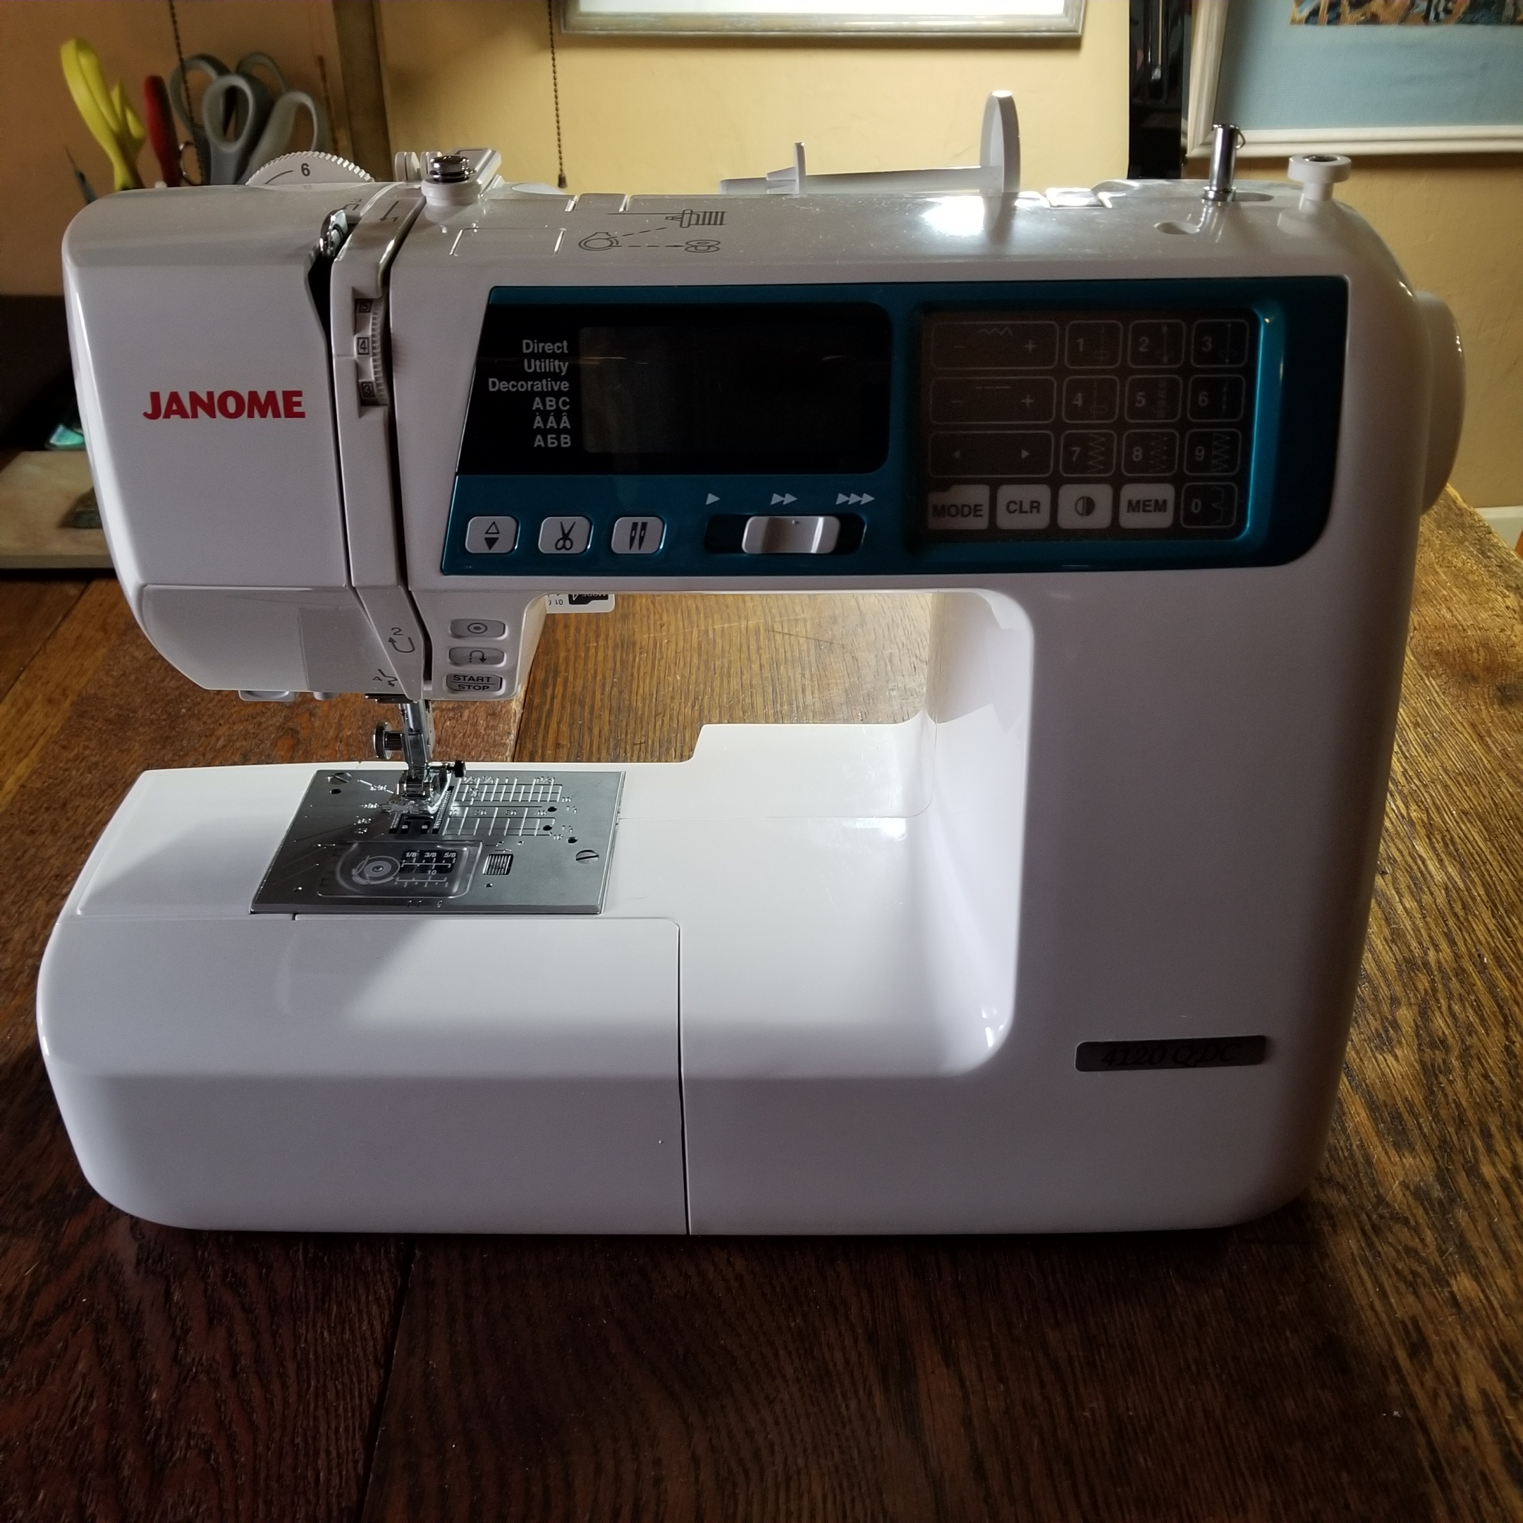
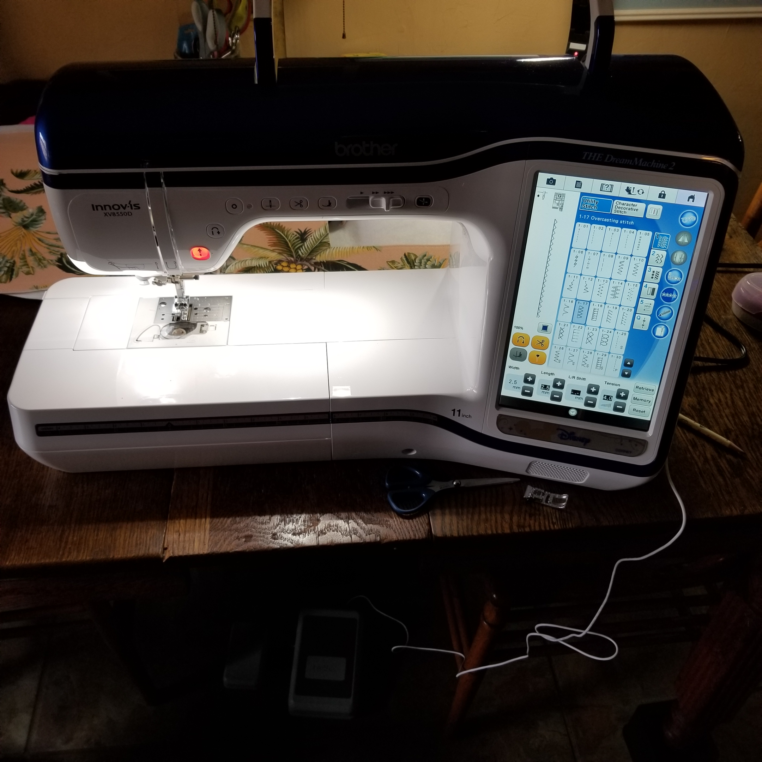
Machine style
A rectangular style machine like the Janome on the left is easier to cover. Styles with areas that jut out, like the Brother machine on the right, will take more customizing

Slide 3
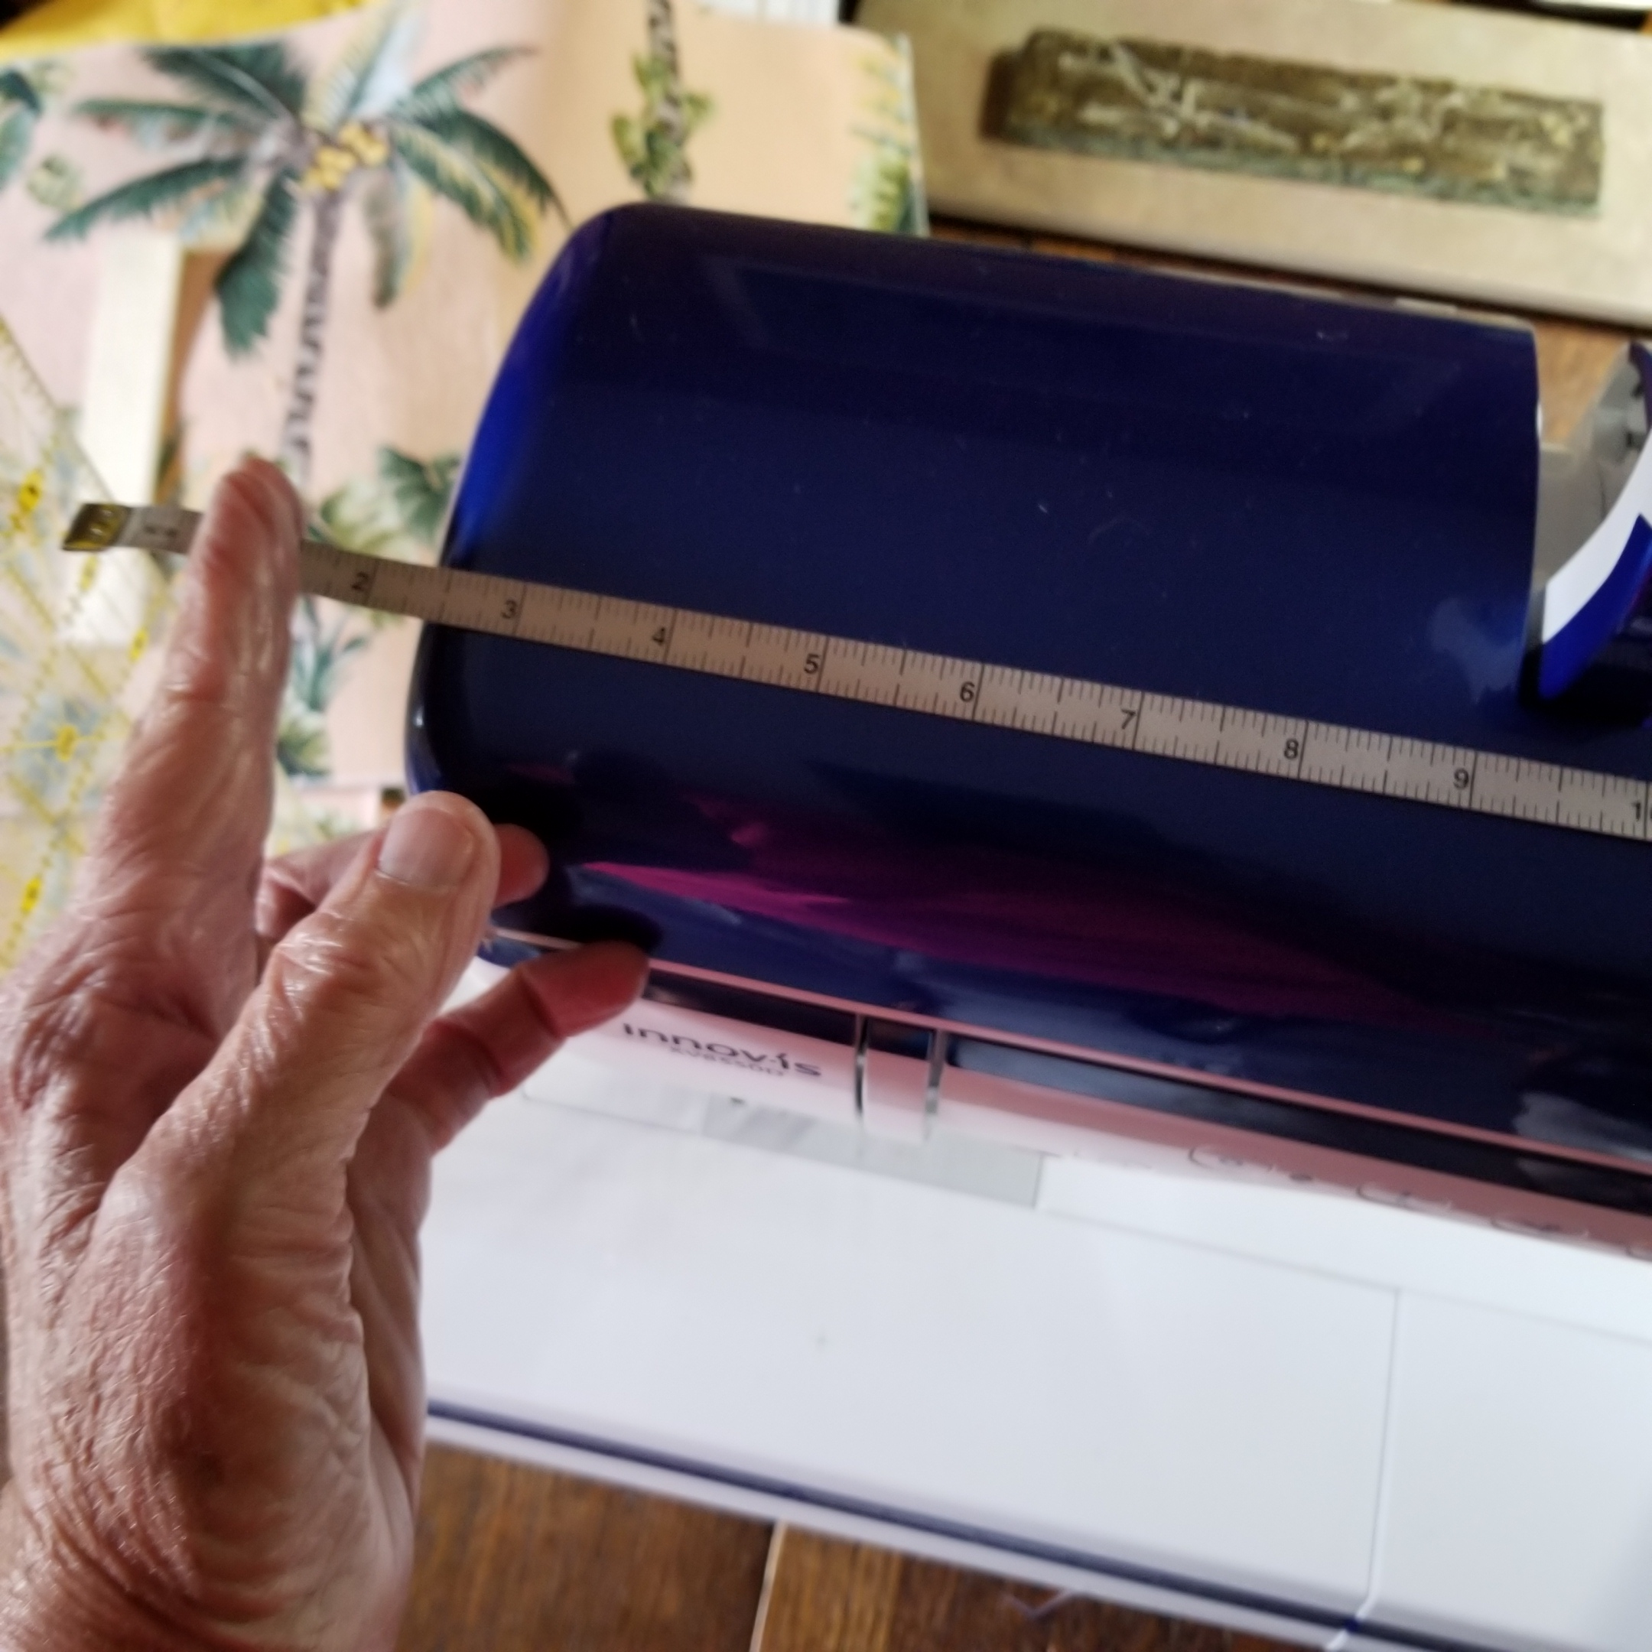
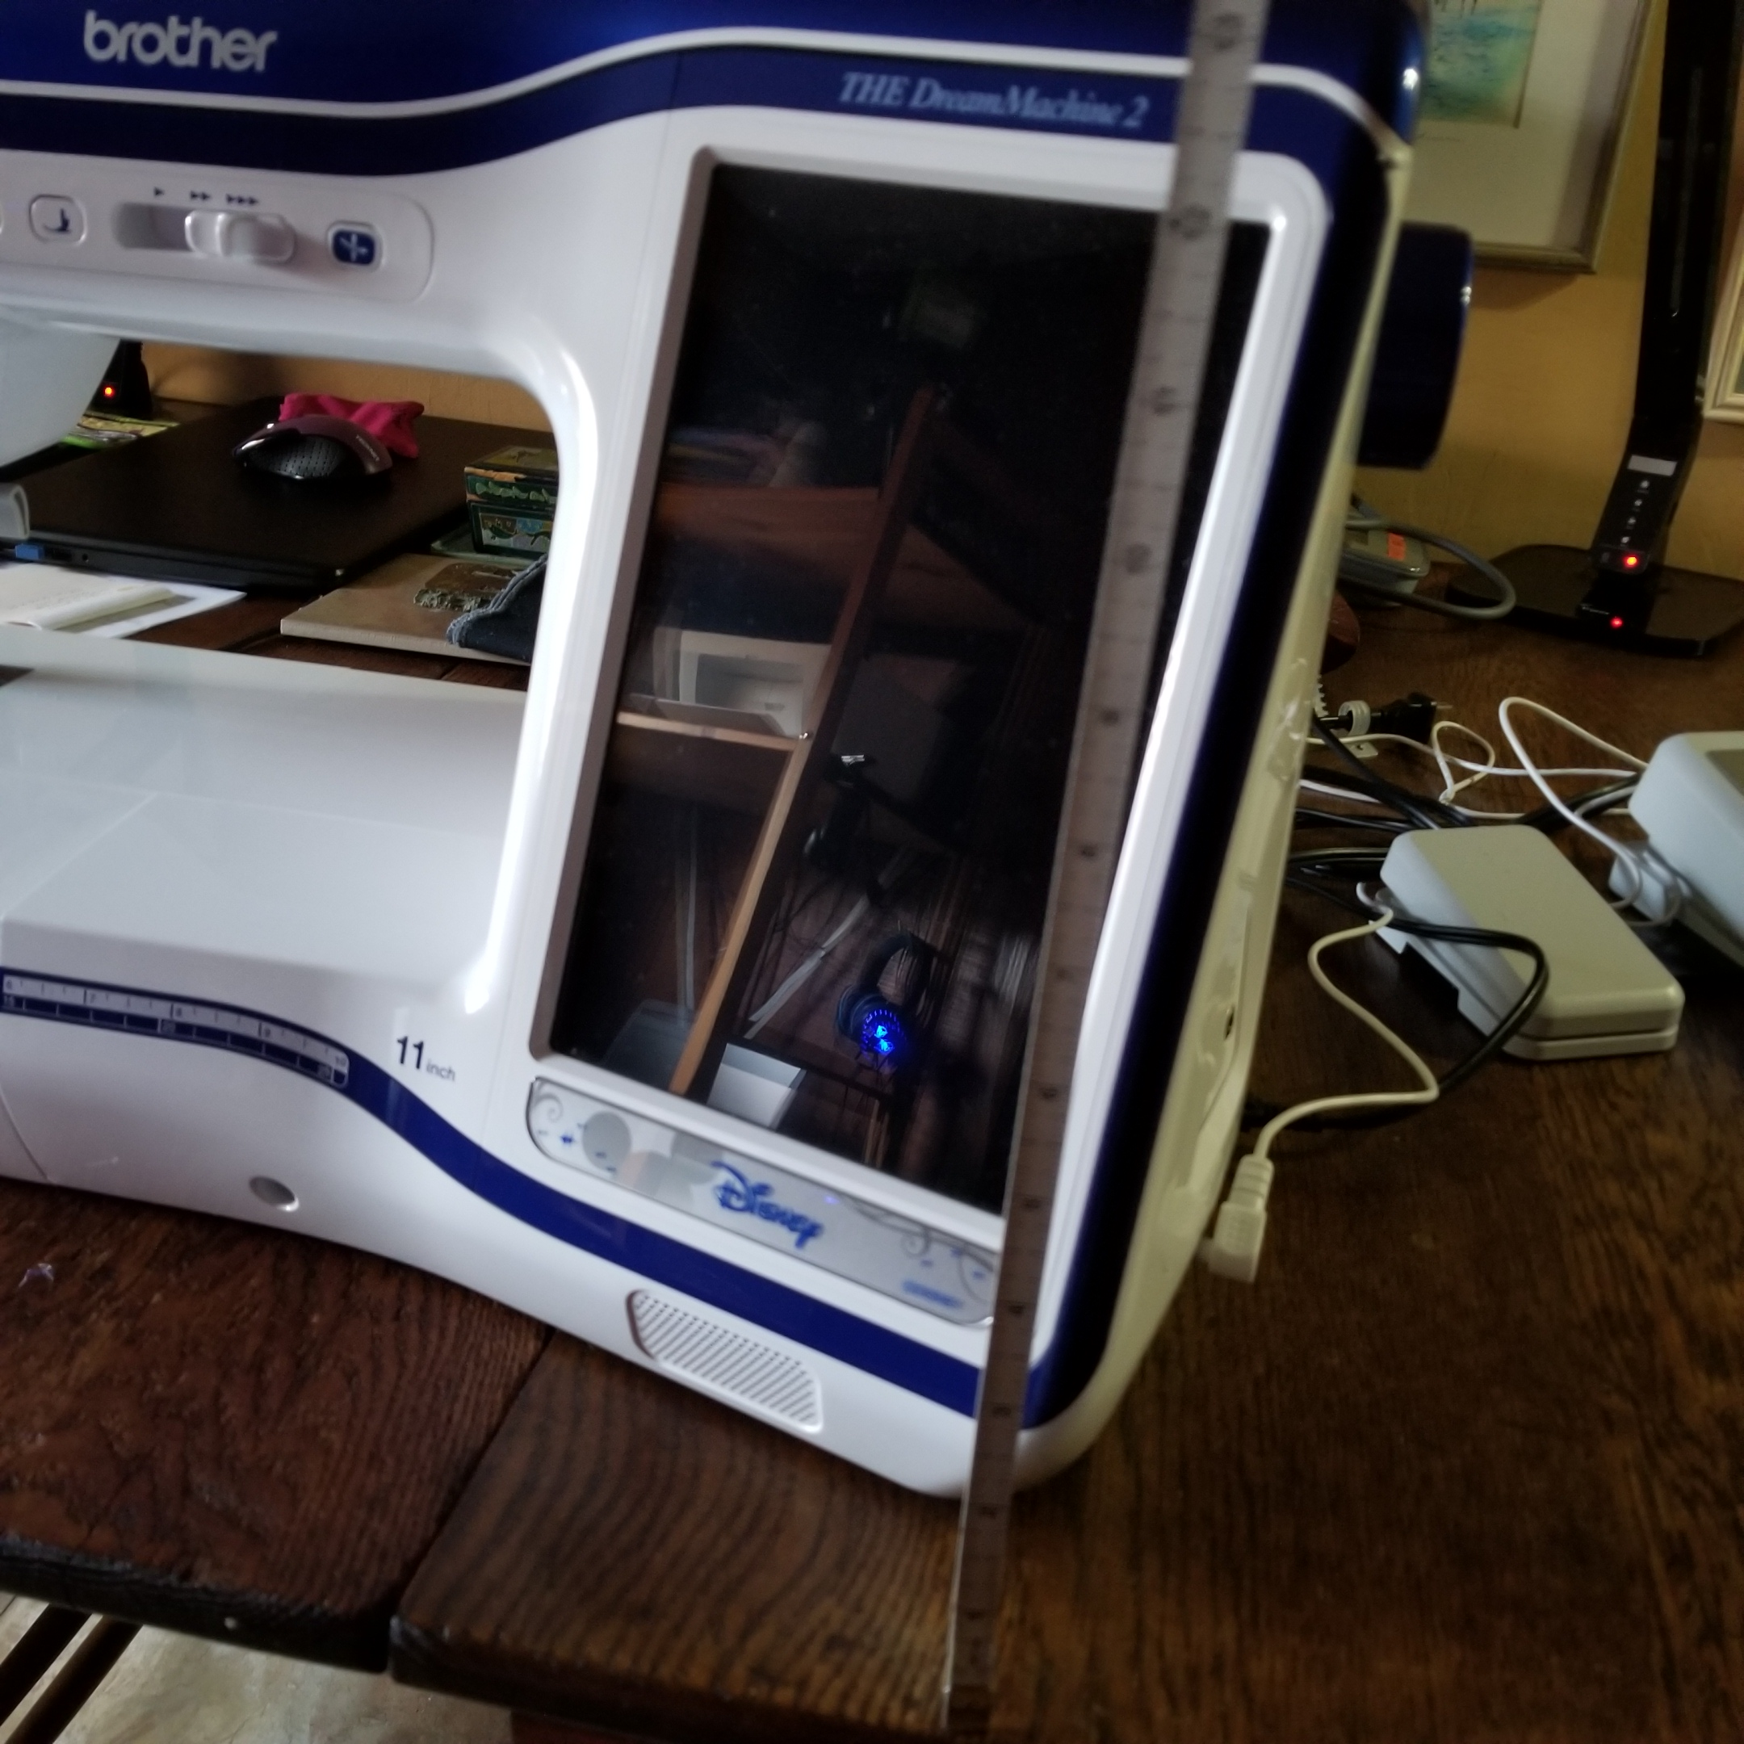
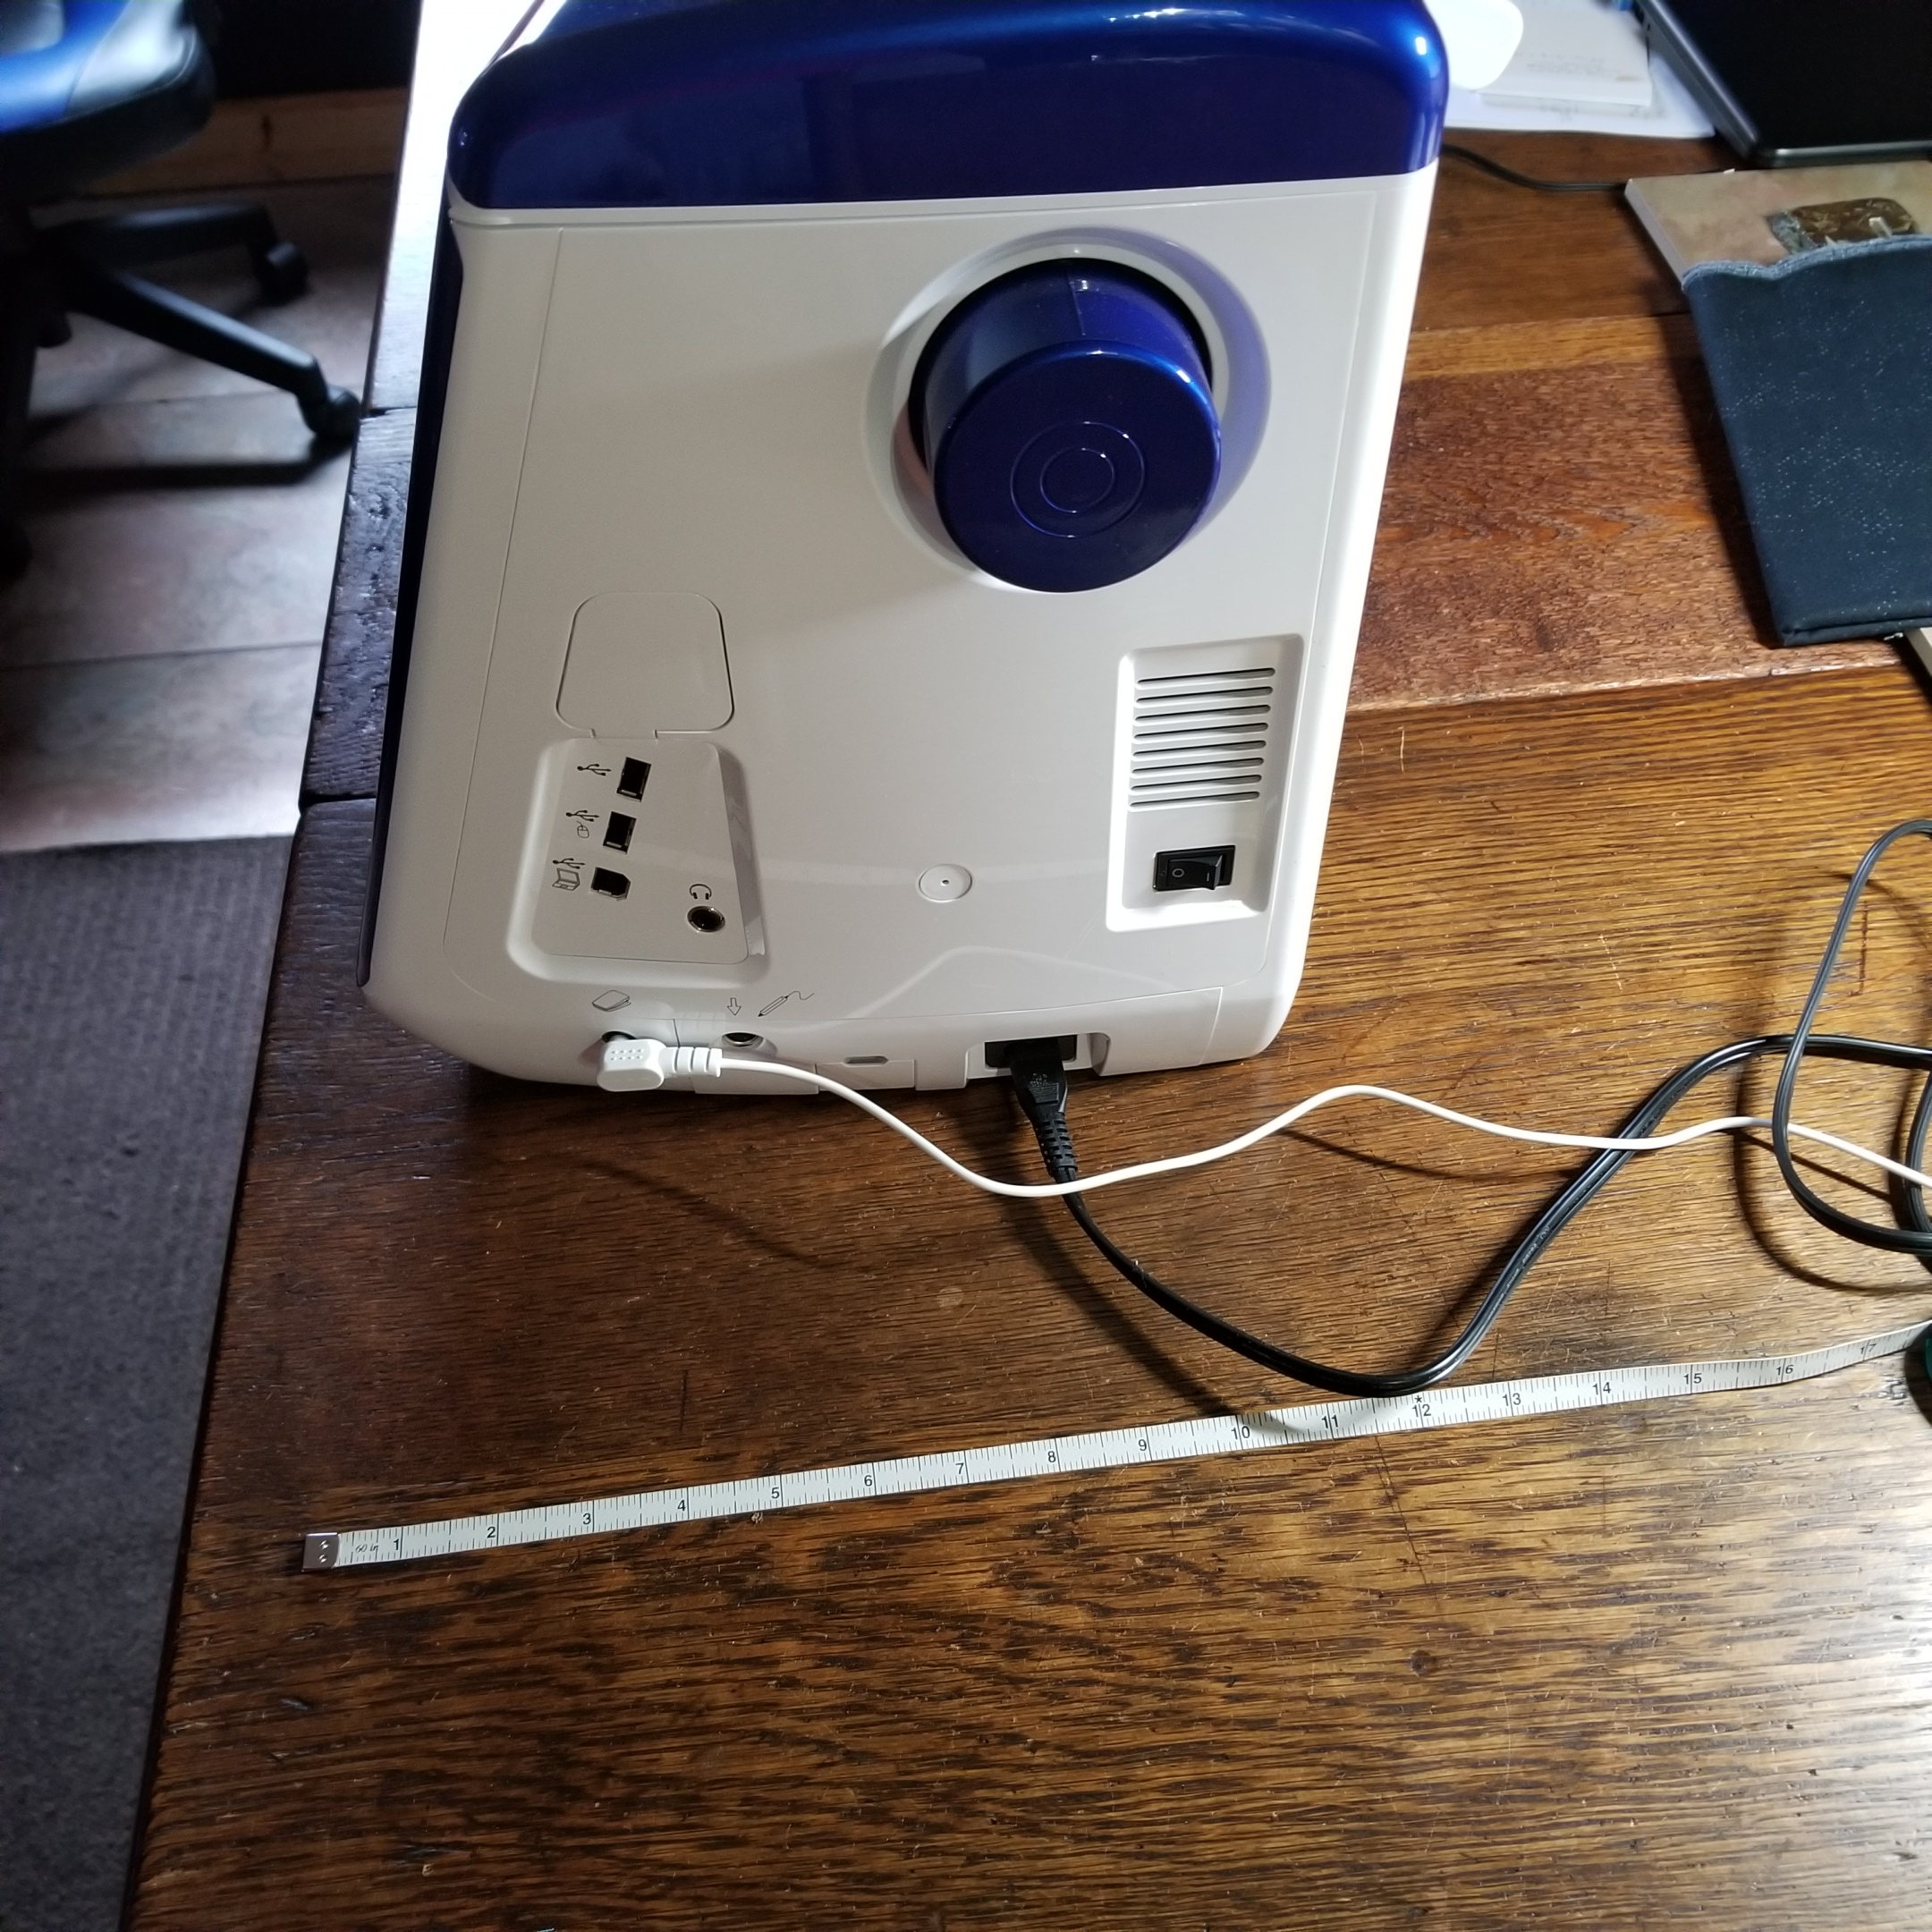
Measure your machine

Slide 4
Measure:
The length, at the longest point, including any extensions, like the handwheel The height, at the highest point, including any thread spool carriers The width, at the widest point, including any extensions

Slide 5
Cut your fabric
Cut 2 pieces using the length measurement plus 1” by the height plus 1” (to account for seam allowances and ease)-these will go on the front and back Cut 2 pieces using the width measurement plus 1” by the height plus 1”-these will go on the sides Cut 1 piece using the length measurement plus 1”by the width plus 1”-this will be the top panel

Slide 6
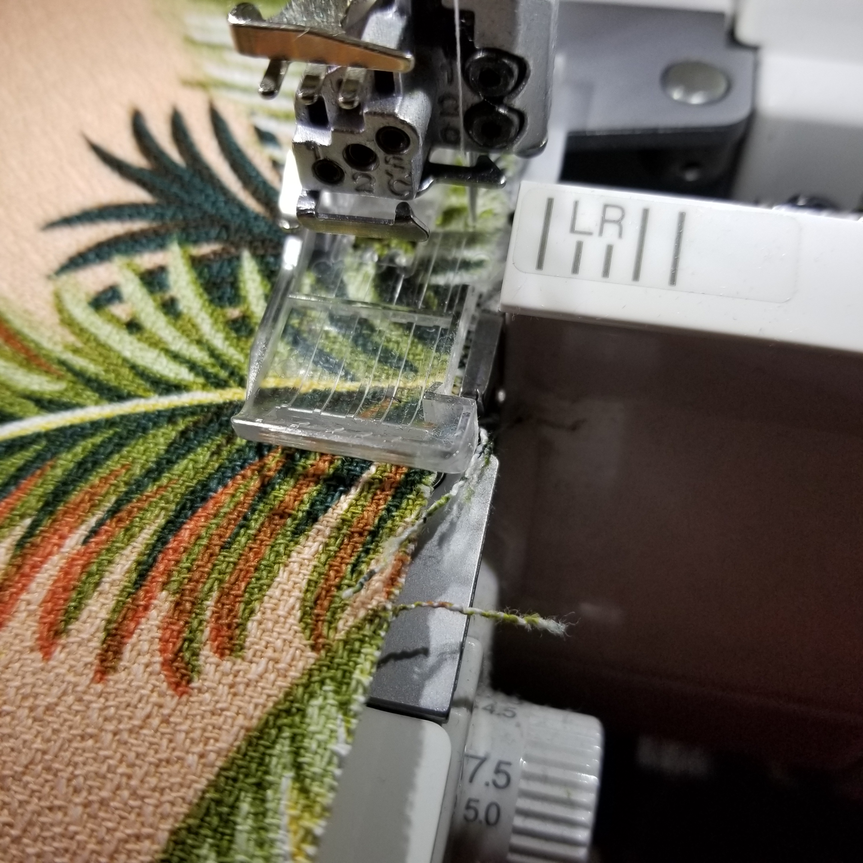
Stabilizing the fabric, finishing edges
I backed my bark cloth fabric with fusible fleece for more body. You could choose a fusible interfacing if the fabric is lighter, like quilting cottons. Upholstery fabric may not need stabilizing; it’s up to you I serged the edges as my fabric ravels. I didn’t cut any fabric off, as I didn’t want to affect the ¼” seam allowance

Slide 7
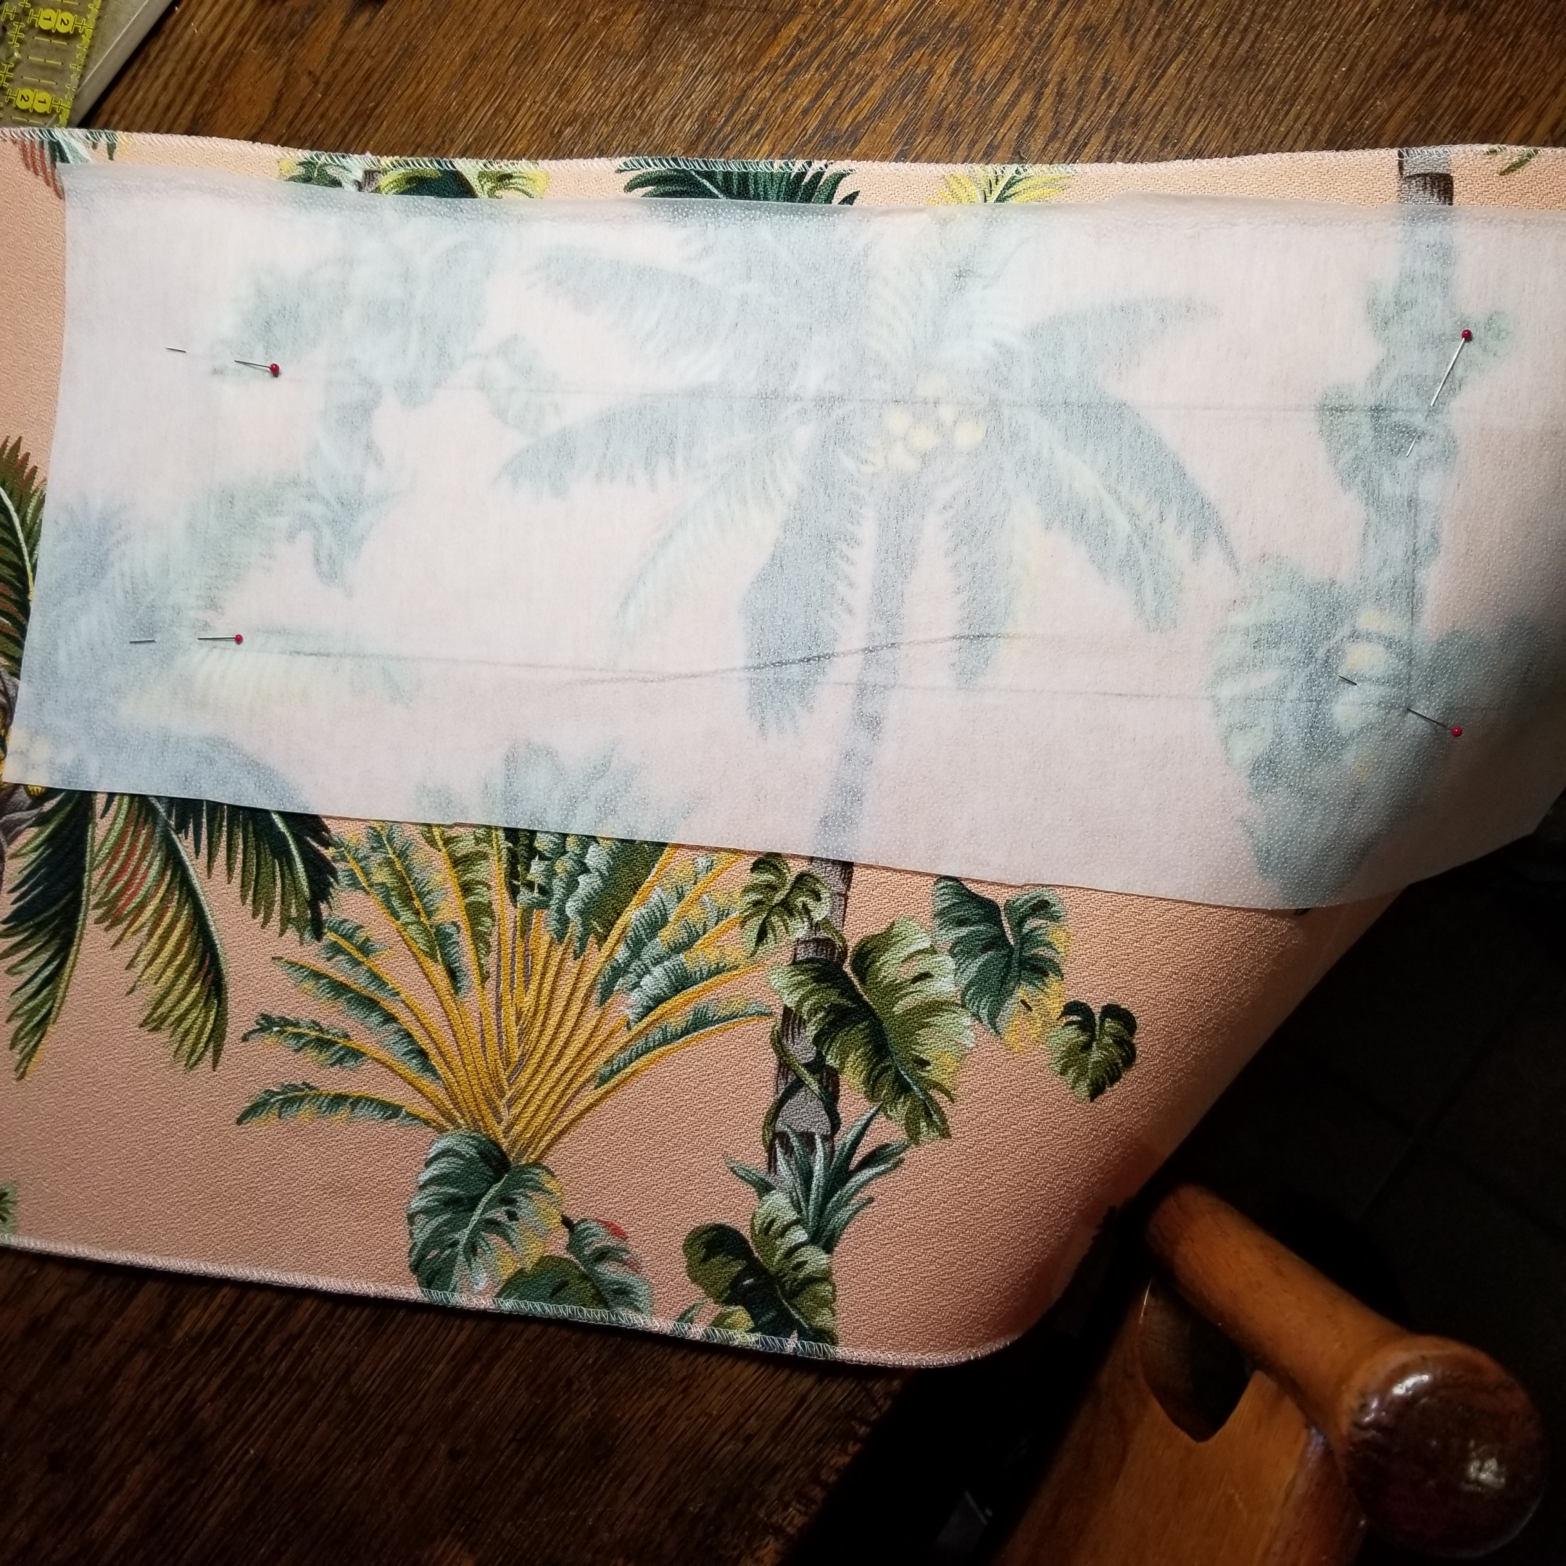
Do you want a hole for the handle?
If so, now is the time to prepare it. I measured the distances from the furthest outer edge of the machine, to each side of the handle, and from front and back of the machine, to the base of the handle. Make an outline of the hole on your fabric with a removable marking product.

Slide 8
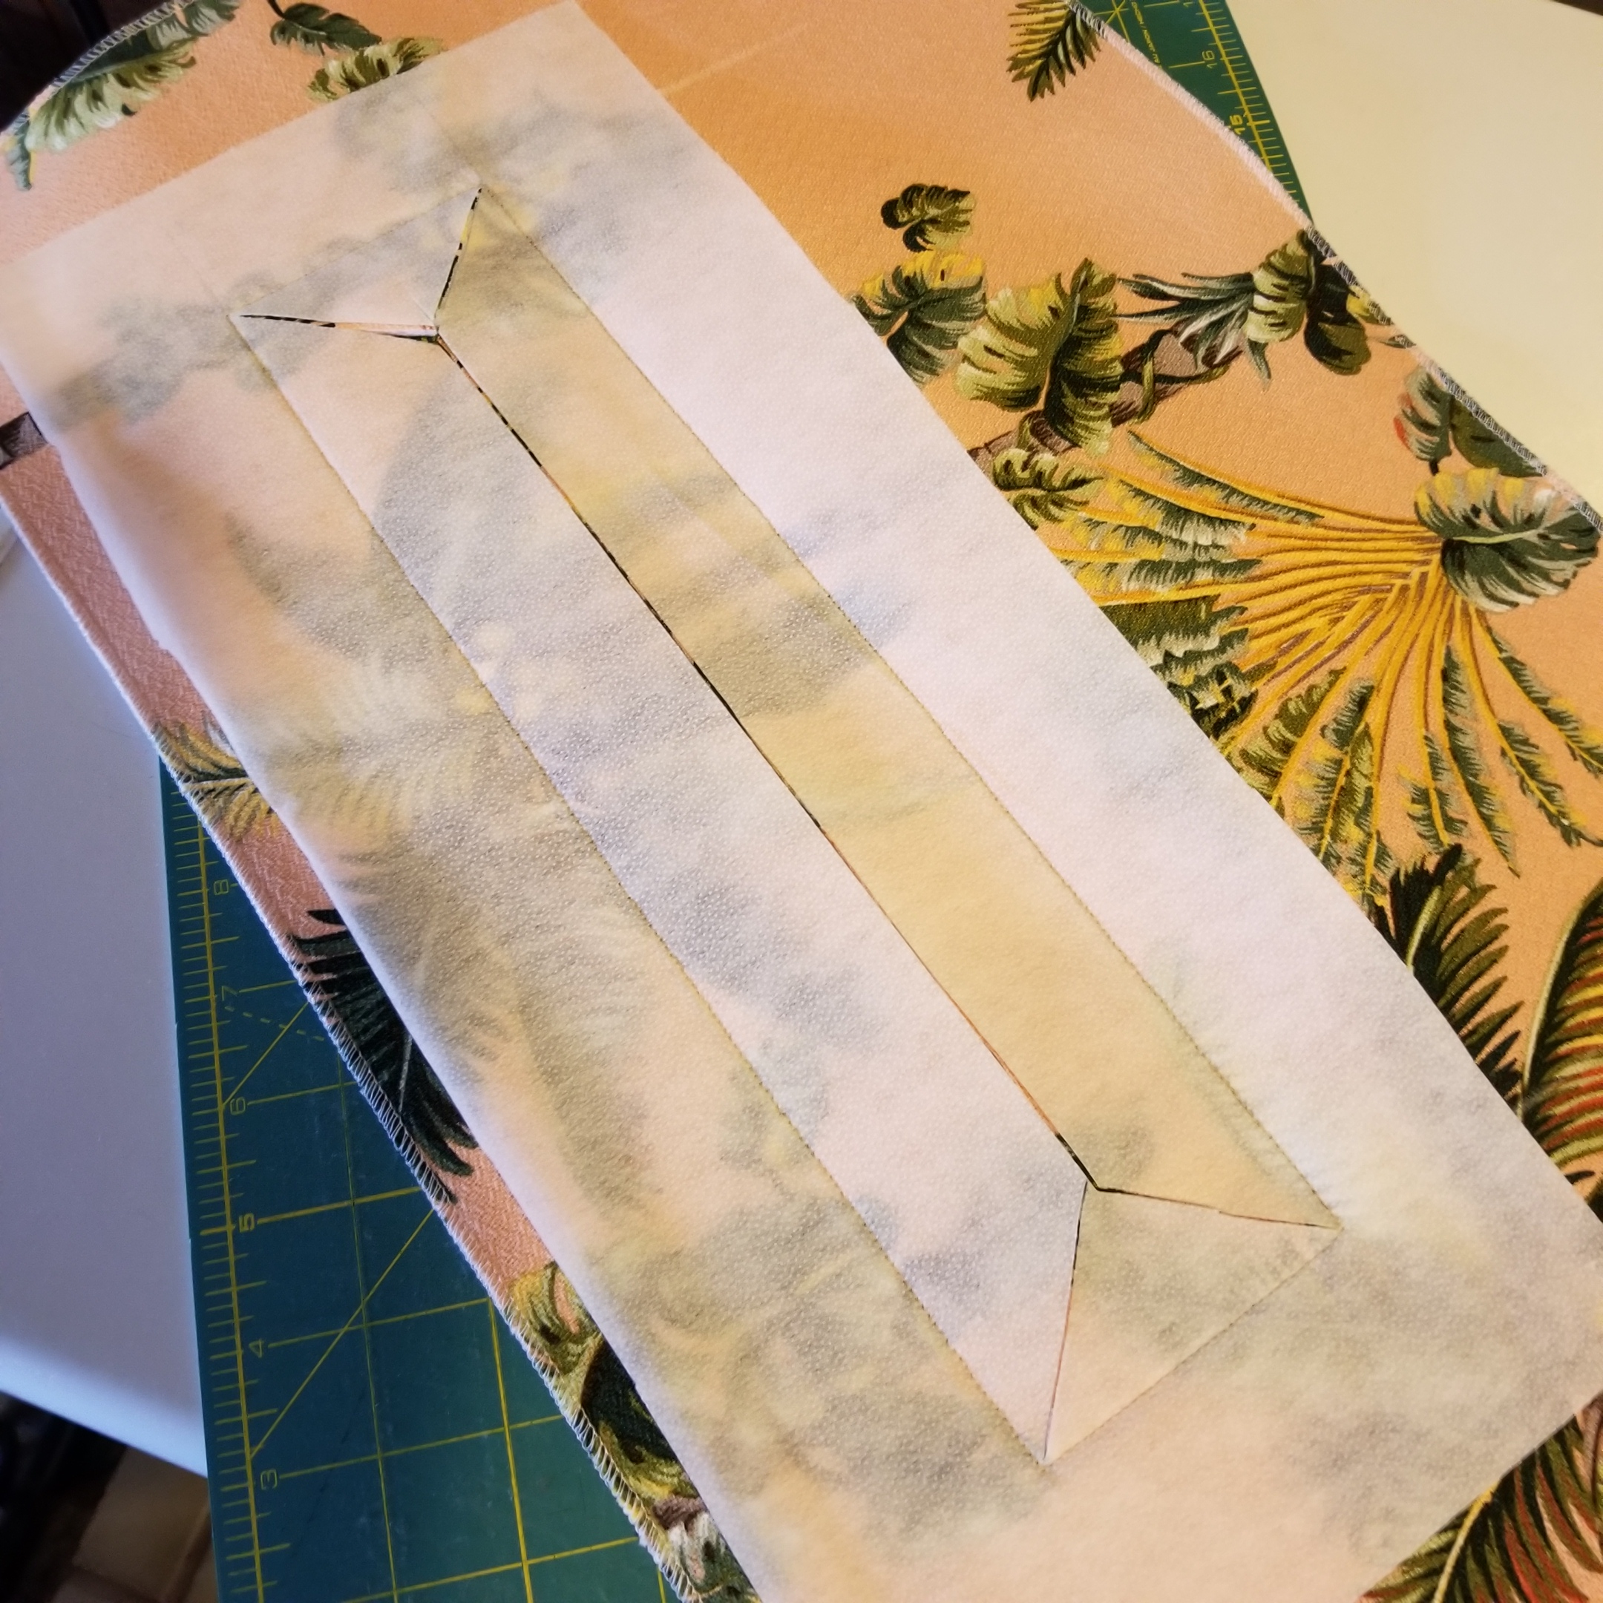
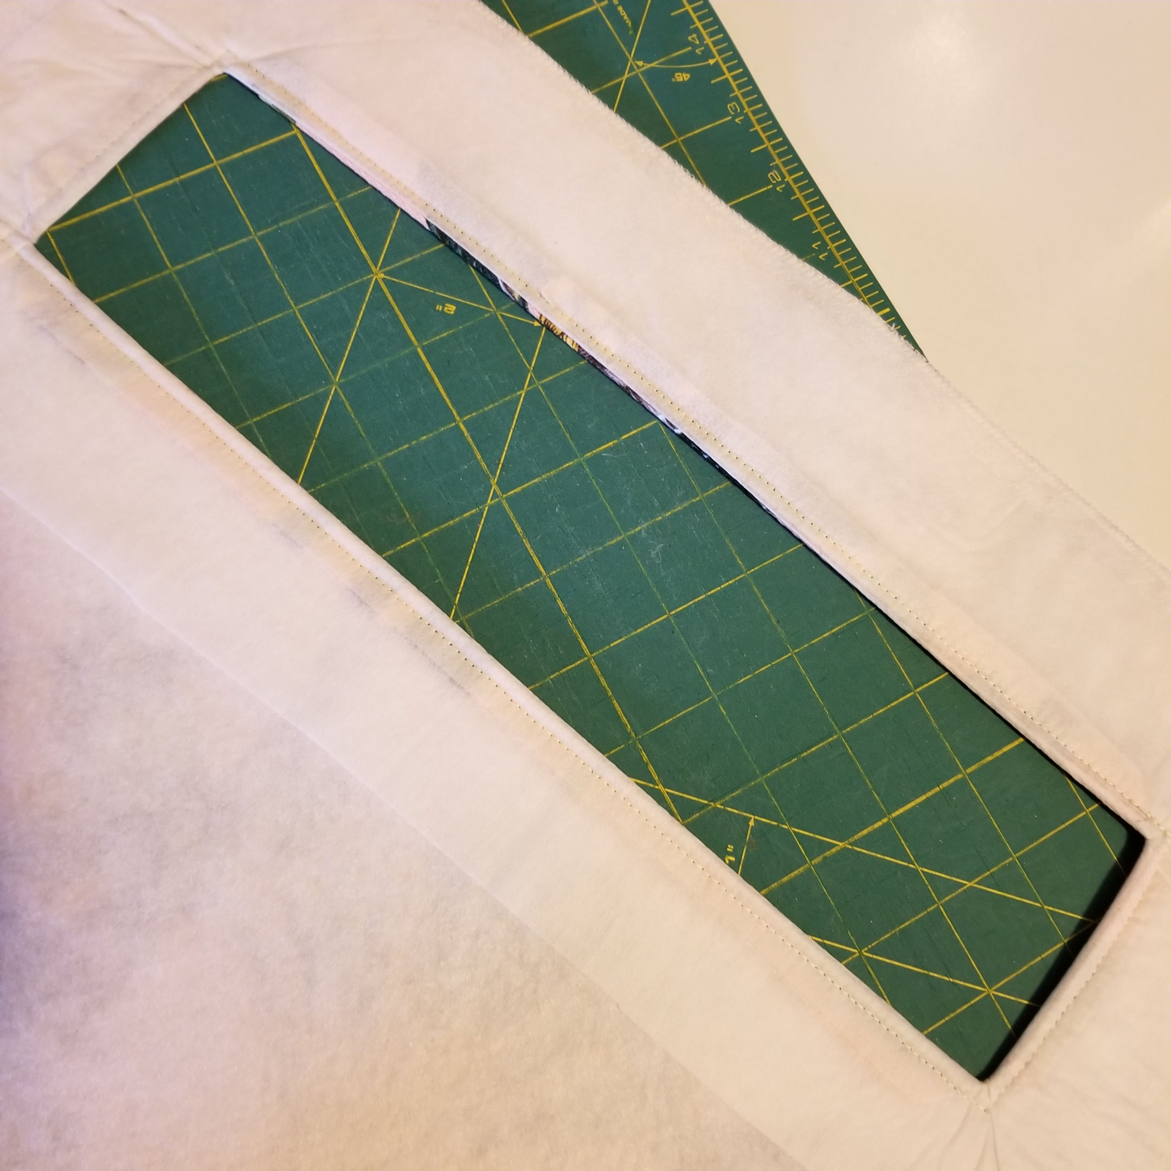
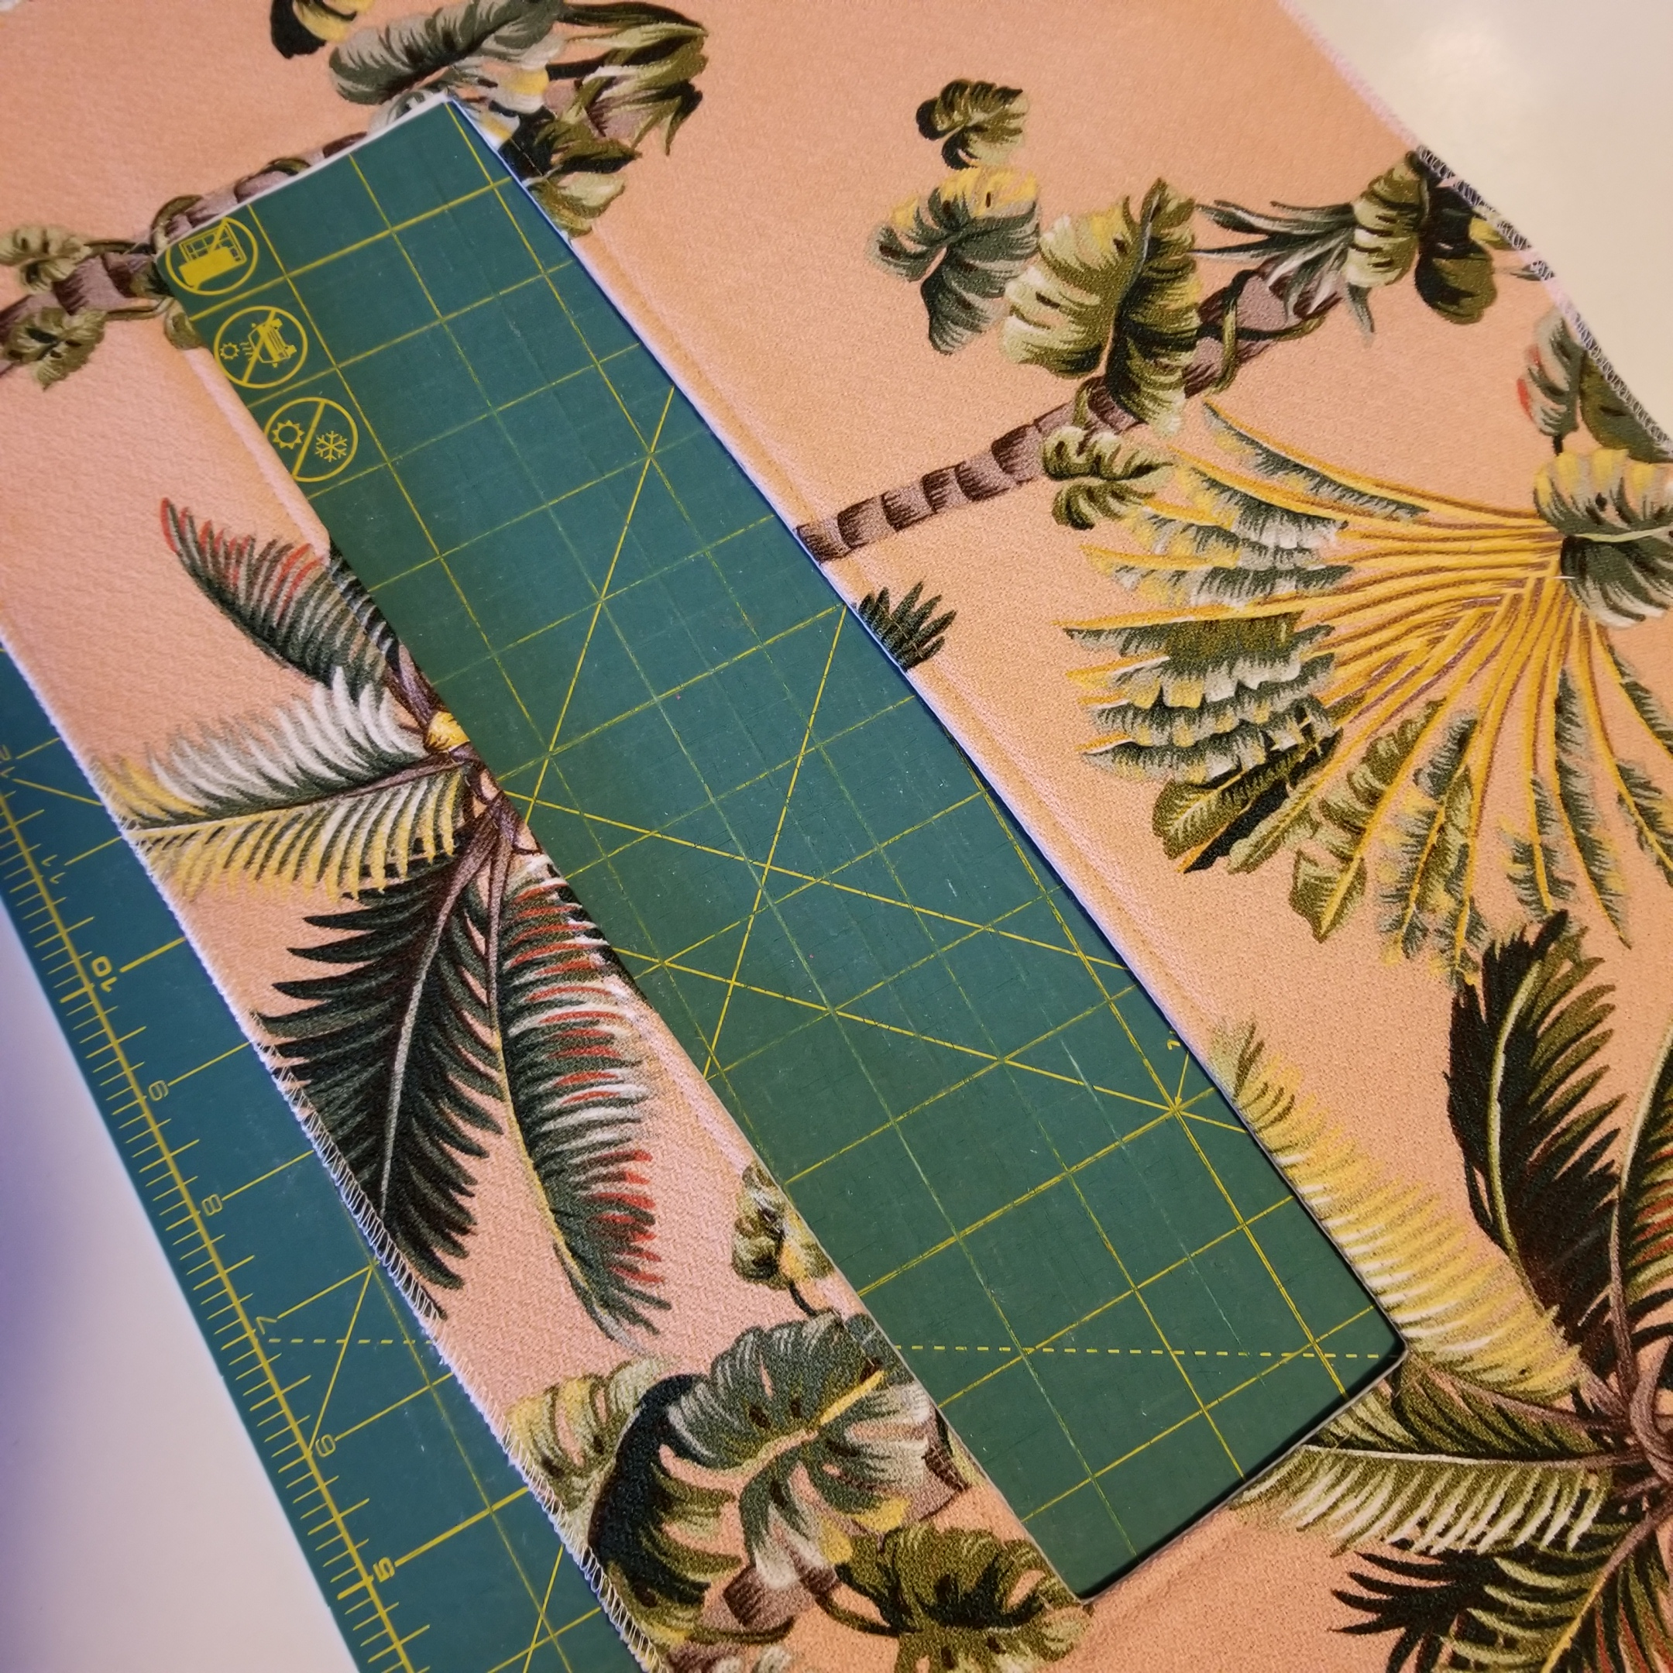
Do you want a hole for the handle?
I used mid weight fusible interfacing, cut longer and wider than the outline for the handle hole, placed right sides together and sewed around the outline. I cut a hole, as for a bound buttonhole, checked the fit over the handle, then turned the interfacing to the inside, fused and edgestitched around the opening.

Slide 9
Construction
I used polyester thread, a 90/14 needle, stitch length of 2.5 for construction, 3.0 for edgestitching, on the bottom hem, 3.5 as the turned up layers were bulky. First, attach sides to top panel, paying attention to directional prints. Using ¼” seam allowance, leave ¼” at the beginning and end of the line of stitching, backstitch at the beginning and end. Check the fit by laying the finished unit over the top and sides of the machine.

Slide 10
Hmmm….
So this is where I started to customize the fit. The top seams were far beyond the top edges of the machine and one side of the machine was wider than the other

Slide 11
Draping your machine
I ripped out the seams and cut back my pieces to fit the width of the top of the machine. Working from the top of the machine down, I marked (actually used a Sharpie) where I wanted to cut the top, (narrower on the left and wider on the right) and side panels, (narrower at the top and wider at the bottom), then re-sewed sides to top. Remember to add ¼” seam allowances.

Slide 12
Draping continued
Then I added the back piece as the back of the machine is flat. I held the back piece up against the side/top unit which was over the machine. I started by holding the right hand edge + ¼” against the right hand seam. I held that in place while marking the back piece where it met the left hand seam. I marked both top and bottom of the left side of the back panel and cut away excess. I sewed that to the side/top unit, with the long unit against the feed dogs, right sides together.

Slide 13
Attaching the front piece
I used the same process to fit the front piece to the side/top unit. I started at the top right and held the front piece where I wanted to join the seam, adding ¼” seam allowance. Then I marked on the left side at top and bottom where the front piece touched the side piece, add ¼”(that was an angled line), cut off the excess and sewed the front to the side/top unit with the larger unit against the feed dogs. Lastly, I turned up 1” hem on the bottom and topstitched it in place. I also ironed every seam with wrong sides pressed together to help shape the corners. I edgestitched the top front and back seams, wrong sides together, to prevent the handle opening from gaping.
(I finished edges on my pieces after each cut, to prevent raveling.)

Slide 14
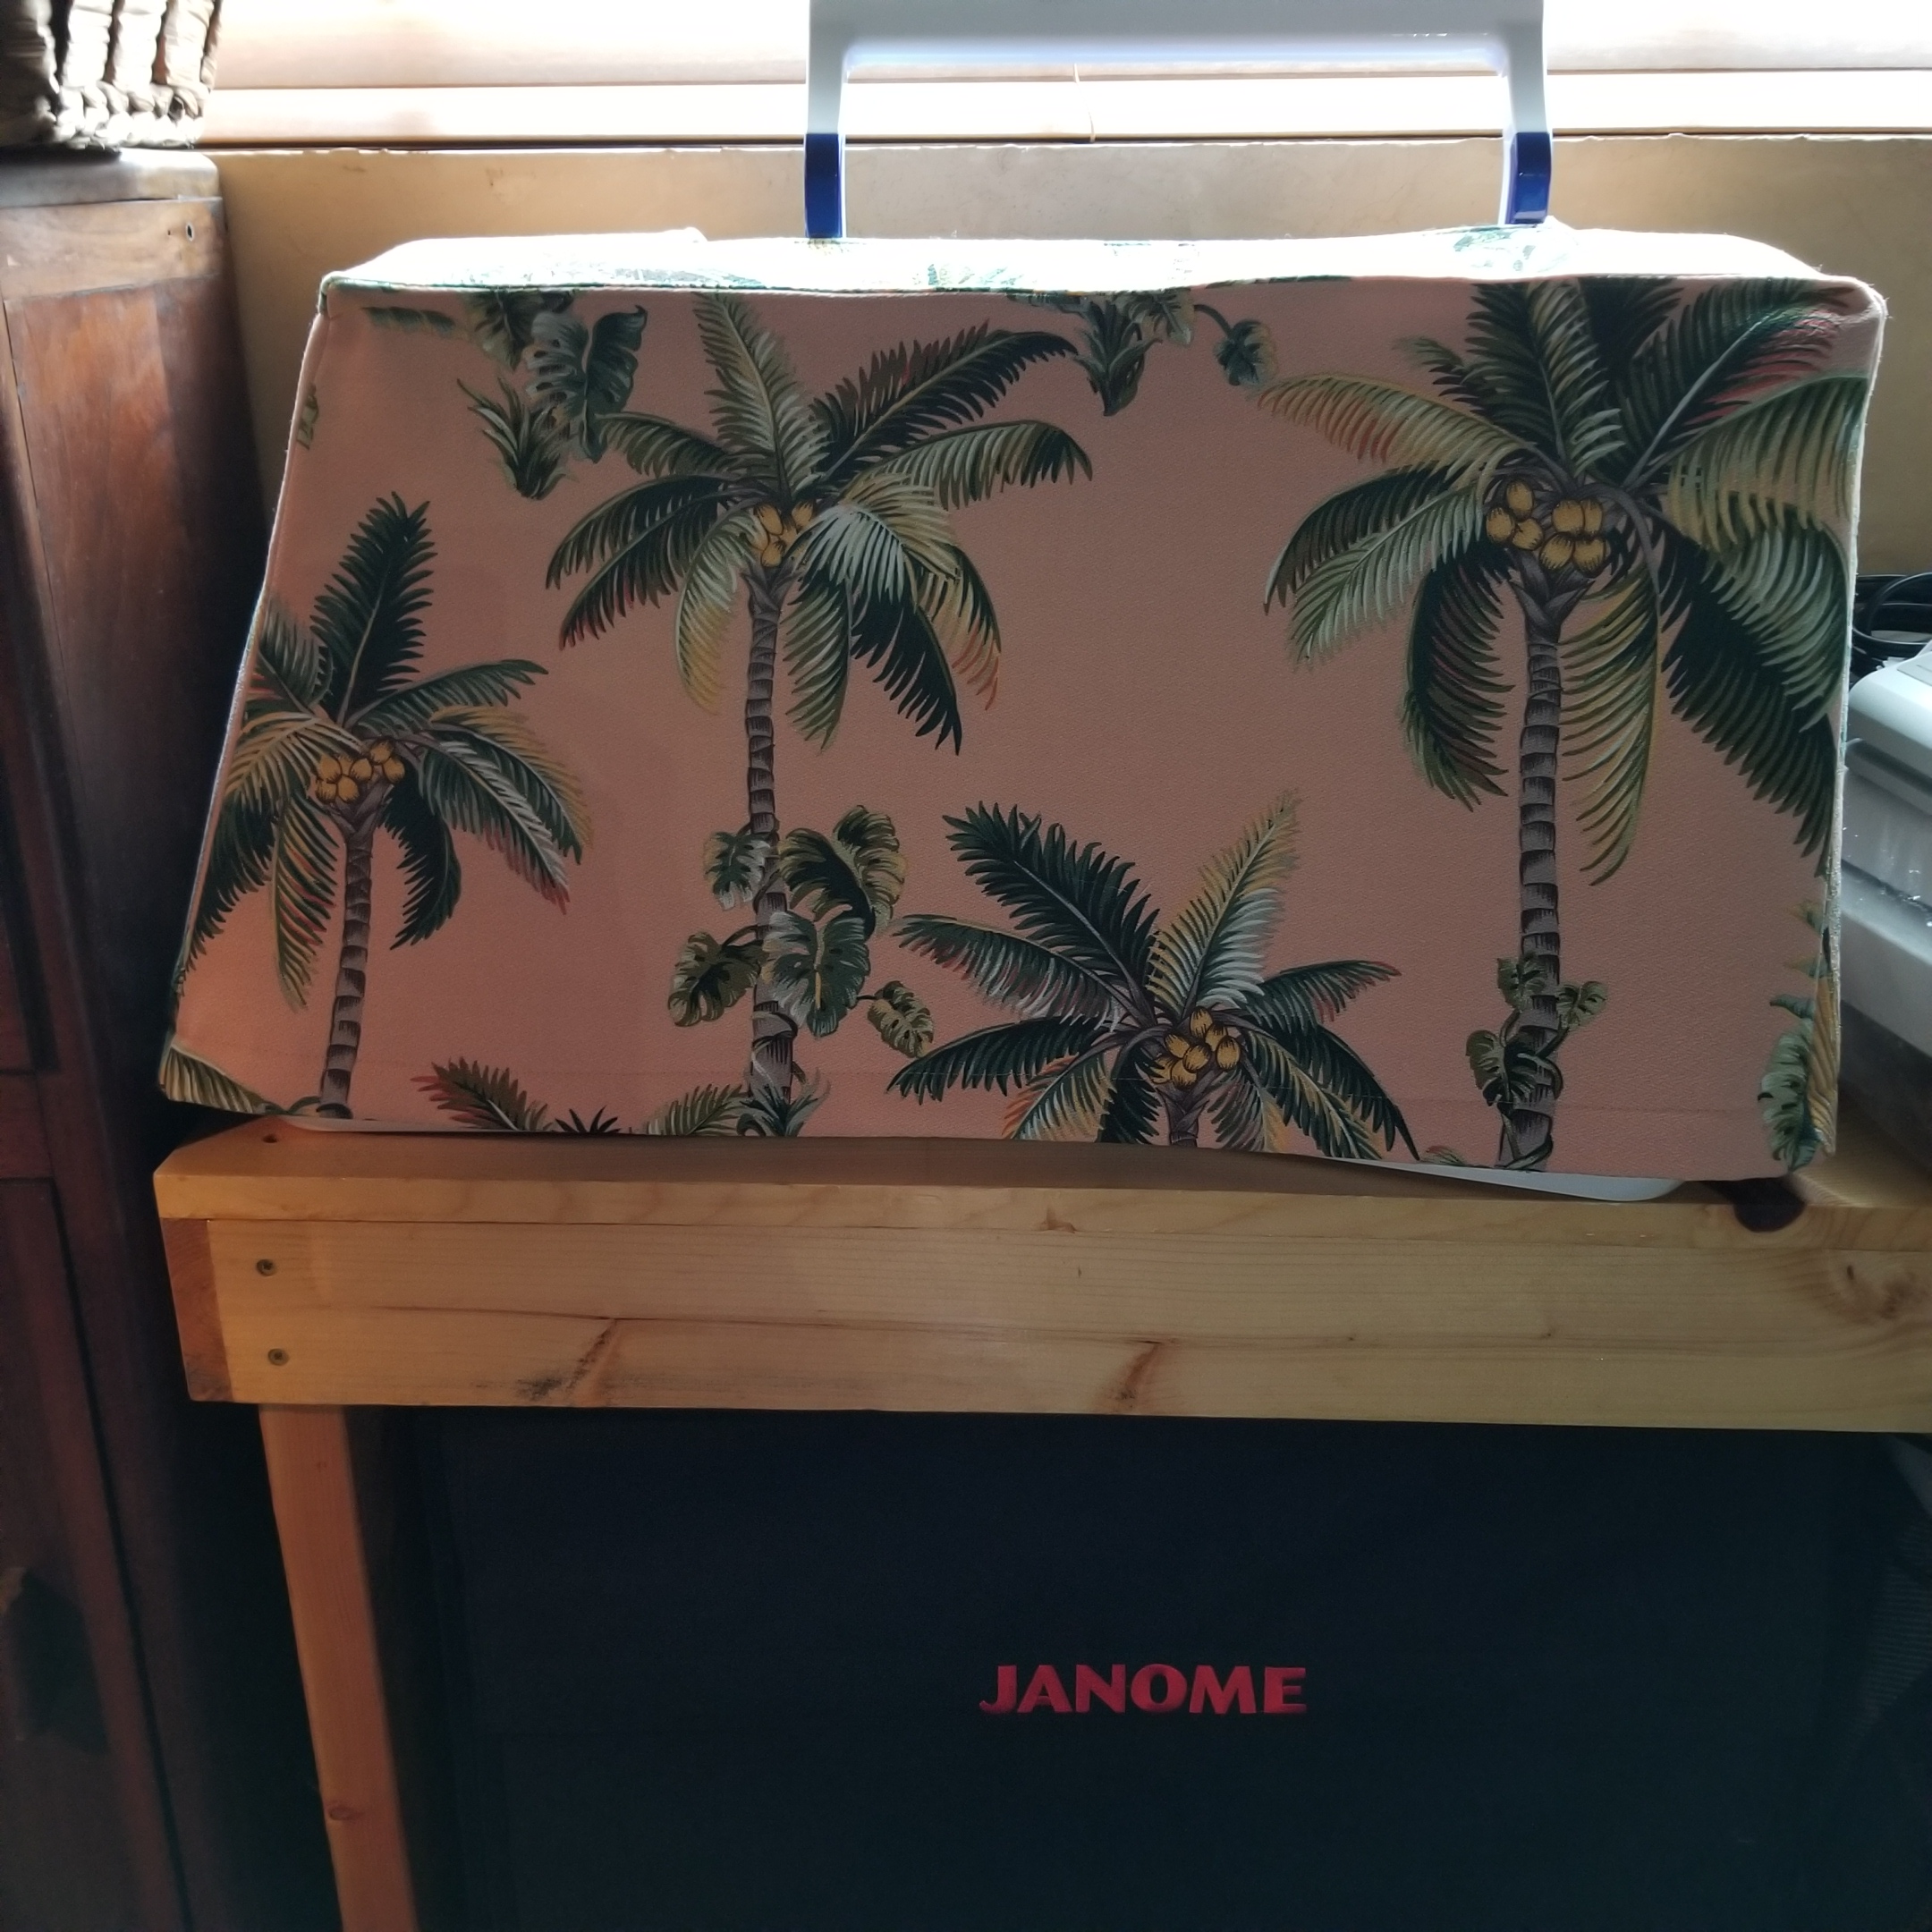
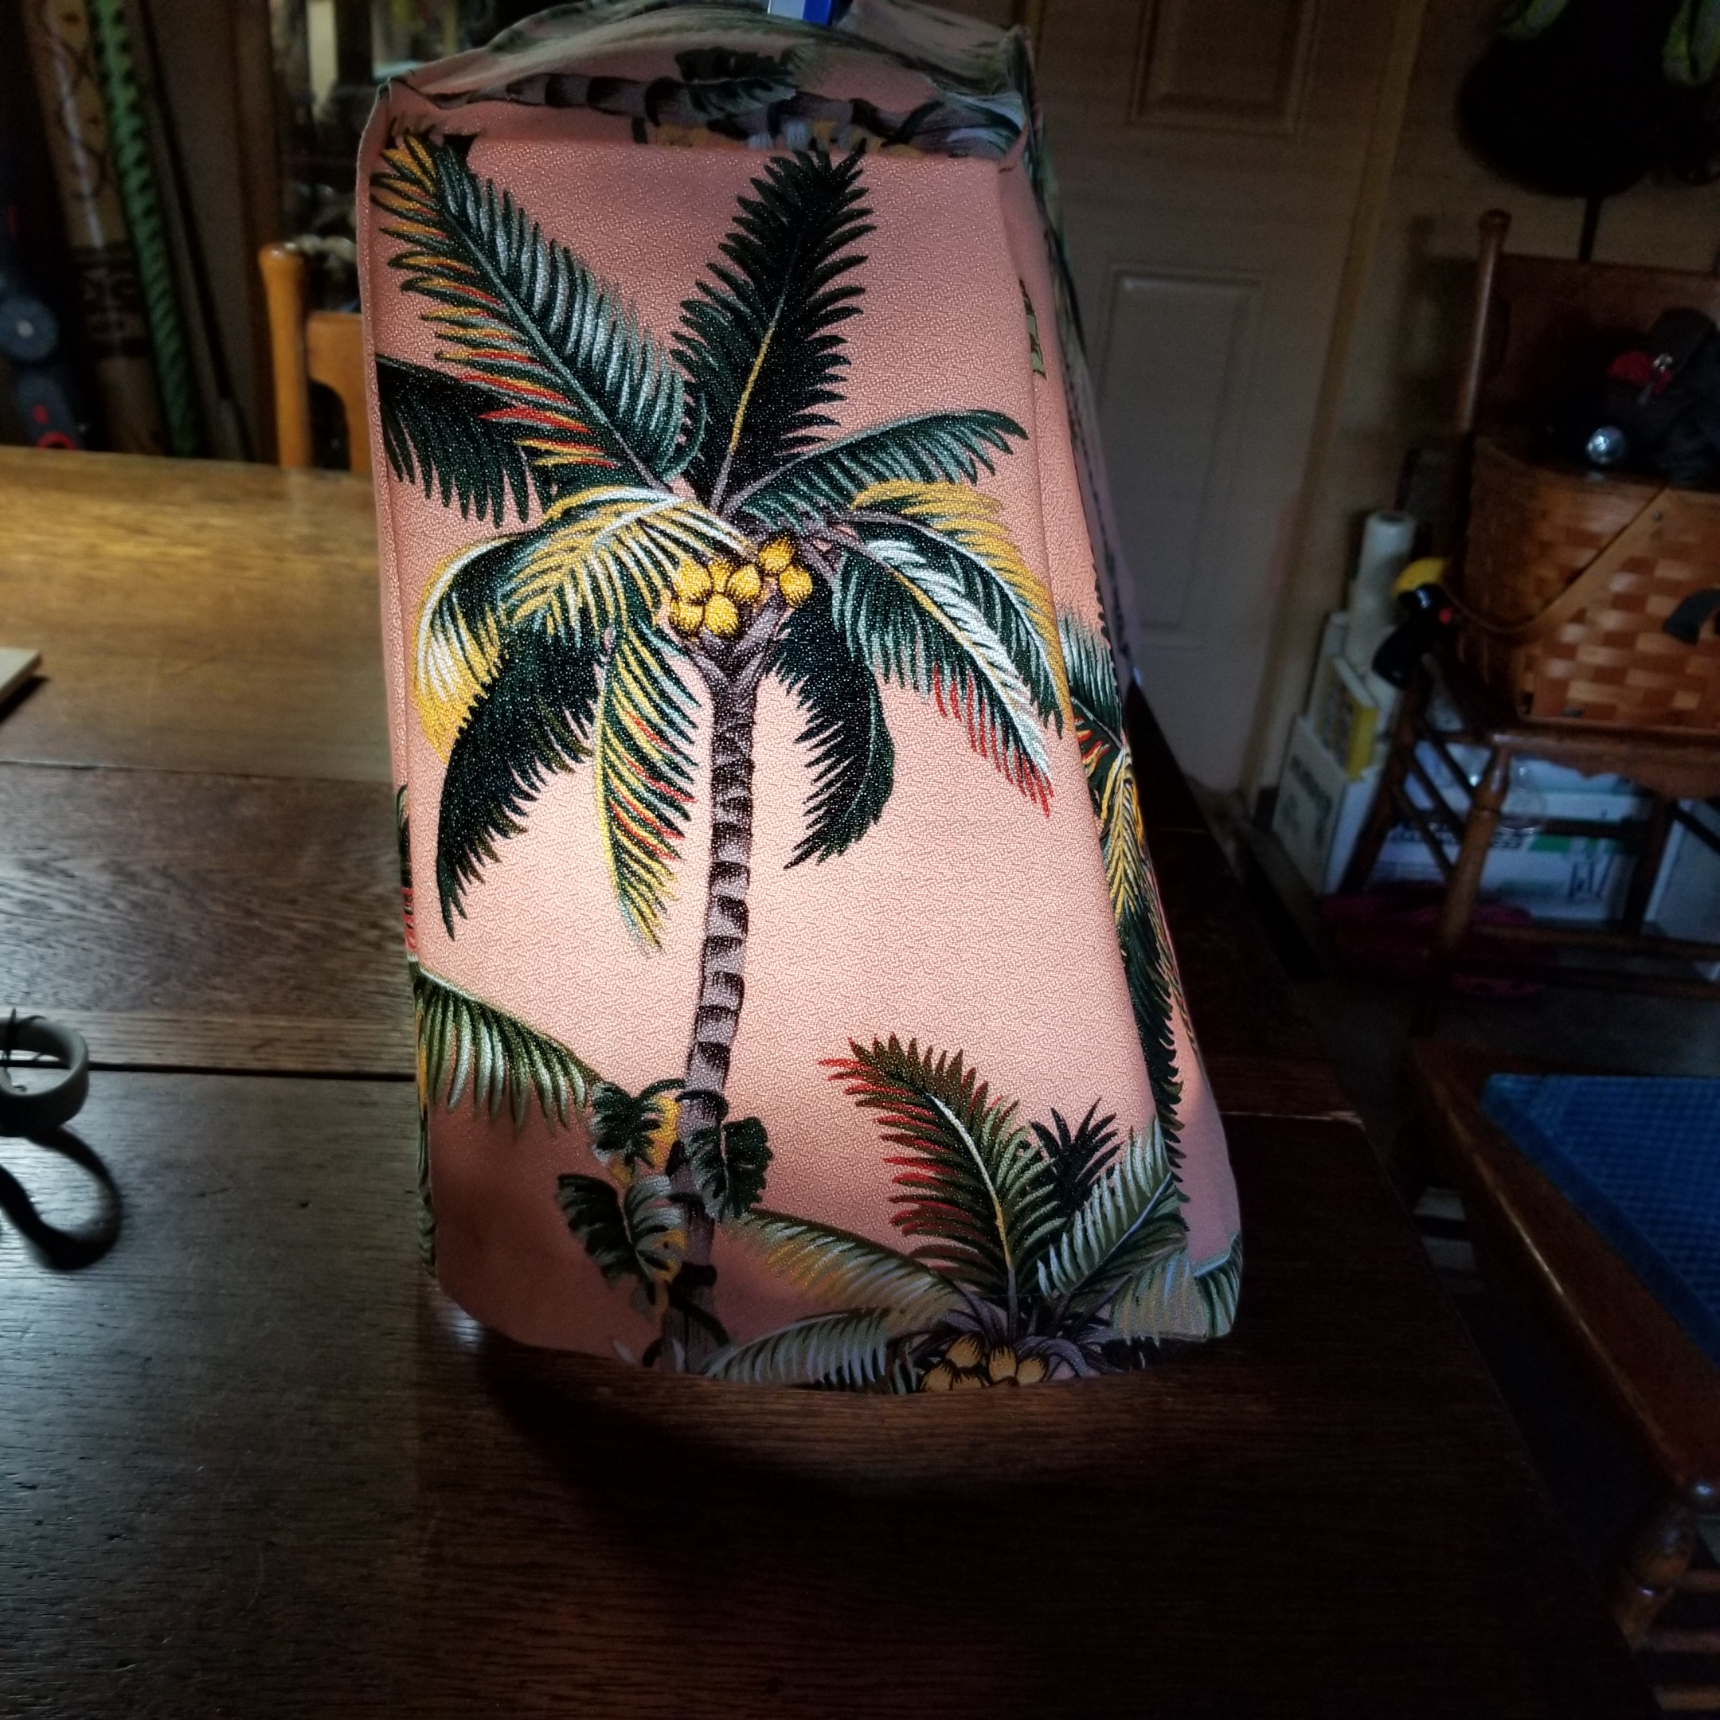
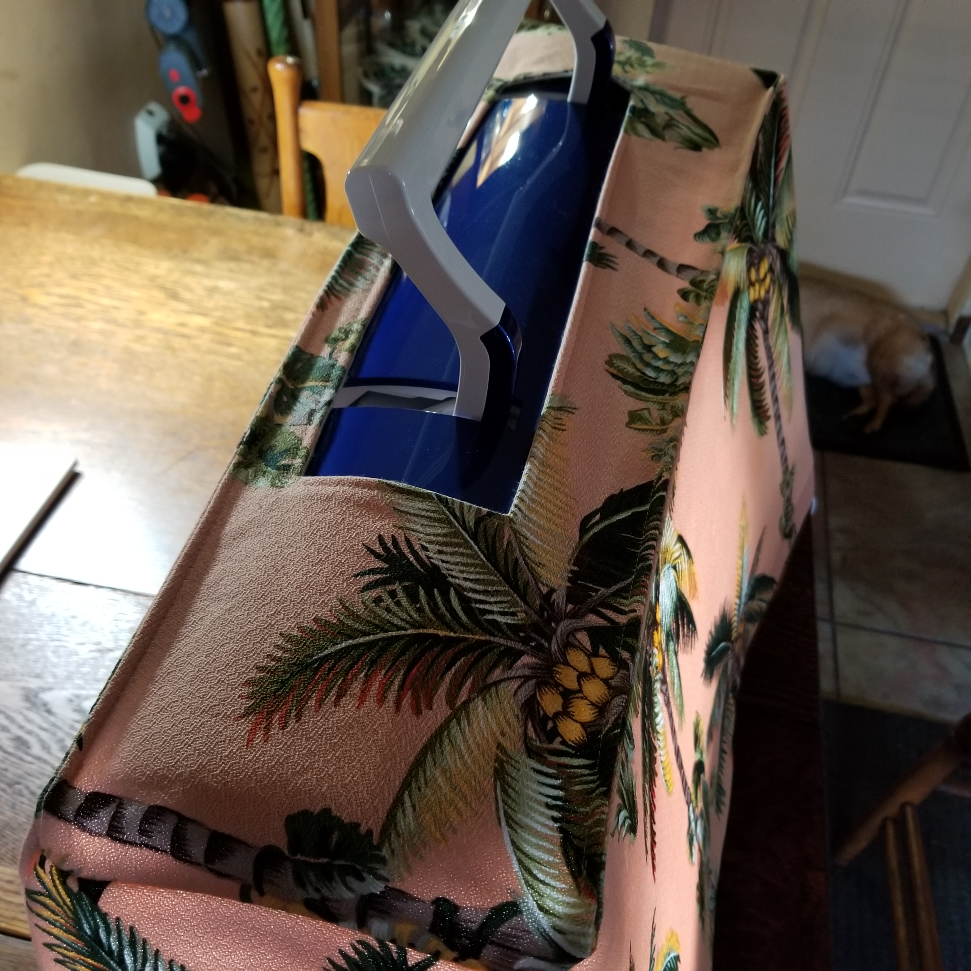
Finally done!

Slide 15
The inspiration video
https://www.youtube.com/watch?v=nw8aY9UzfRI

Slide 16
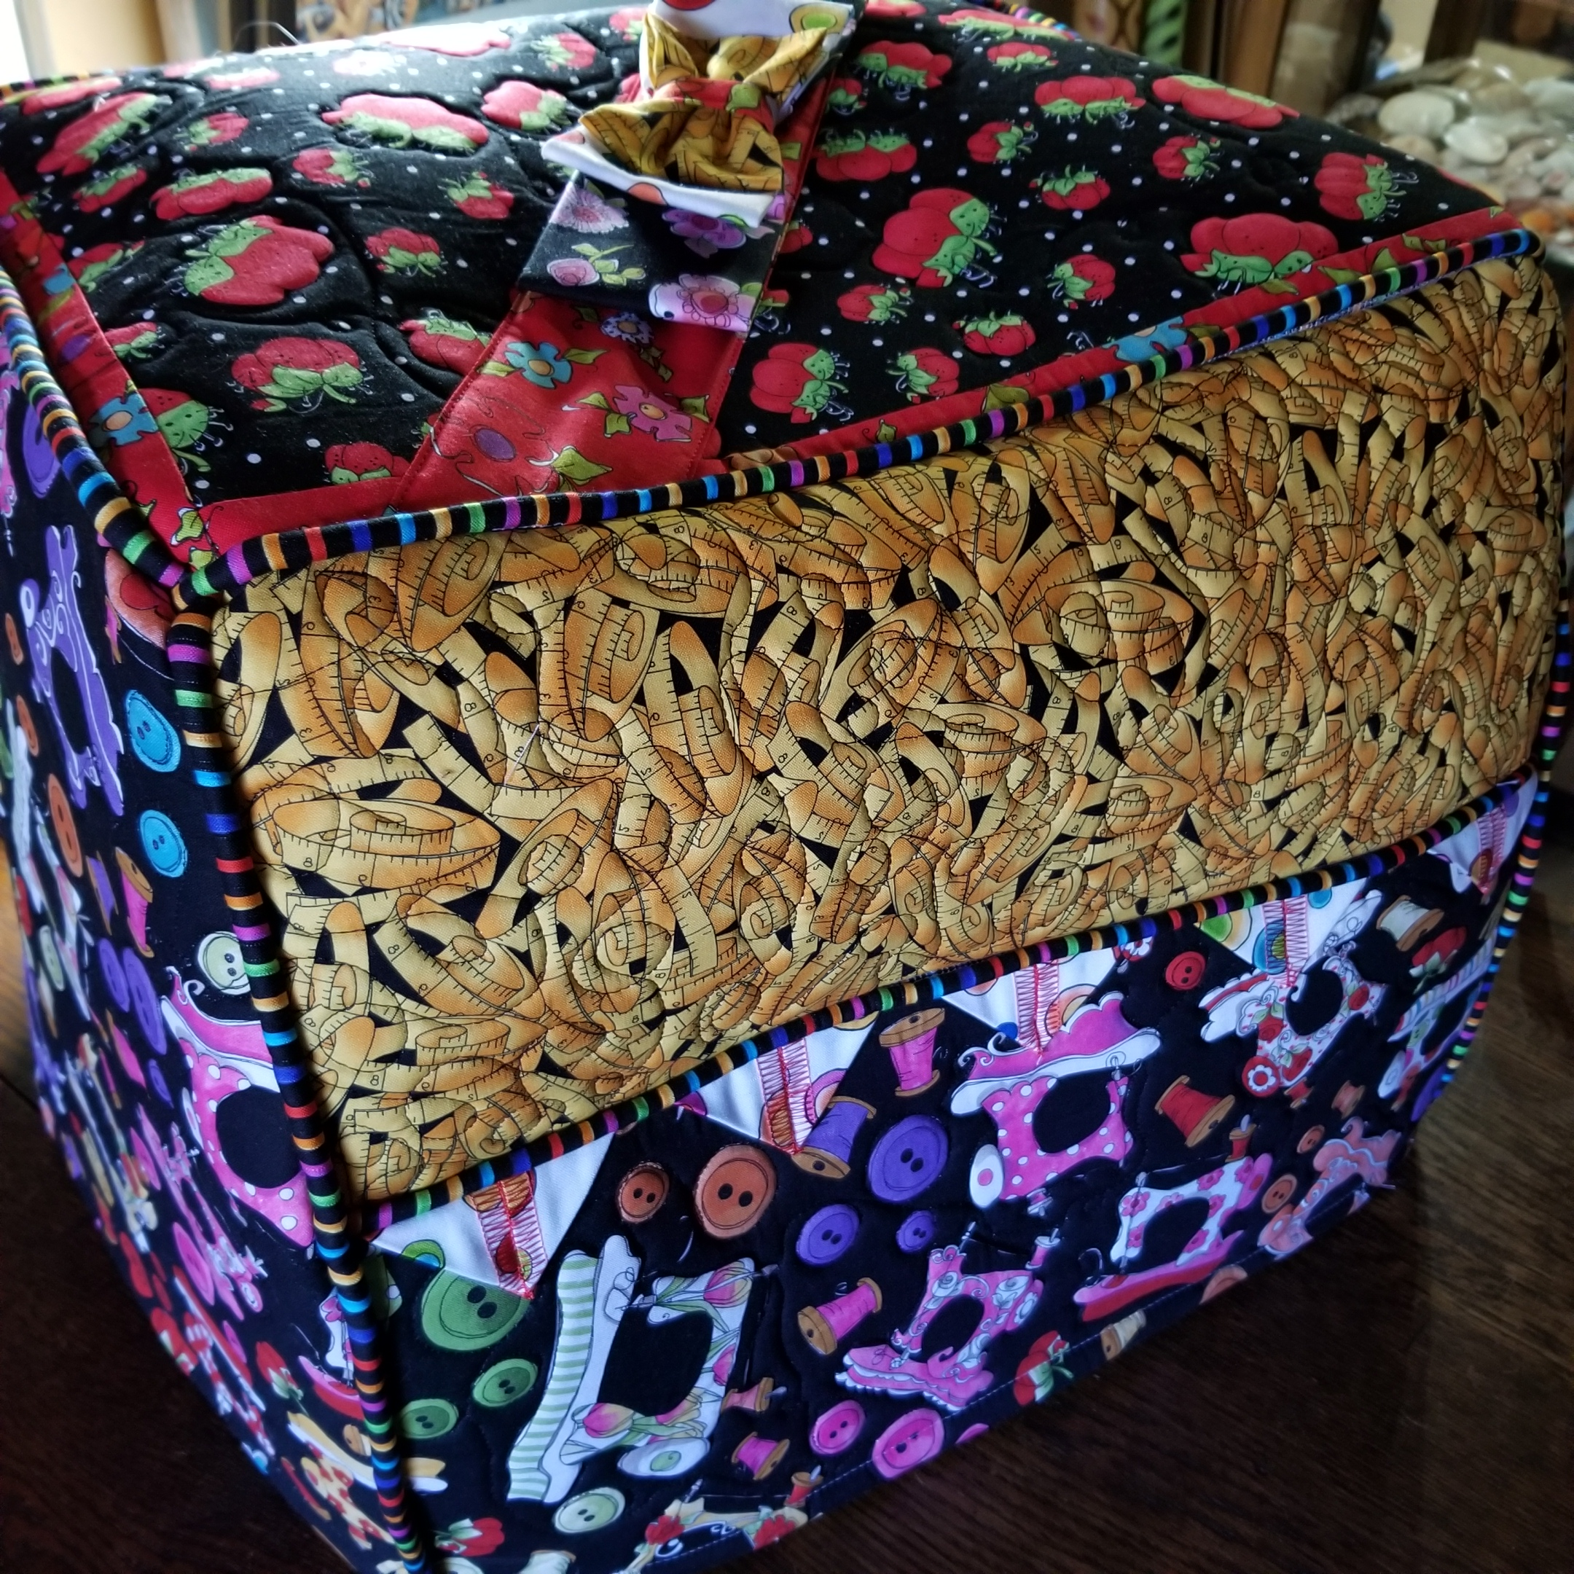
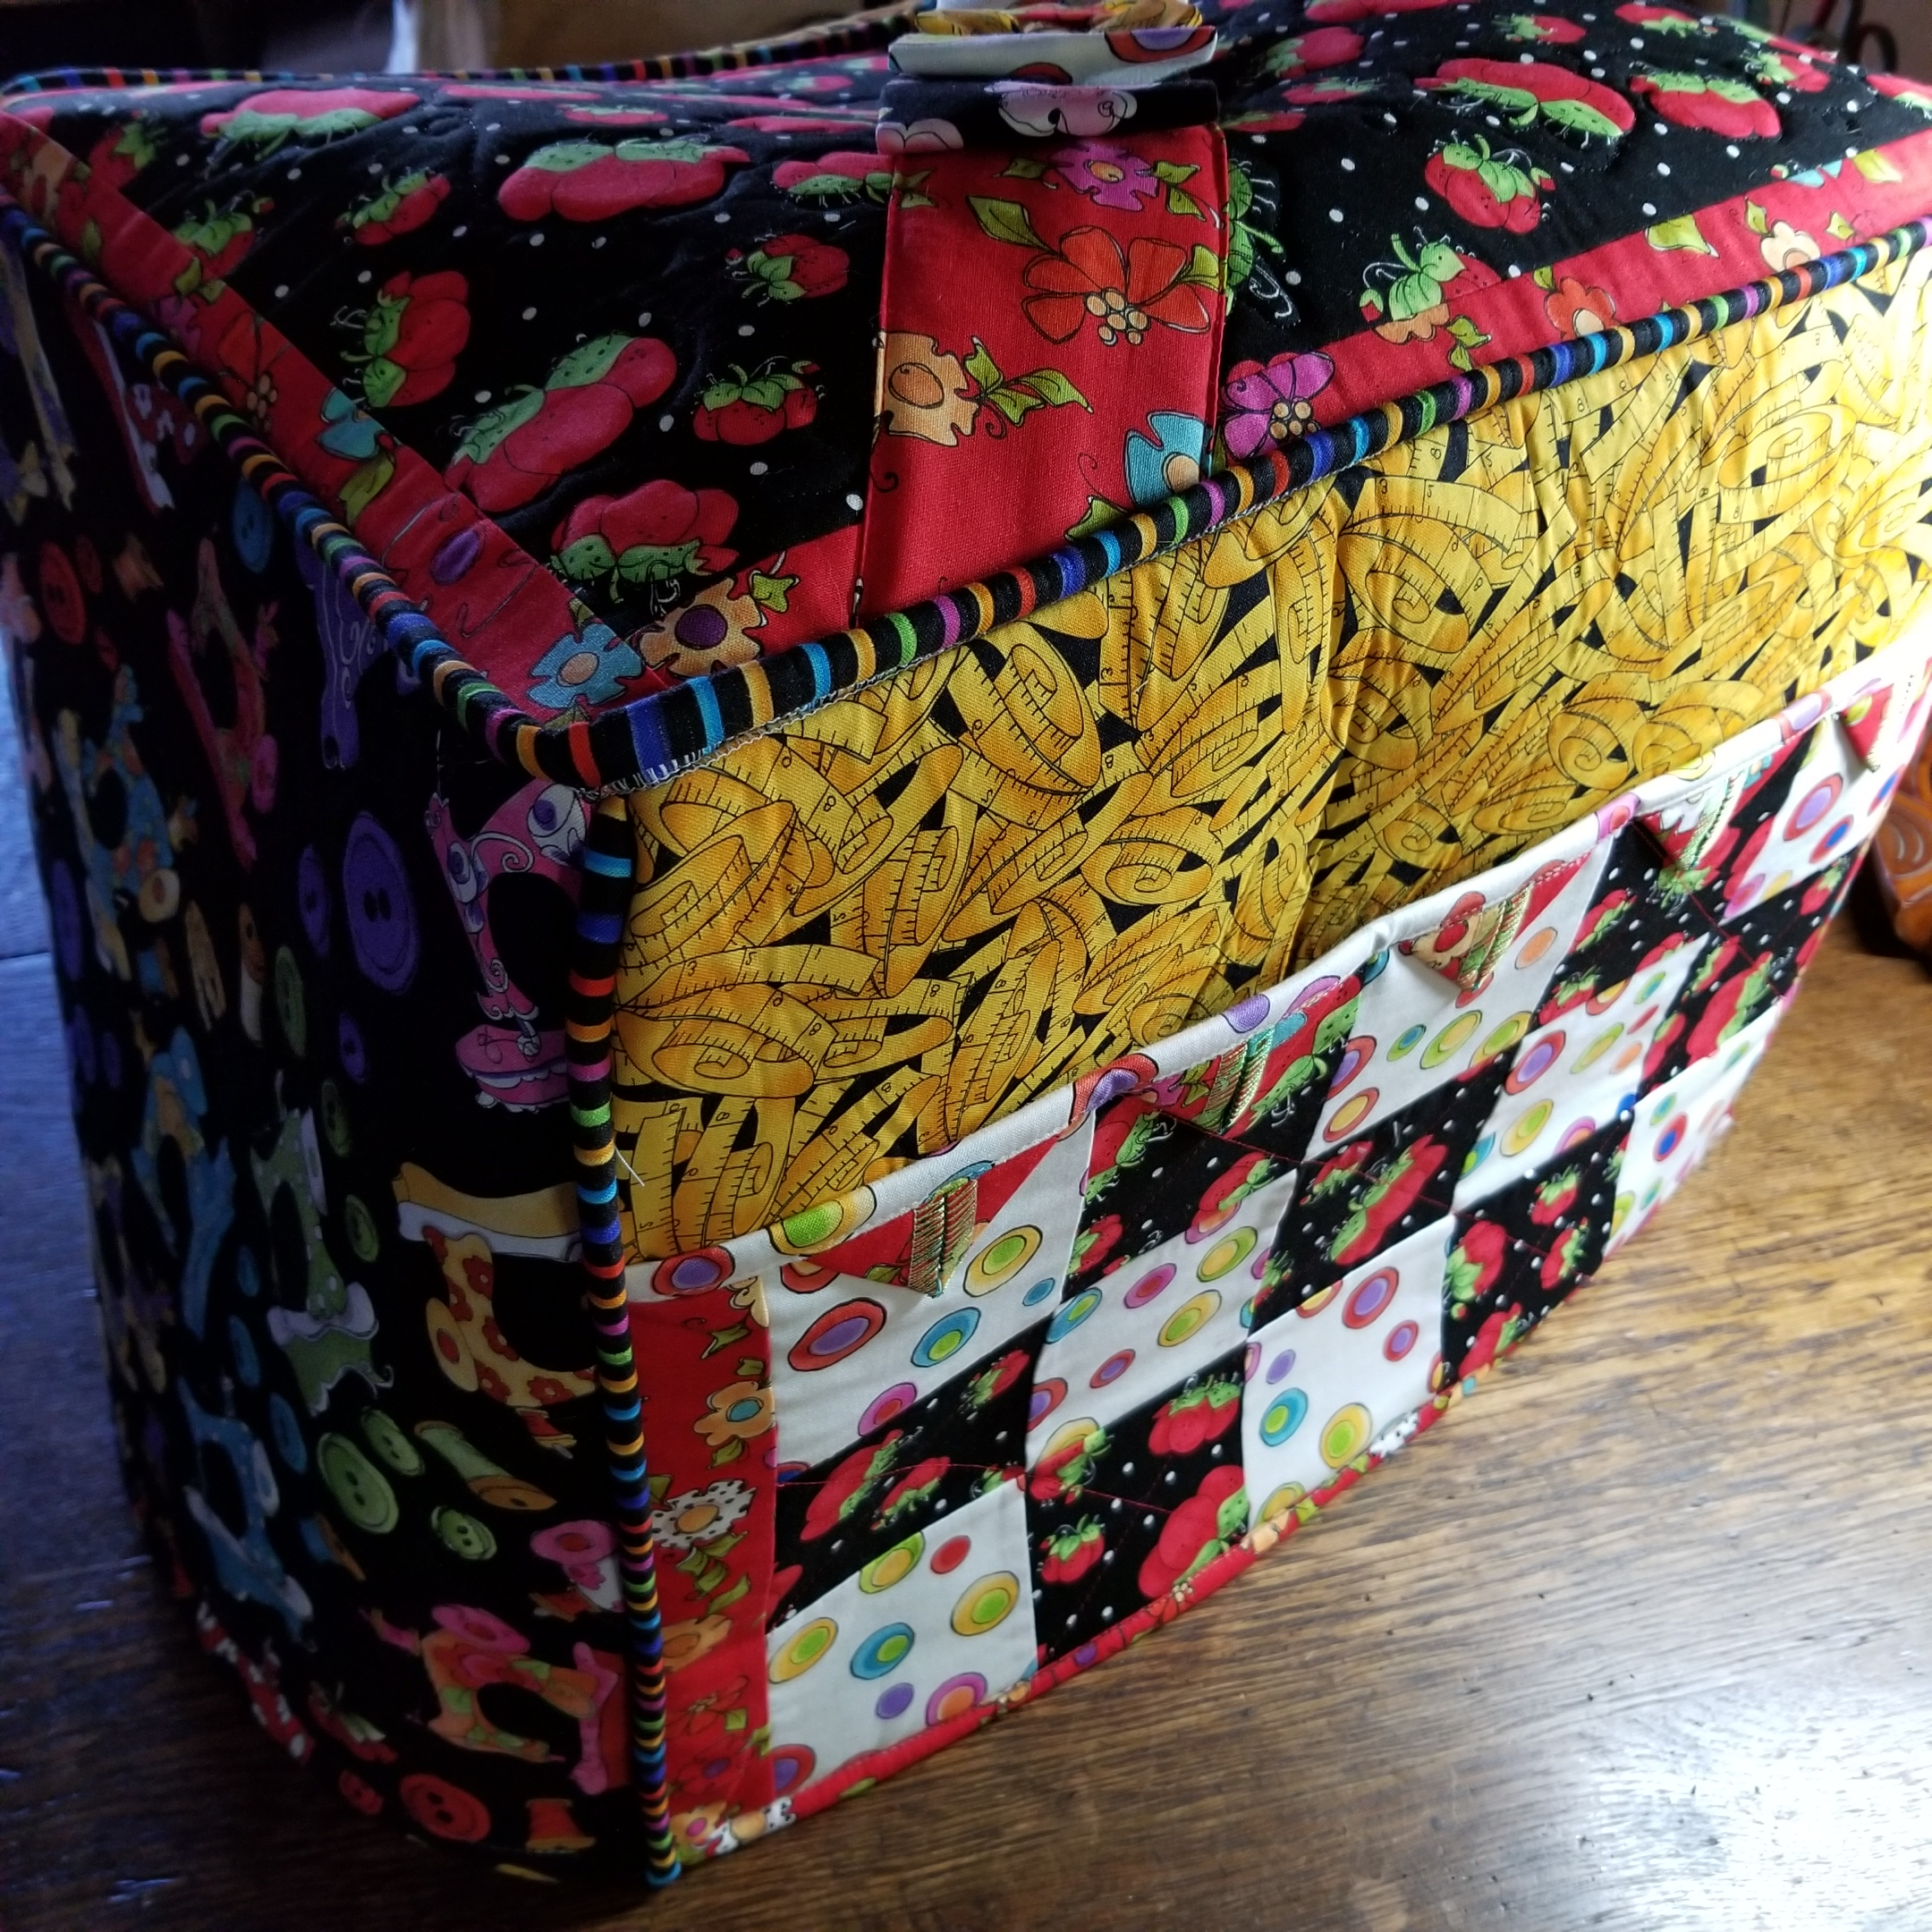
Serger covers
Deb Canham Studios (Serger Instructions and Patterns - Deb Canham Studio) has a pattern for Baby Lock sergers with helpful videos explaining each step. She has instructions for Triumph, Ovation, Evolution, Accolade sergers as well as modifications for tables. She uses the serger for most of the construction and instructs in a variety of serger techniques.

