Slide 1
#DIY Wrist Wallet | Tutorial – YouTube DIY Phone Armband - How to Make a Phone Armband - YouTube The Lunch Money Cuff Tutorial (lemonsqueezyhome.com) DIY craft: Easy DIY Wrist & Armband Wallet for cellphone and personal values. – YouTube WRIST WALLET | WRIST POUCH | SEWING TUTORIAL – YouTube Buki | Wristband Wallet Making | DIY Tutorial Recycle Idea - Bing video

Slide 2
Fabric Wrist Cuffs, with a hidden pocket for cash and Cell Phone Arm Cuffs

Slide 3
Supplies: Fabric Interfacing or stiffener Zipper Closure material – velcro, snaps, buttons, elastic

Slide 4
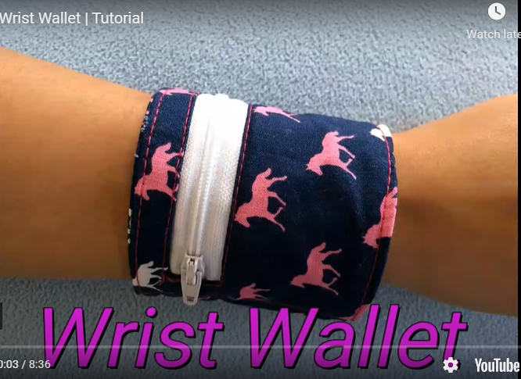
Wrist Wallet/Cuff Ideas

Slide 5
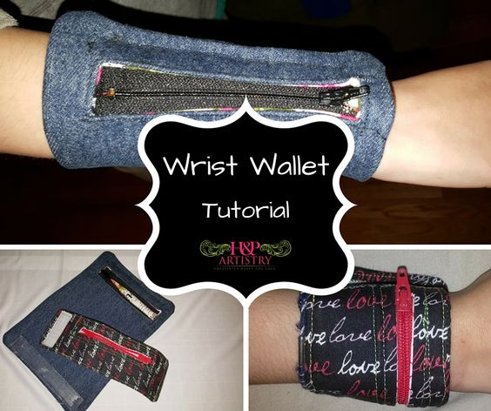
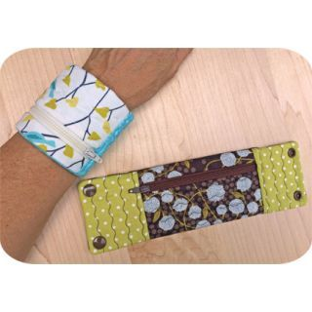

Slide 6
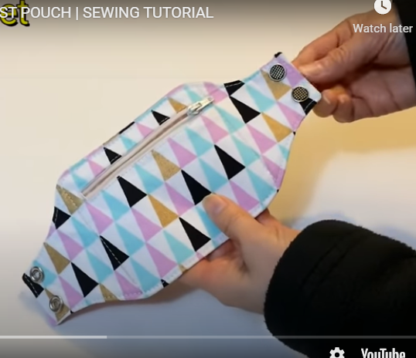
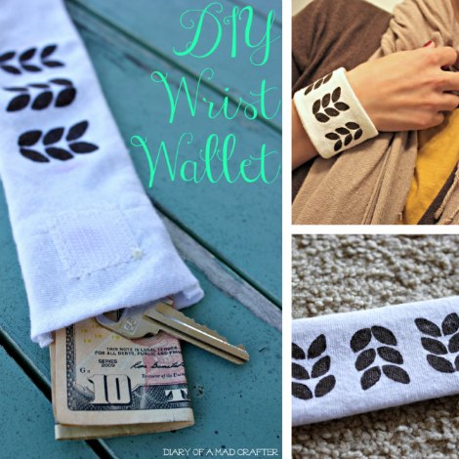
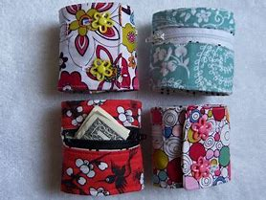

Slide 7
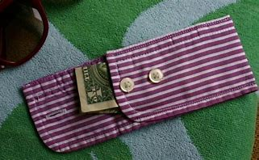

Slide 8
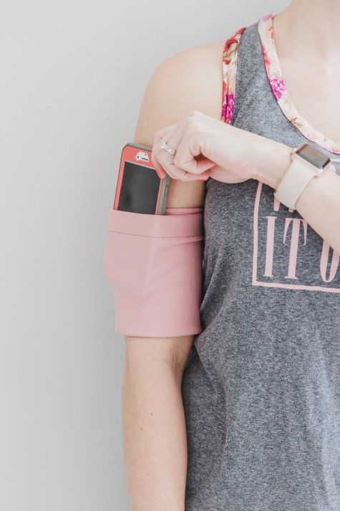
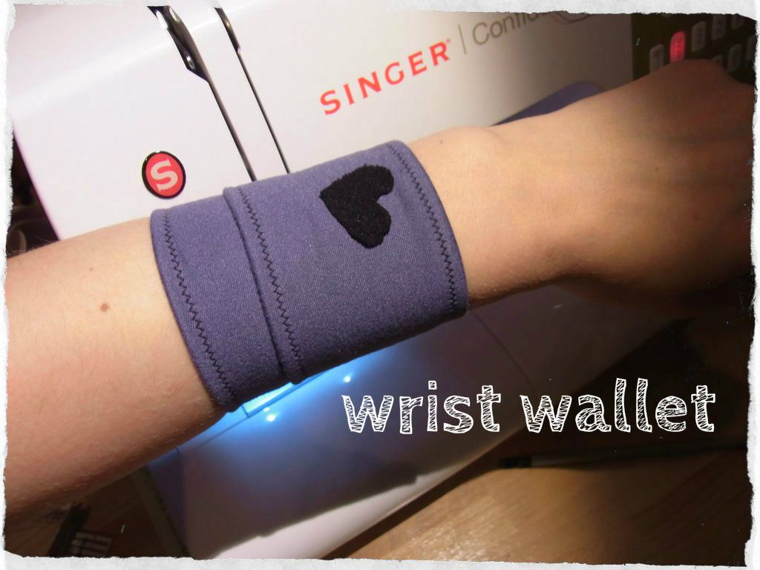
Cell Phone Cuff Ideas

Slide 9
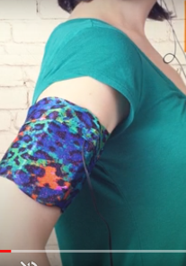
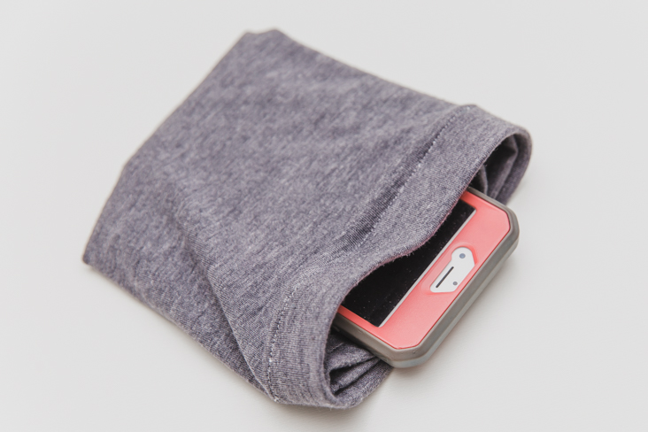

Slide 10
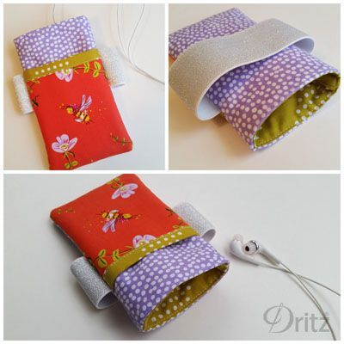
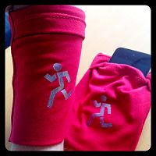

Slide 11
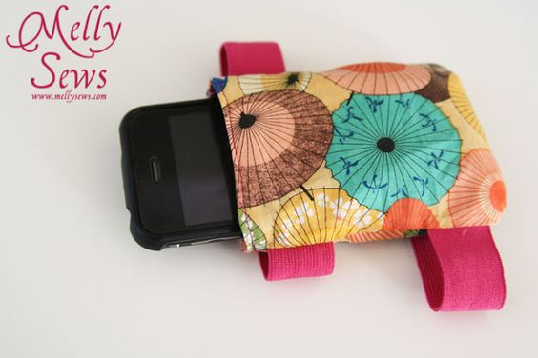
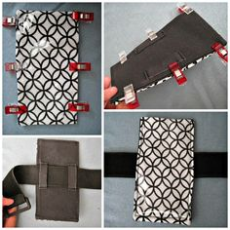

Slide 12
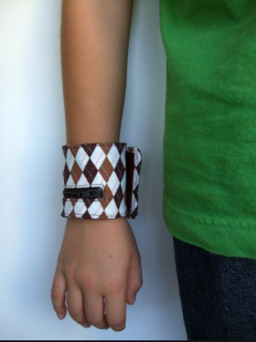
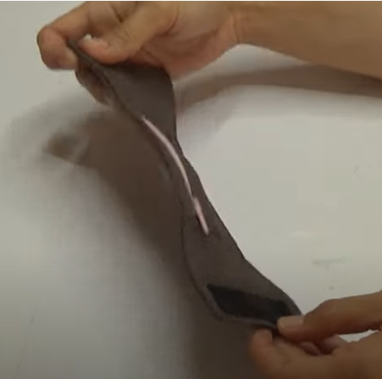
Closure Ideas

Slide 13
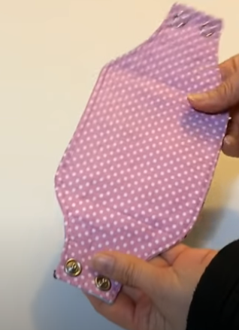
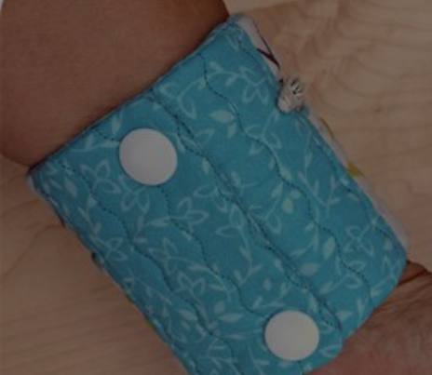
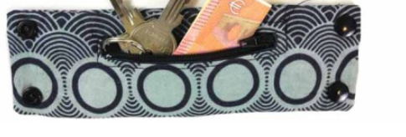
Closure Ideas

Slide 14
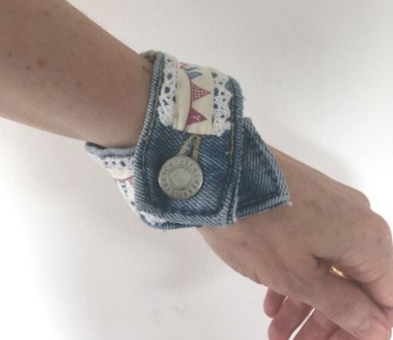
Closure Ideas

Slide 15
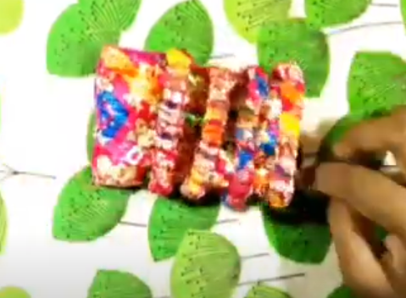
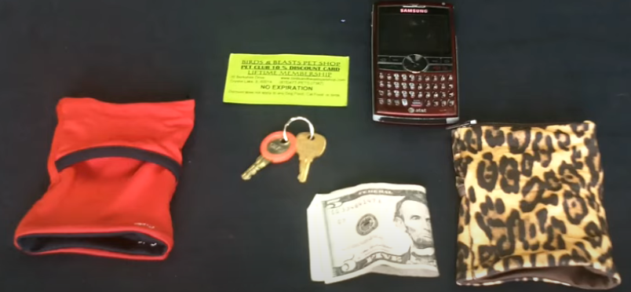
Closure Ideas

Slide 16
#DIY Wrist Wallet | Tutorial – YouTube

Slide 17
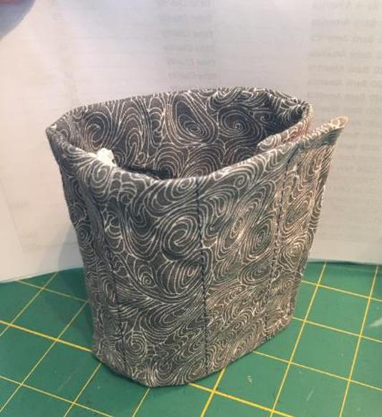

Slide 18
Do your preplanning. What do you want your final result to look like?
You’ll want to get your final fabric result ready – embroidery, quilting, applique, before adding zippers and constructing.

Slide 19
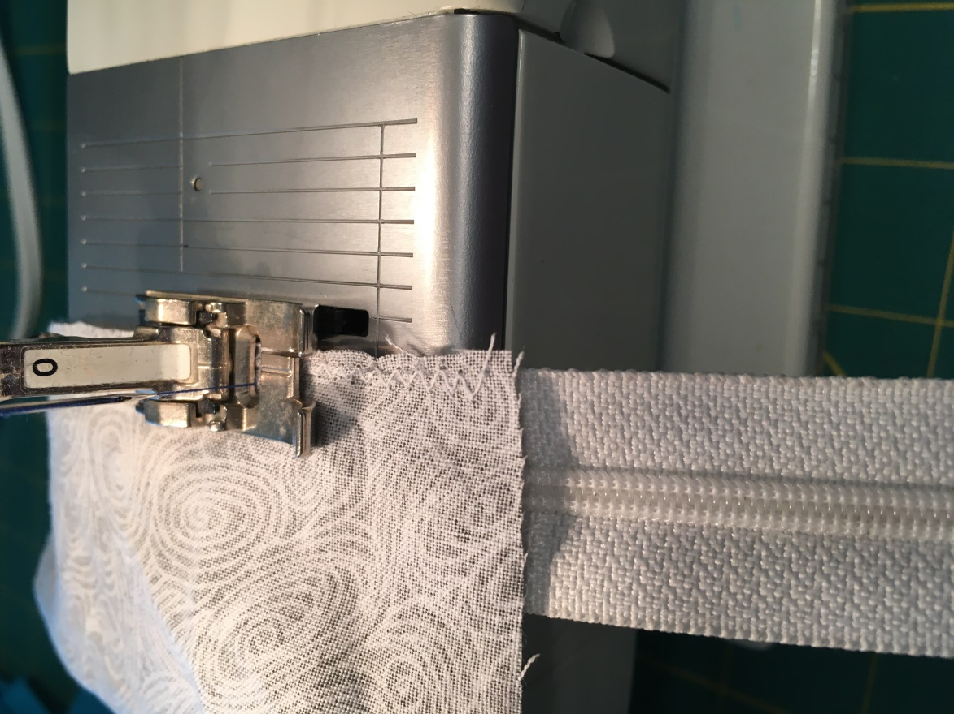
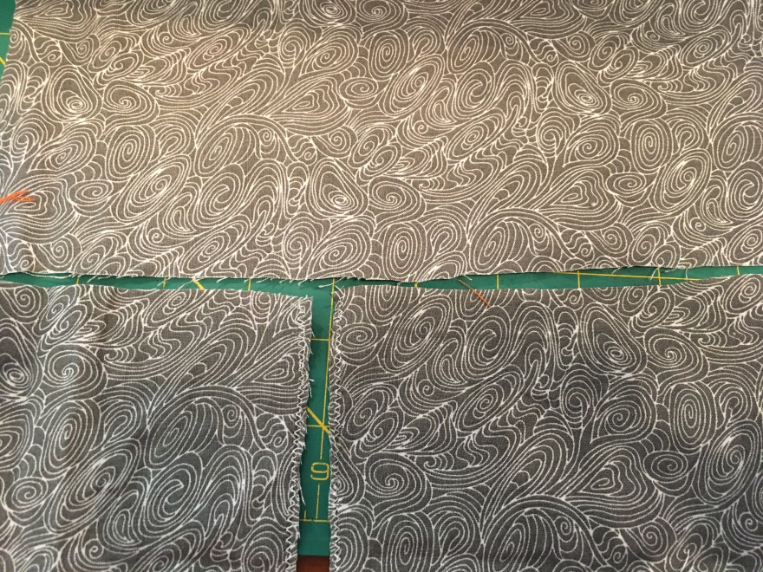
Size:
2 pieces
Measure your arm,
plus 1½”, 1” for fold
over for velcro, and
for ¼” seam allowances
For mine it was 9 1/2”

Slide 20
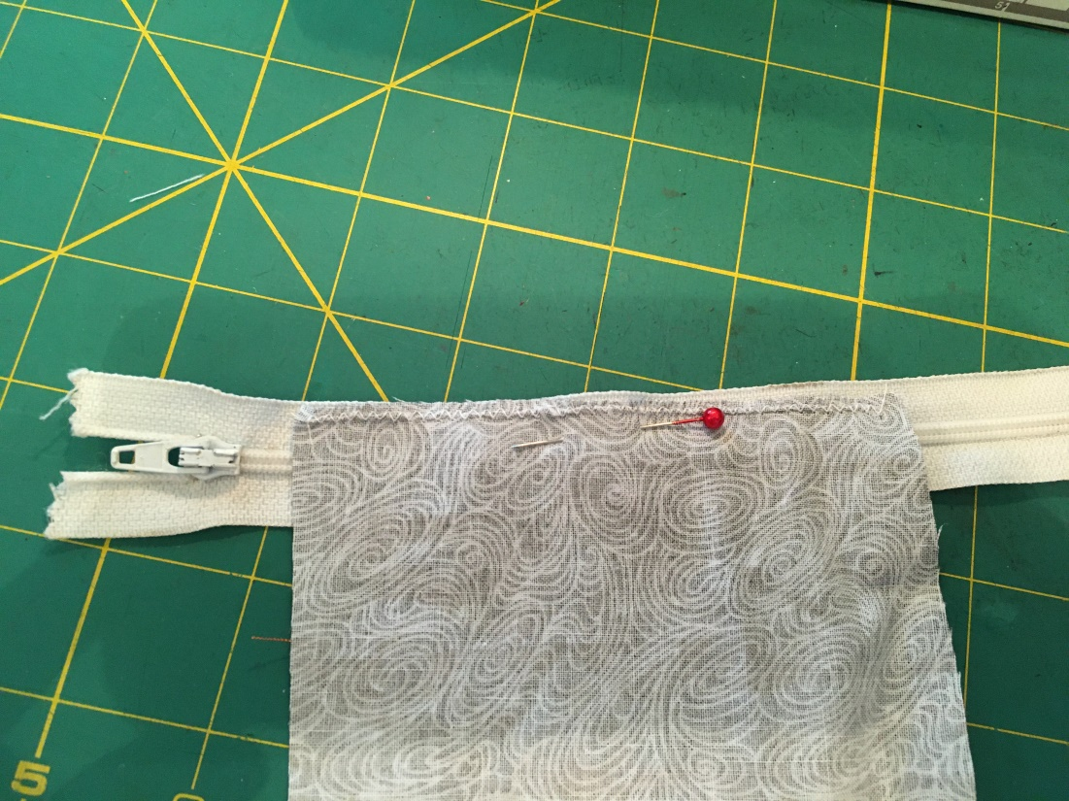
Split one of the pieces into two to apply zipper.
Zipper:
Place one part, face down on zipper (right sides together).

Slide 21
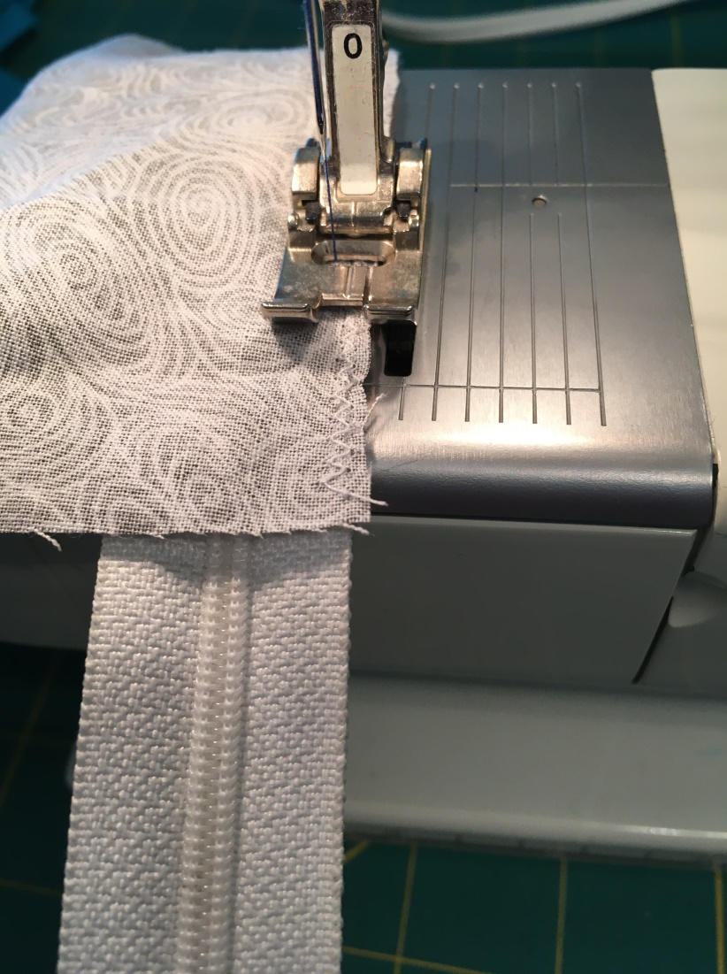
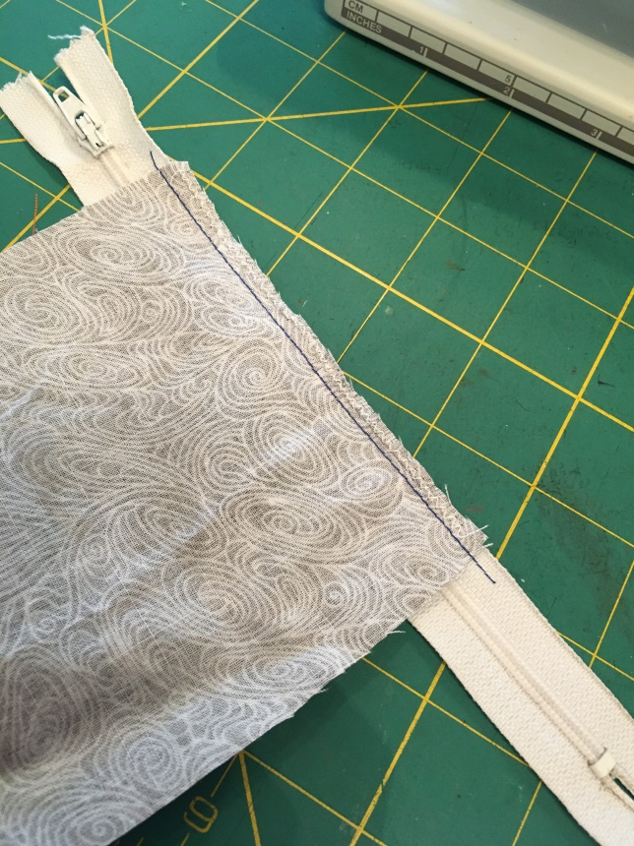
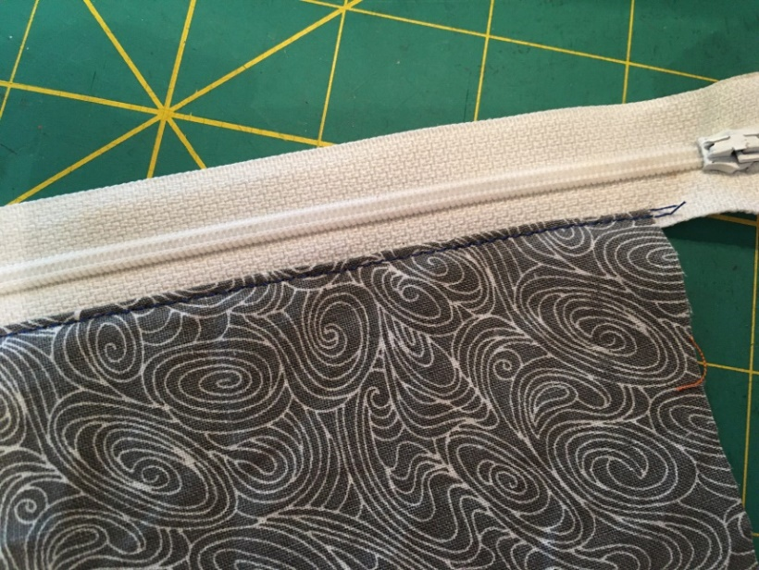
Sew close to zipper, left most needle position, finger press open, and topstitch

Slide 22
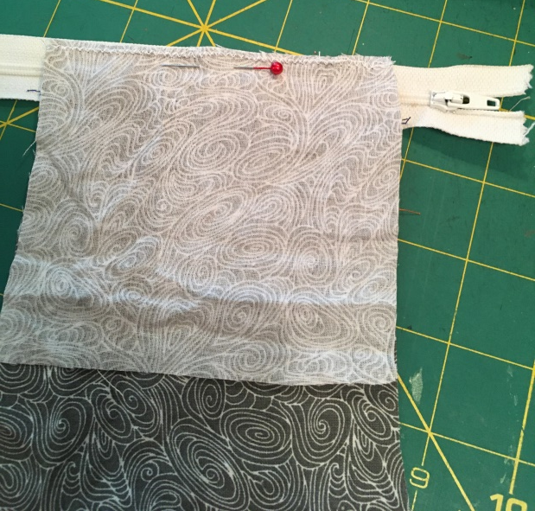
2nd piece, right sides together

Slide 23
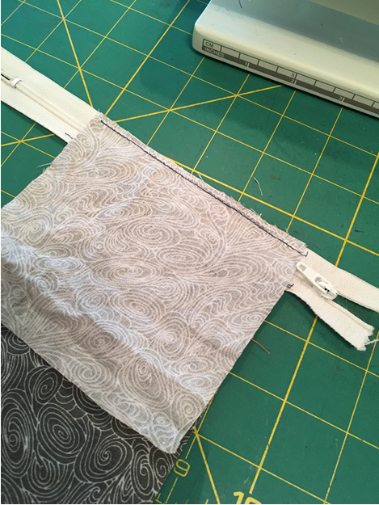
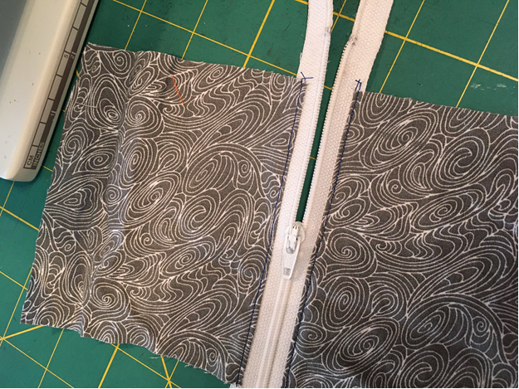
Sew presser foot close to zipper teeth, needle position far left
Finger press, topstitch open

Slide 24
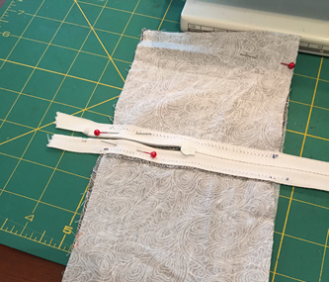
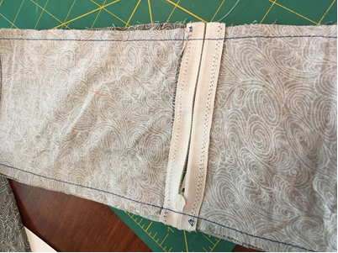
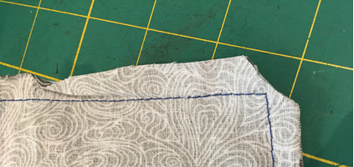
MAKE SURE YOU PULL ZIPPER TOP INTO MIDDLE OF PROJECT BEFORE CONTINUING.
Sandwich two pieces, right sides together. Sew along all 4 sides and LEAVE AN OPENING to turn inside out.
Clip corners

Slide 25
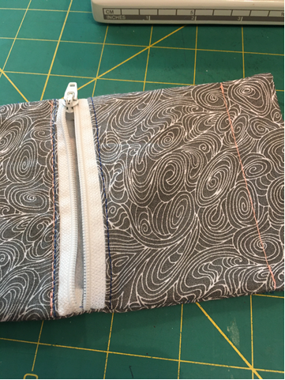
Your choice to top stitch around all 4 sides.
Sew a line of stitch through both layers, 1.5 inches from right, and just to the left of zipper. This provides the “pocket” area. Don’t have to.

Slide 26
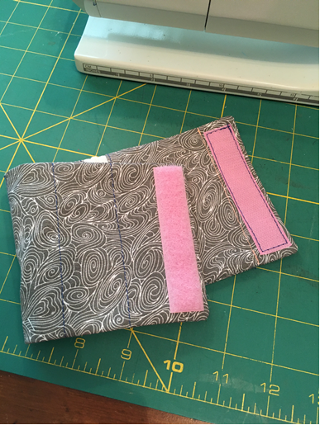
Add your closure.
For this one, used velcro.
Could have used snaps, buttons.

Slide 27
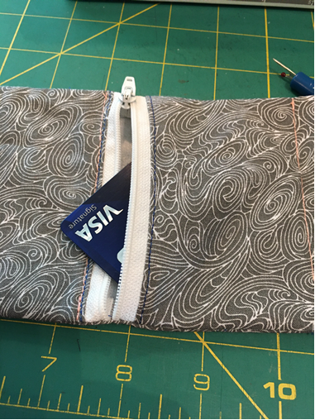

Slide 28
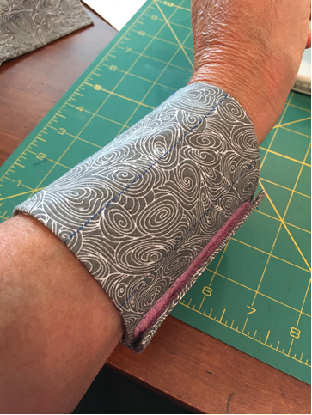
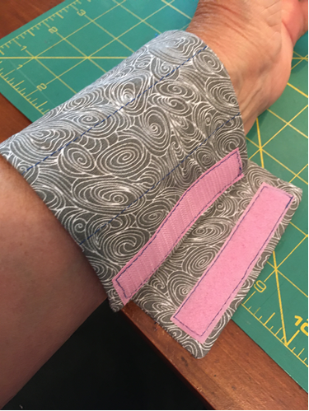

Slide 29
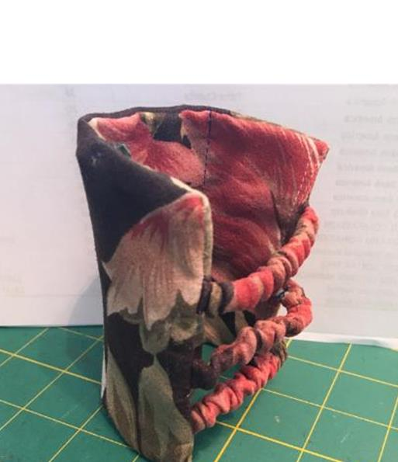

Slide 30
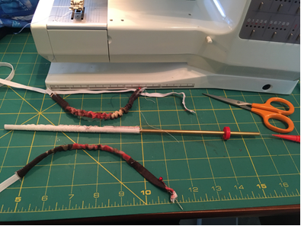
Make 3 fabric tubes, that will be filled with elastic, and provide the ability for cuff to be pulled on and off.
Used 1” fabric strips, folded in half, right sides together, used Fasturn to turn the tubes, and then again to feed the elastic through

Slide 31
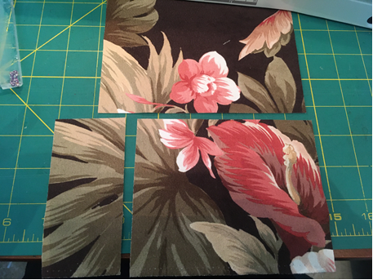
Cut 2 pieces of fabric.
6.5 x 5”
7.5 x 5”, split at 3”
1 will be smaller, because you’ll attach elastic fabric tubes to them.
Cut larger piece into two to apply zipper

Slide 32
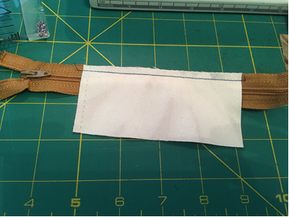
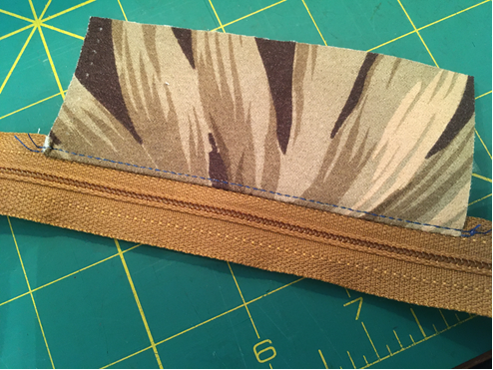
Insert zipper same way as previous wrist wallet

Slide 33
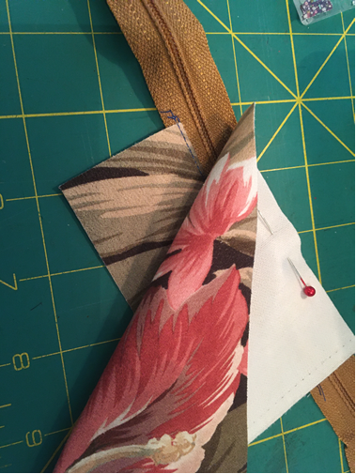
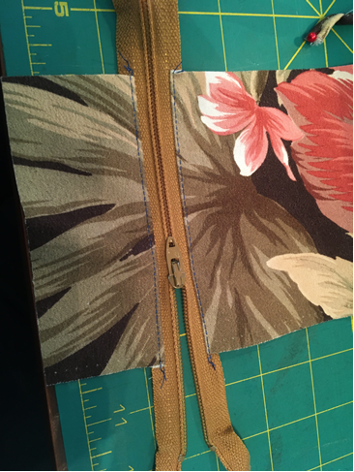

Slide 34
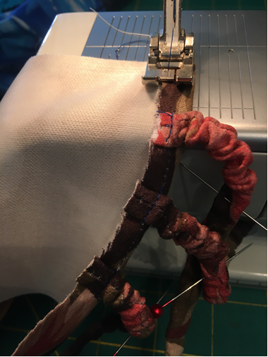
On smaller piece, mark where you want your stripes to be – I measured 1” in on both sides and centered the third between them. Turn under 1/4-1/2” and sew tubes down.

Slide 35
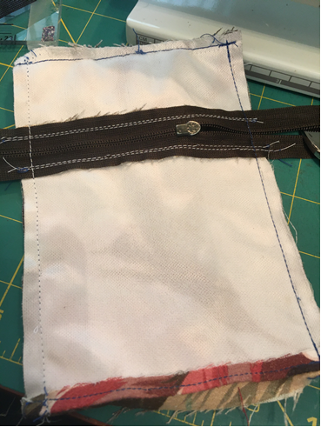
MAKE SURE ZIPPER PULL IS OPEN AND IN MIDDLE OF PROJECT NOW.
Make a fabric sandwich, right sides together. NOTE where your tubes are, they should be INSIDE the fabric sandwich.
Sew along 3 sides, long side, end, long side.
Leaving end open, this will be the end to tuck in the opposite ends of elastic tubes.
Now you can trim corners and zipper ends.

Slide 36
Turn right side out – this is what it looks like – tubes on one side, open other end on other

Slide 37
Sew a line of stitch through both pieces, about 1.5 “ from edge. This will provide a pocket. Can be left off.

Slide 38
Depending on your wrist measurement, pull tubes about 4”, pin them in the open end, top stitch entire edge to secure

Slide 41
Zipper application like previously described
MAKE SURE ZIPPER PULL IS IN MIDDLE OF PROJECT before you sew further
Take each piece and fold in half lengthwise and sew to make a tube

Slide 42
Sew two tubes right sides together

Slide 43
Measure elastic so that it will go over widest part of your hand with ease. Overlap and sew together
Fabric measurements – can use extra fabric, if you want it look more gathered.

Slide 44
Fit on elastic
I ironed bottom edge and then sewed down with topstitch

Slide 47
Stretchy material
Cut 2 pieces 7.5 x 5”, Split 1 for zipper

Slide 48
Install zipper like previous examples Make sure zipper tab is in middle of project Sew long edge together, Fold in half lengthwise and sew into a tube

Slide 49
Trim zipper Turn to wrong sides together Fold under last edge and zig zag topstitch.

Slide 51
Cell Phone Cuff

Slide 52
Following tutorial of Sewmuchado.com
https://www.youtube.com/watch?v=McOB2W7_7VI

Slide 53
Need: Knit fabric – 40% stretch
1” wide elastic
Measure length of phone
Measure bicep circumference
Cut fabric – 2phone lengths long x bicep circumference wide – greatest stretch should be along bicep measurement

Slide 54
Example:
Bicep measurement of 13”
Phone length of 5.5”
Cut fabric 13 x 11, with greatest stretch along 13” direction

Slide 55
Fold fabric in half in half, right sides together, matching raw edges, along length/2x phone measurement
Stitch along edges using ½” seam allowance – remember to use a serger stretch or zig zag stitch

Slide 56
Cut 1” wide elastic piece circumference of tube plus 1”
Pin or clip elastic to raw edge of tube, overlapping ends ½”
Stitch elastic to fabric along top edge

Slide 57
Fold elastic/fabric toward WRONG side. Stitch close to bottom edge of elastic.

Slide 58
Fold bottom hem of tube inside.
Meeting with elastic top edge.
Slide phone inside pocket, and slide on top upper arm.

