Slide 1
Sewing WITH CORK
And adding APPLIQUE

Slide 2
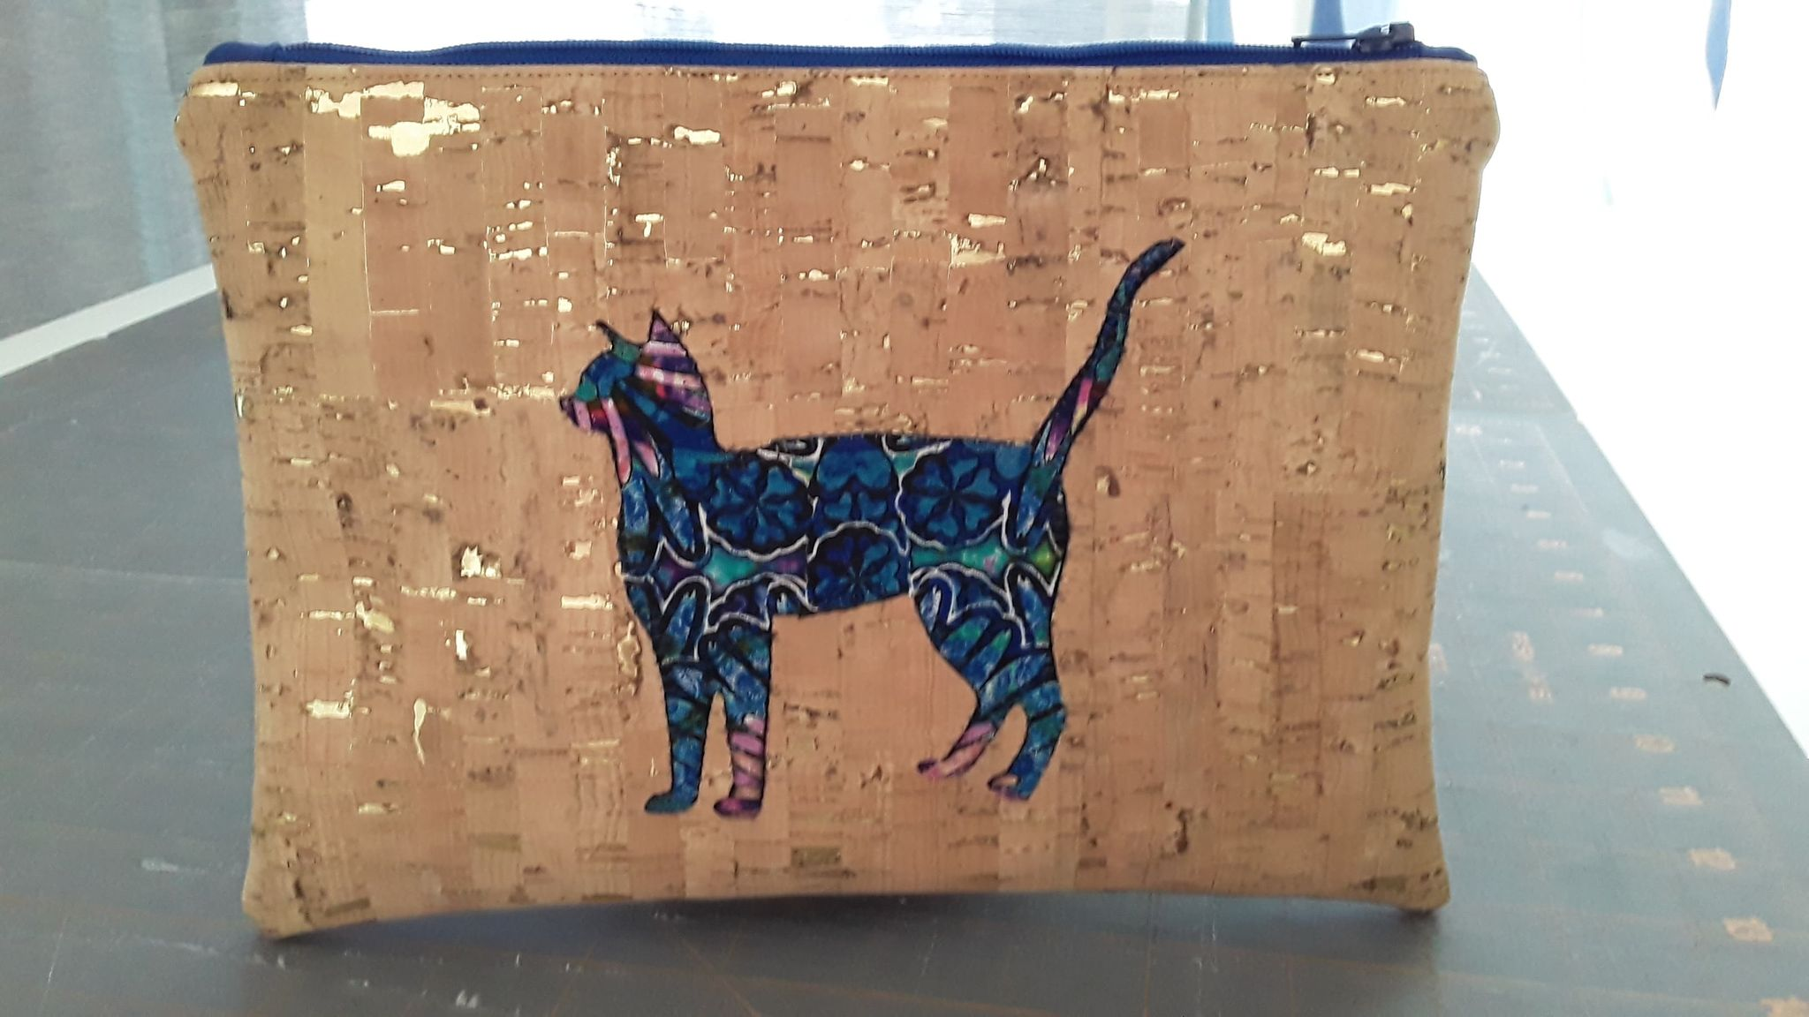

Slide 3
Places to Buy CORK
Modern Sewist (in Sarasota) https://www.themodernsew.ist/shop/Fabric/Special-Substrates/Cork.htm
Sew Worth It (in Sarasota)
Sew Sweetness https://sewsweetness.com/?s=cork+fabric&post_type=product
Fabric Fun House https://fabricfunhouse.com/collections/cork-items
Sallie Tomato https://sallietomato.com/collections/cork-fabric
* Be cautious buying cork at Joann’s…it may be thinner than you like. Cork should be about 1 mm thick *

Slide 4
Cork – photos of back and THICKNESS

Slide 5
Other supplies YoU MAY want FOR SEWING ON CORK:
Microtex needle 80/12. Universal needle OK too.
Wonder clips or other sewing clips (can’t really pin cork)
Zipper (if you project includes a zipper)
Dritz 1/4″ Wash Away Wonder Tape (to hold zipper in place)
Hump jumper or other tool for sewing on uneven/thick material

Slide 6
Other supplies YoU MAY want FOR APPLIQUE ON CORK:
Fabric for the applique
Heat n Bond, WonderUnder, or adhesive for applique. I used Heat n Bond LITE…but the others will work too. Dritz 1/4″ Wash Away Wonder Tape would also work.
Press cloth or scrap fabric to use as a press cloth
MonoPoly Clear Invisible thread (made by Superior Threads) https://www.superiorthreads.com/monopoly-clear-spool/p/119-01-CLEAR Regular cotton or polyester thread of any coordinating or contrasting color would work too
NOTE: If I use MonoPoly thread on top, I use polyester thread in the bobbin.

Slide 7
TIPS FOR SEWING ON CORK
Use wonder clips if you need to hold things together. Pins will leave holes.
Use a Microtex needle (80/12) or a fresh new Universal needle
Lengthen stitch length a little to about 3.0 or so. Stiches that are too close together could cause the cork to perforate
Consider using your walking foot
Sew carefully. Ripping out stitches will leave holes.
Cork edges can be left raw

Slide 8
Cork Sewing Videos (For the Patterns THAT WERE E-mAILED)
Cork Zipper Pouch https://www.youtube.com/watch?v=VNzUML84e64
Cork Passport Holder https://www.youtube.com/watch?v=Xu5iG8nhbpU
Cork Eyeglass Case https://www.youtube.com/watch?v=U1Hd5dNXNnw
Small Cork Wallet https://www.youtube.com/watch?v=Tsi0o2Zrjm0

Slide 9
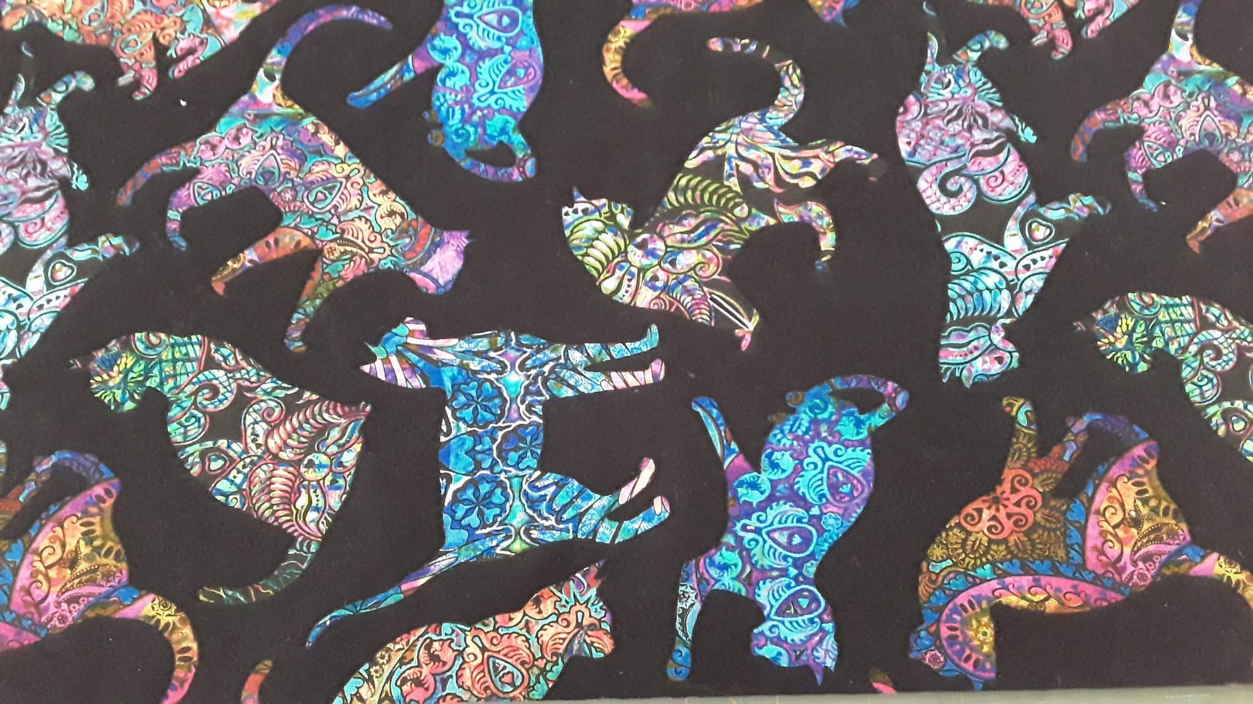
Adding Applique to CORK
use novelty fabrics with with CLEARLY DEFINED EDGES.
Rough cut around the item you want to applique.

Slide 10
Add Heat N Bond or Adhesive to the back of Applique
Preheat iron to medium heat, No steam. Place adhesive on back of material to be bonded (paper liner should face up).
Place and hold iron on the paper liner for 2 seconds. Repeat until entire surface is bonded. Allow to cool.

Slide 11
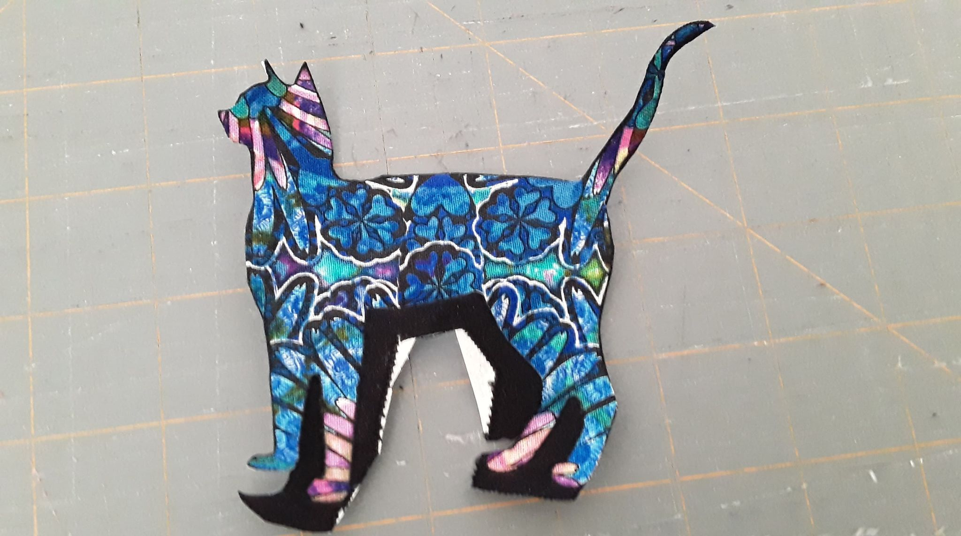
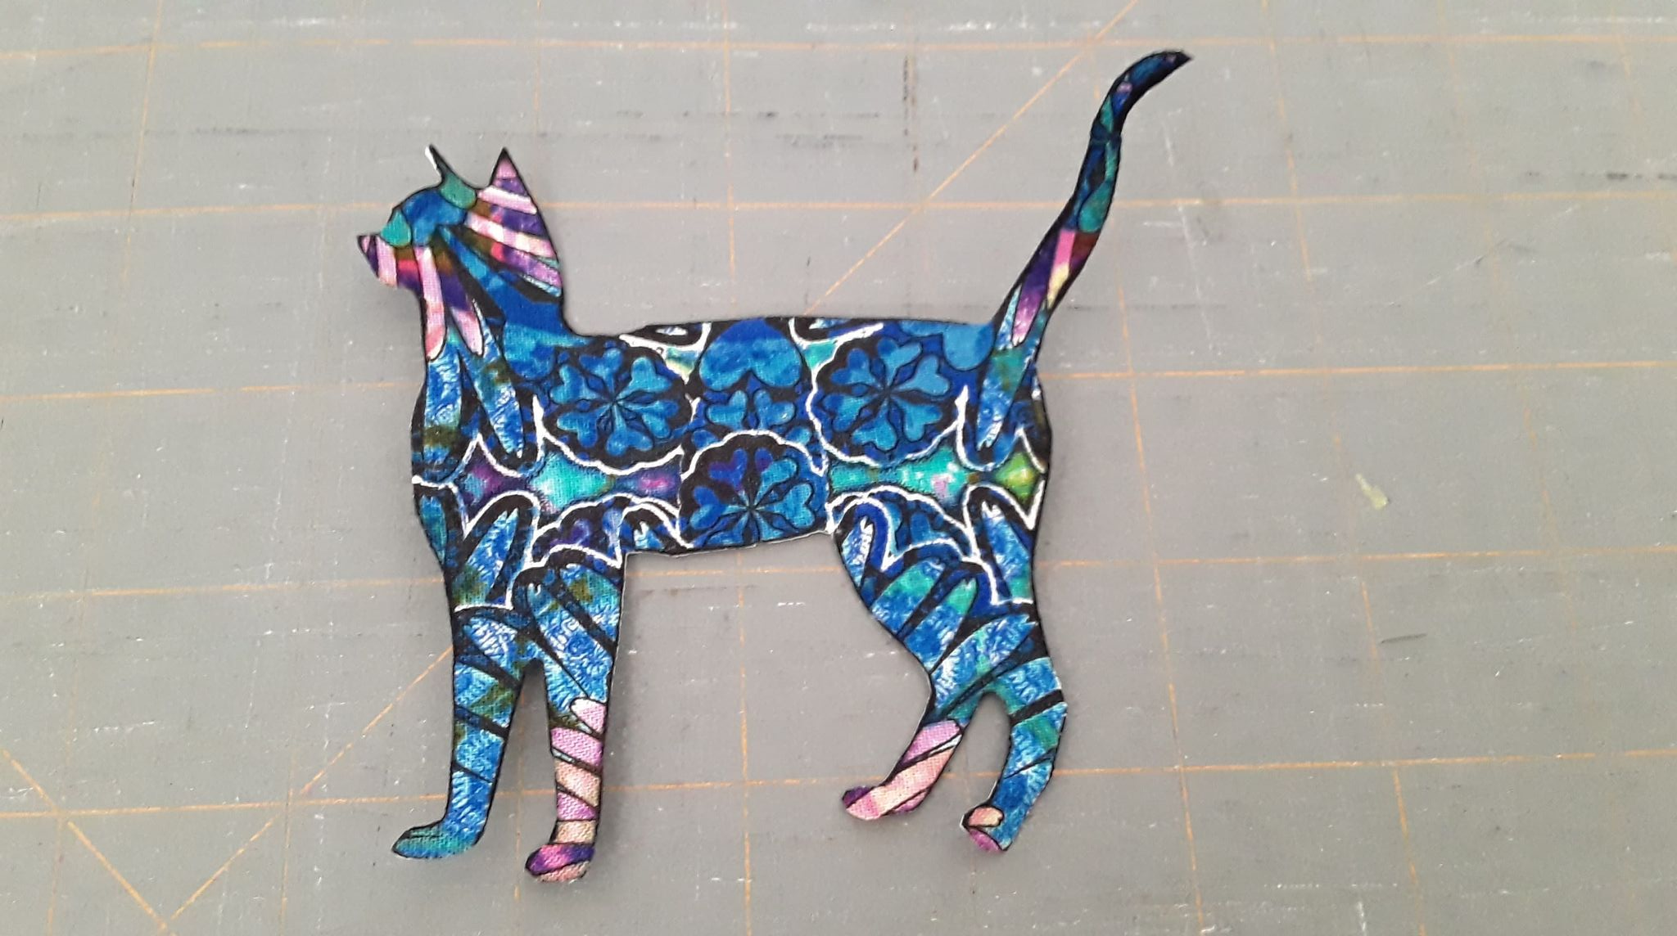
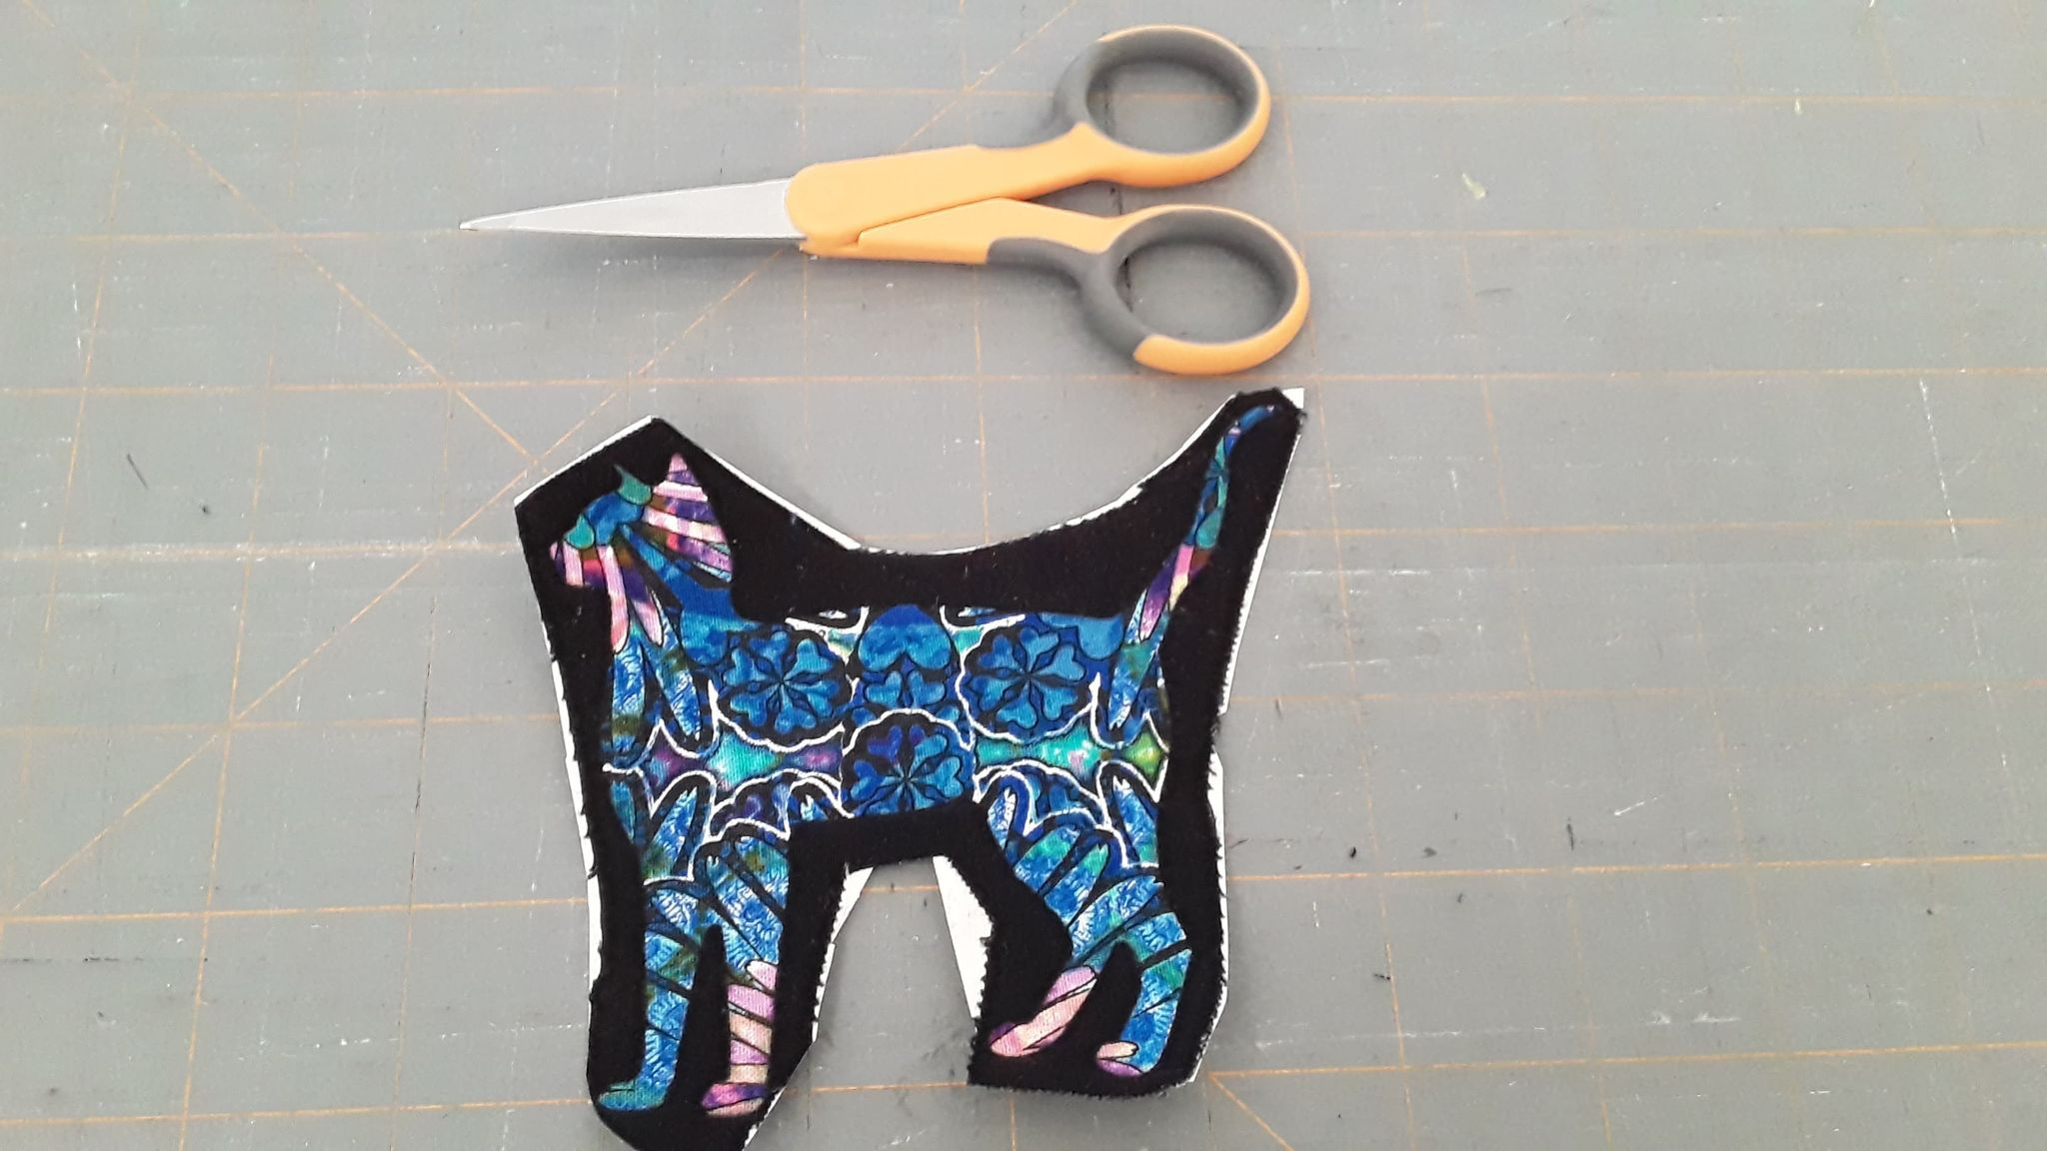
CAREFULLY CUT OUT ITEM YOU WANT TO APPLIQUE
Consider using smaller scissors
Take your time
Cut as close to the edge of the item/design as possible

Slide 12
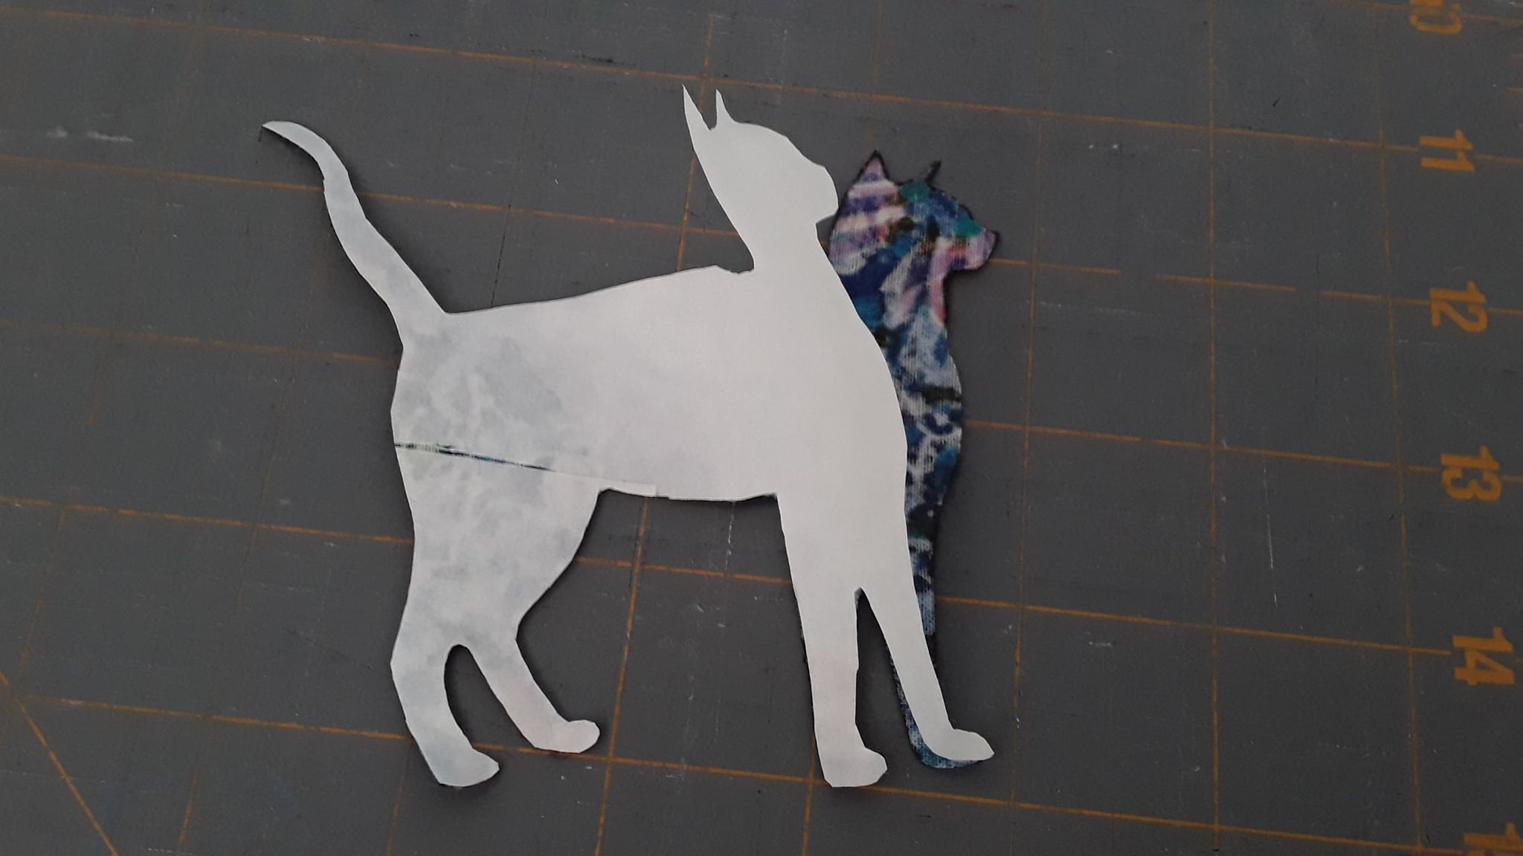
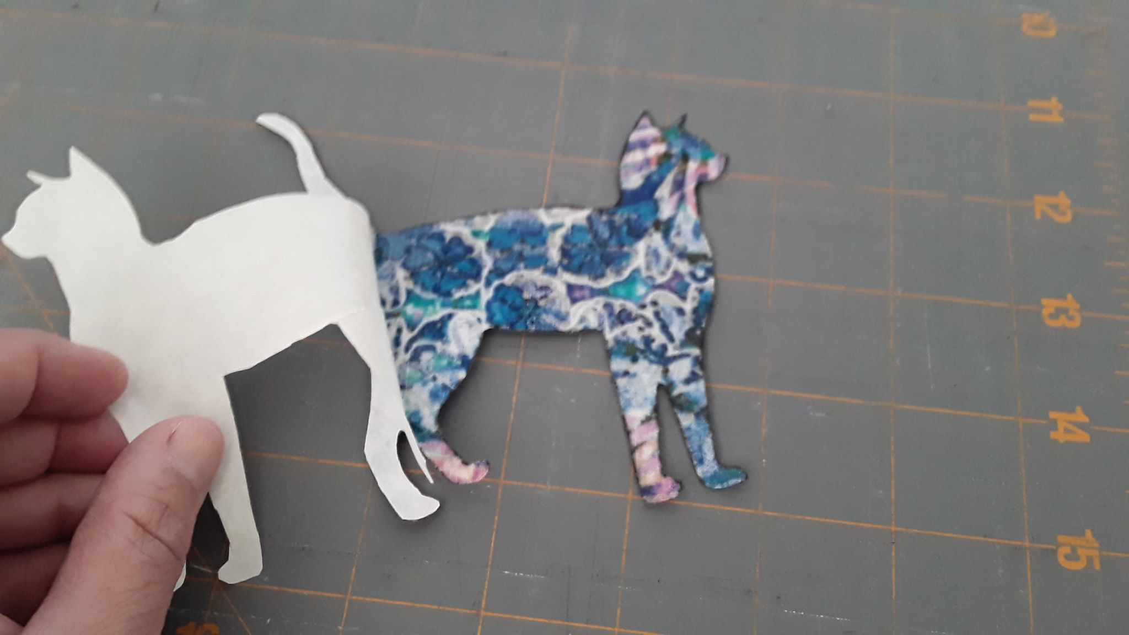
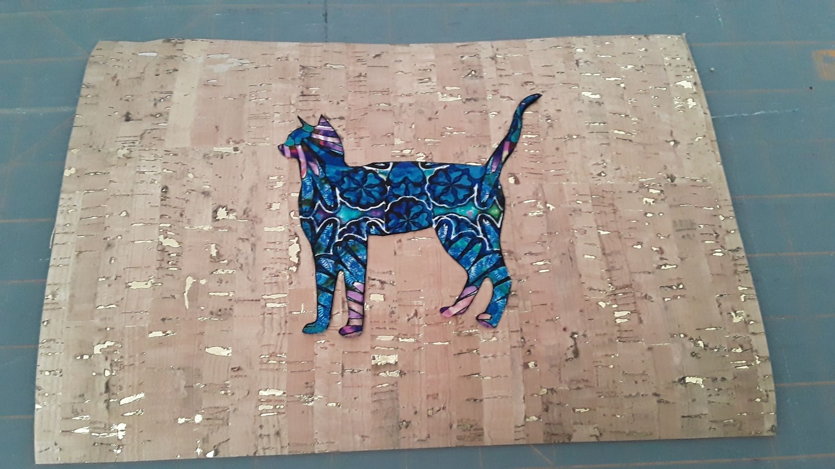
Adhere APPLIQUE TO CORK
Peel off Heat N Bond paper from the back of applique
Position / reposition applique on cork
Using a press cloth or scrap of fabric as a press cloth and low/medium heat, iron the applique onto the cork. 2 seconds with the iron will probably be plenty.

Slide 13
STITCHING the APPLIQUE TO THE CORK
Use invisible thread (with polyester bobbing) OR a coordinating / contrasting color of regular cotton or polyester thread.
On your machine – use a blanket stitch, fine zig zag, or blind hem stitch. I use BLANKET STITCH.
Adjust the width of the stitch based on the size of your applique
If your machine has speed control, set it on the SLOWEST speed
If your machine has a NEEDLE DOWN option, turn in on and use it
Start on a corner or straight edge if possible, then sew around all raw edges of shape to secure applique to the cork. Pivot with needle down at tight curves or corners.

Slide 14
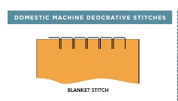
STITCHING ON THE APPLIQUE WITH BLANKET STITCH – GO SLOW!

Slide 15
MAKING THE CORK ZIPPER BAG

Slide 16
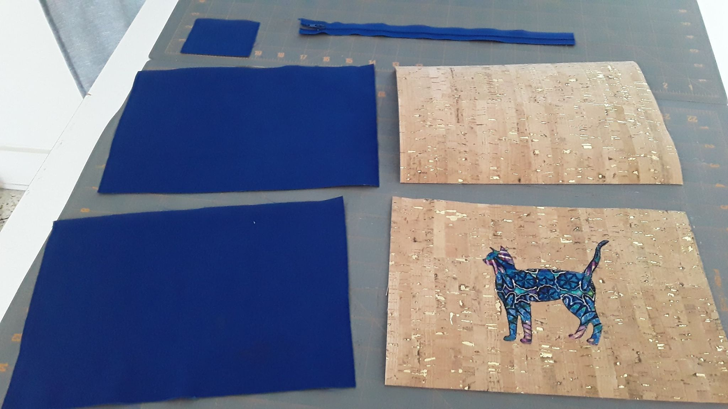
Zipper Tabs – 1piece
2.5” x 3”
Zipper -- 9” or longer
Lining – 2 pieces
10”x 7”
Cork – 2 pieces
10” x 7”

Slide 17
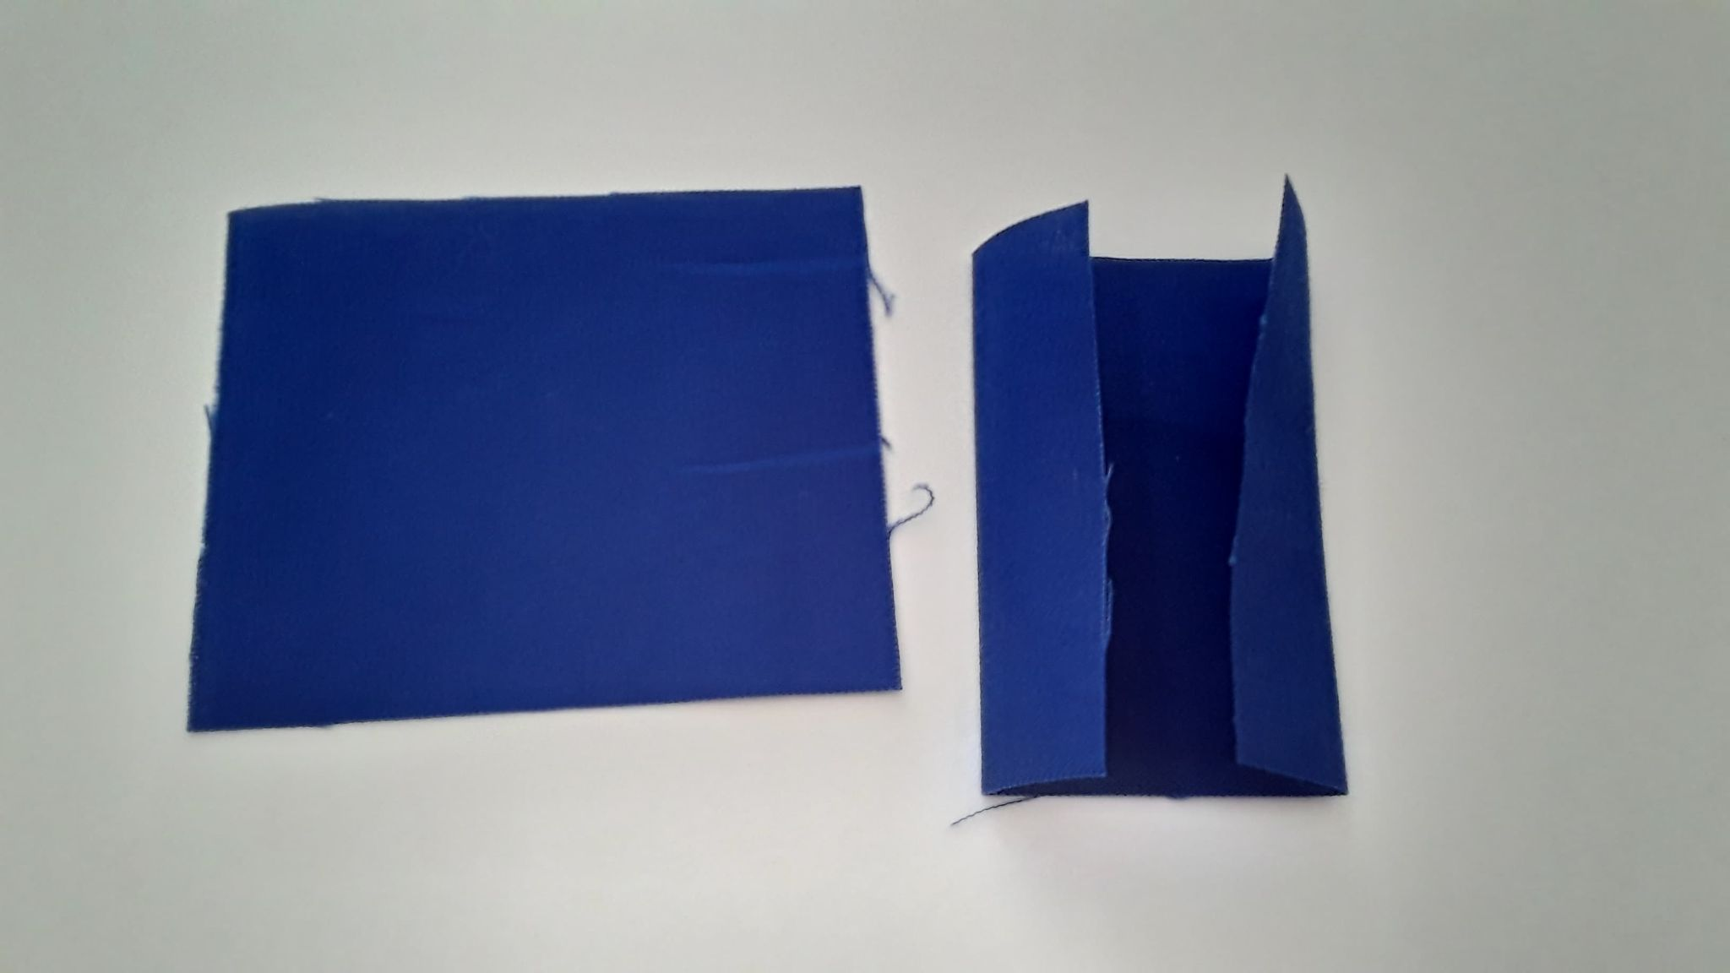
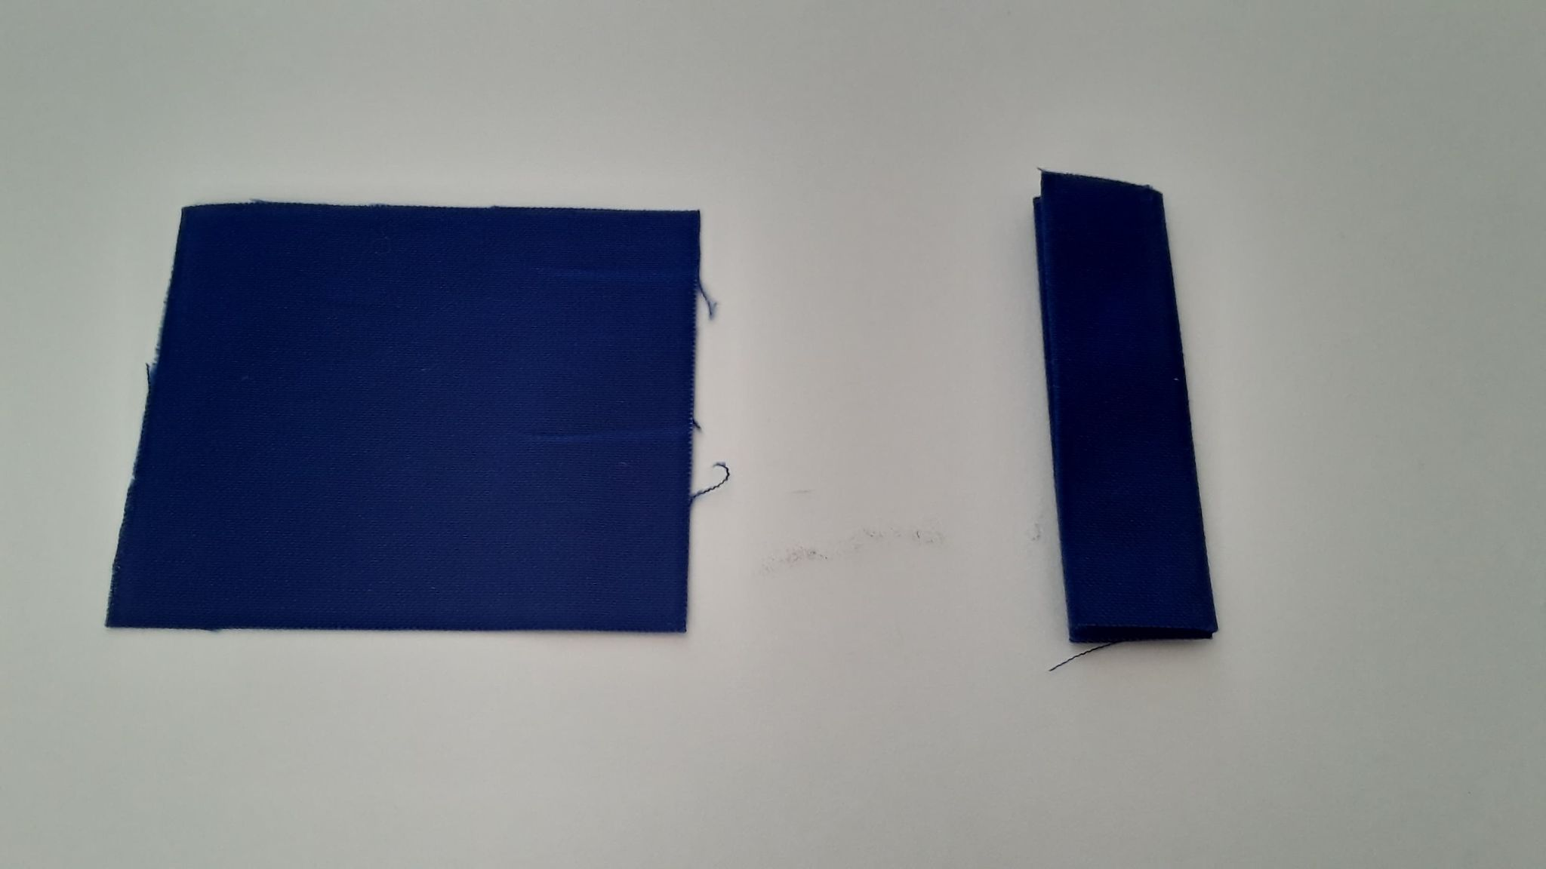
Making the Zipper TabS
Press 2.5” x 3” fabric in half along 3” side to form a 1.25” x 3 “ folded piece
Open and press raw edges to meet center crease.
Press in half lengthwise again.

Slide 18
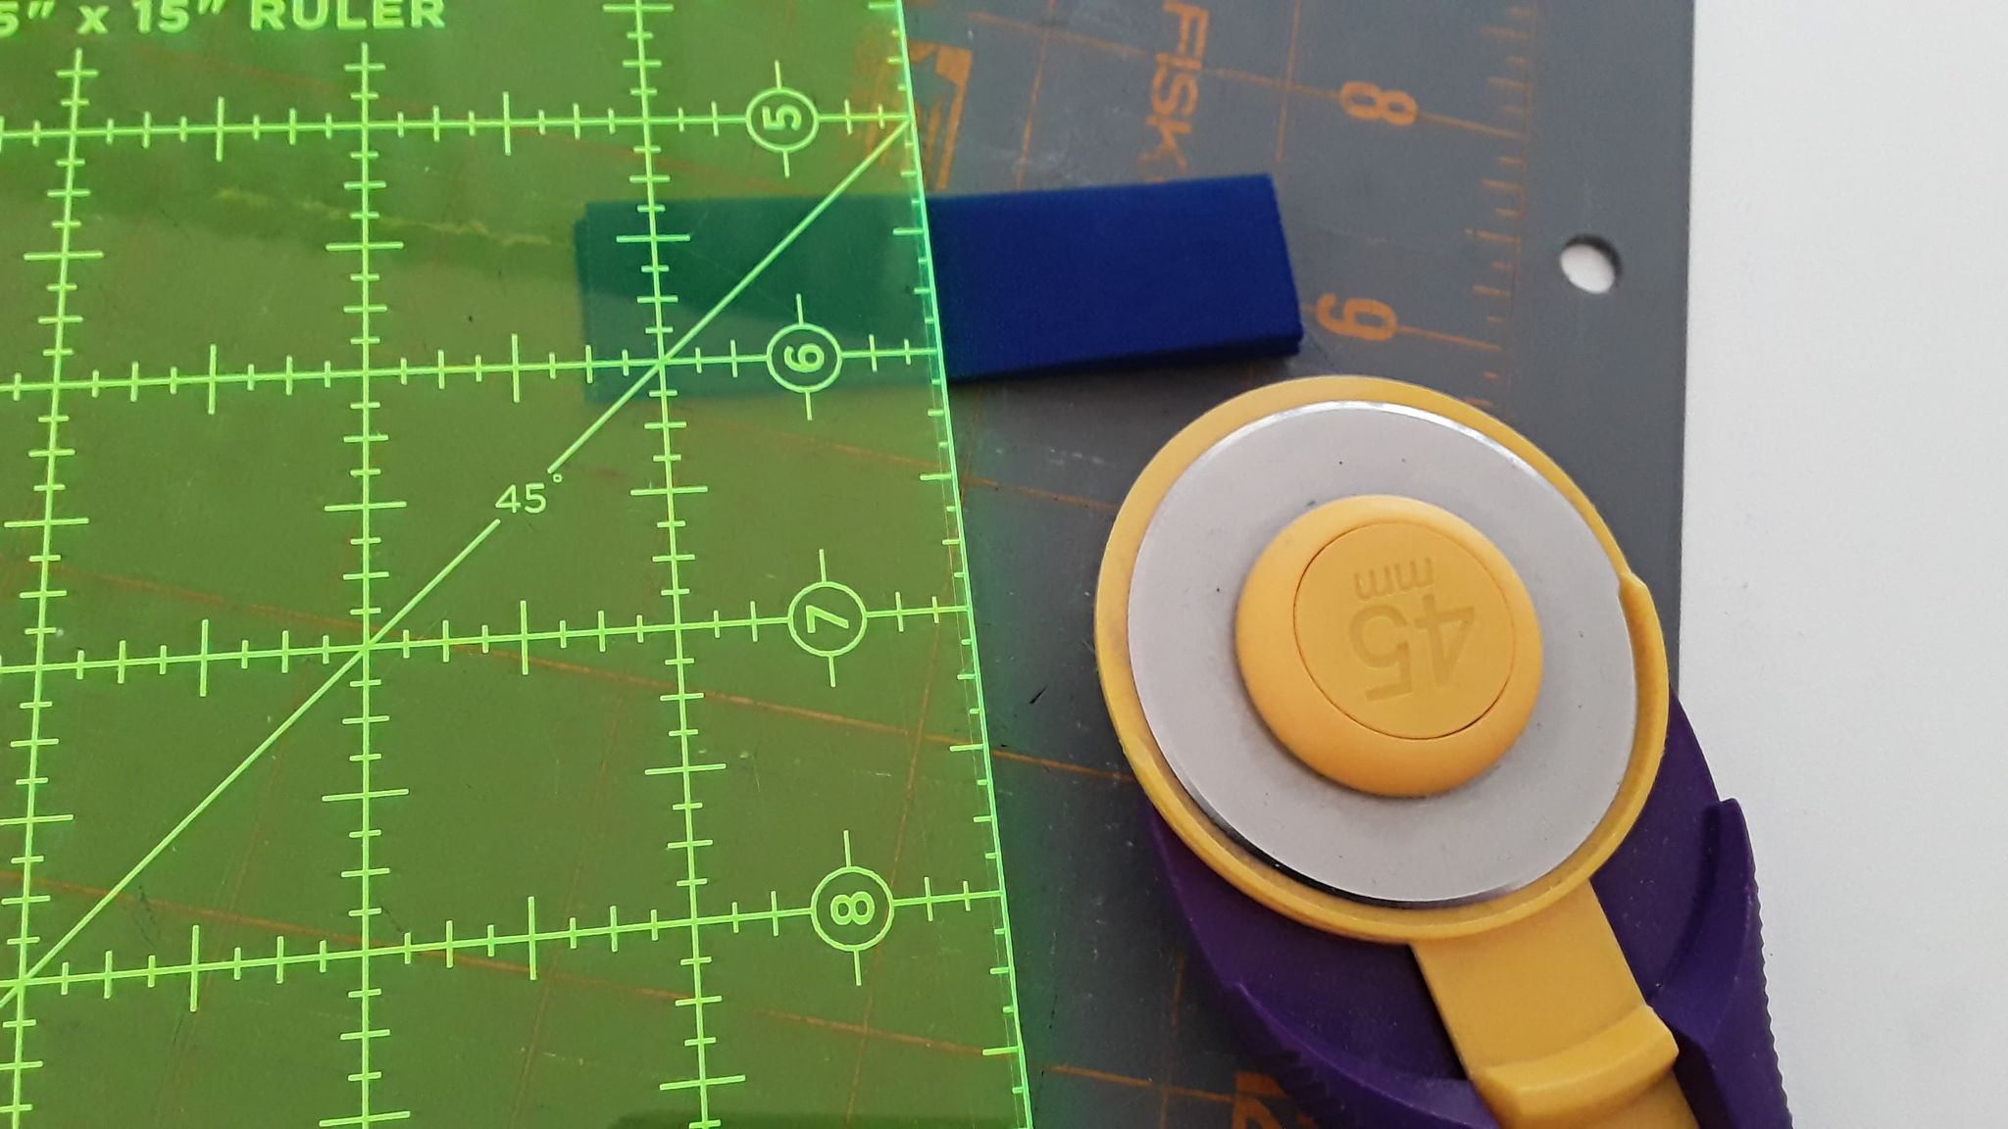
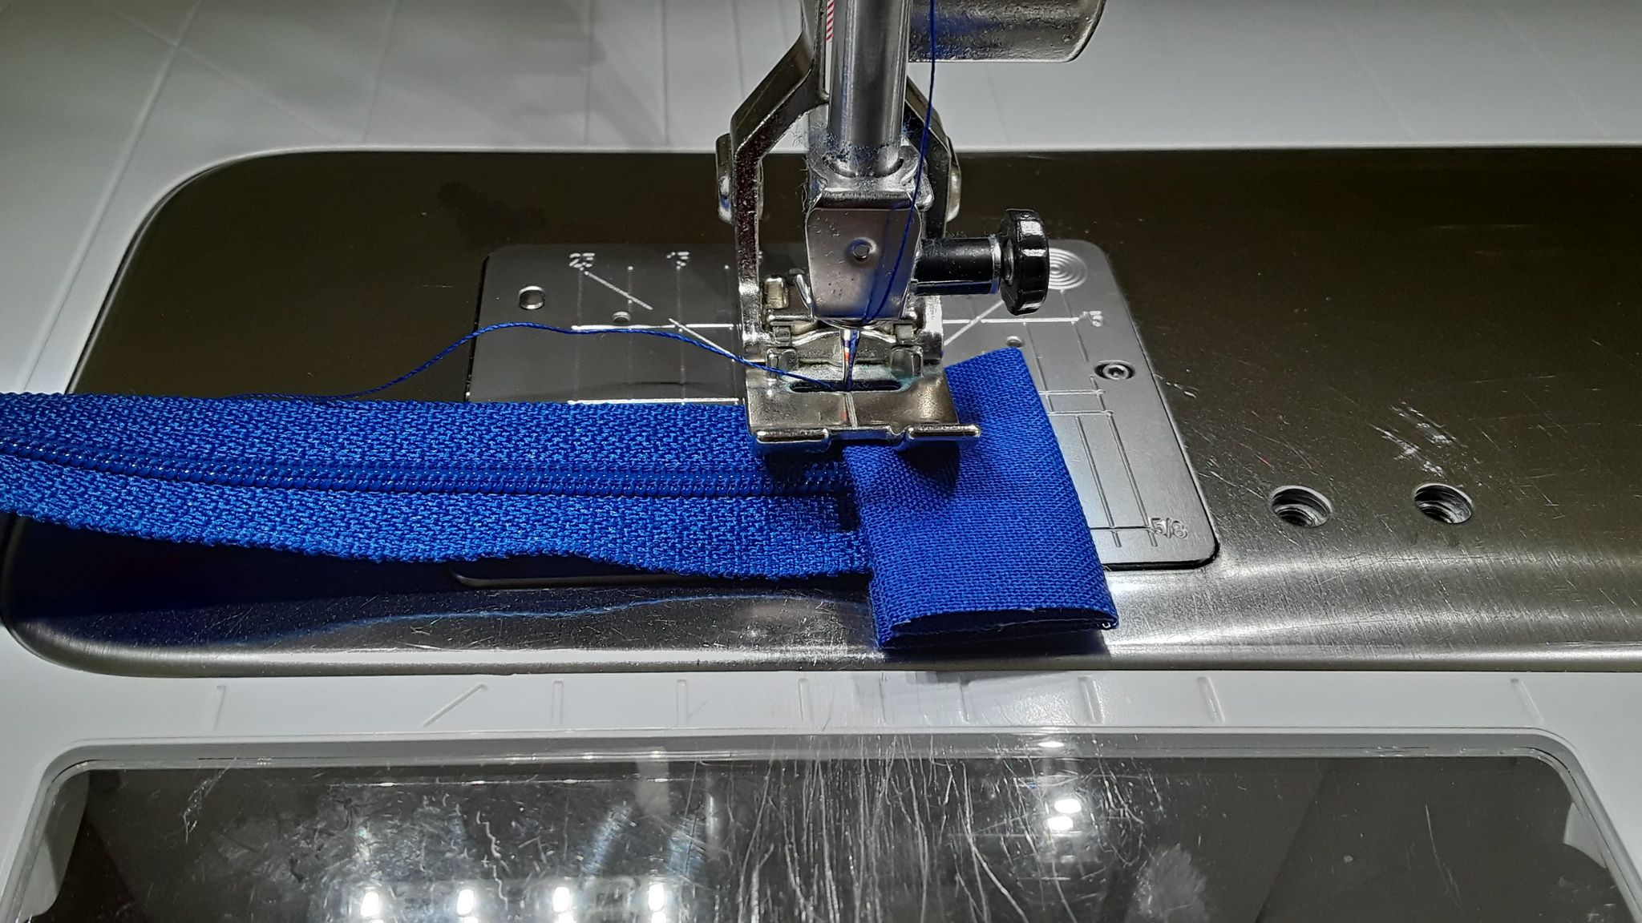
Added TABS to the Zipper (It SHOULD BE 9 inches total WITH TABS)
Cut in tab half, creating two 1.5” pieces.
Place end of zipper inside fold of fabric tab. Fold fabric down and over zipper end.
Topstitch tab close to the inner edge of fabric. Repeat at other end of zipper.

Slide 19
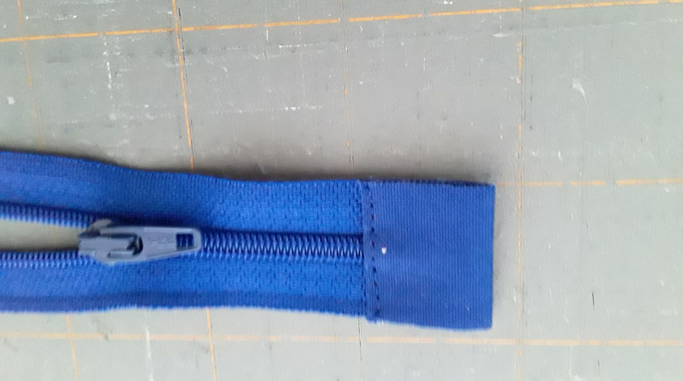
Sewing the Bag
Trim zipper tabs to match the width of zipper. Repeat at other end of zipper.
Place zipper and one lining piece right side up, aligning the top raw edges. Zipper should be centered on the fabric with ½” of space on each side. Using zipper foot, baste along top 1/8” from top edge.

Slide 20
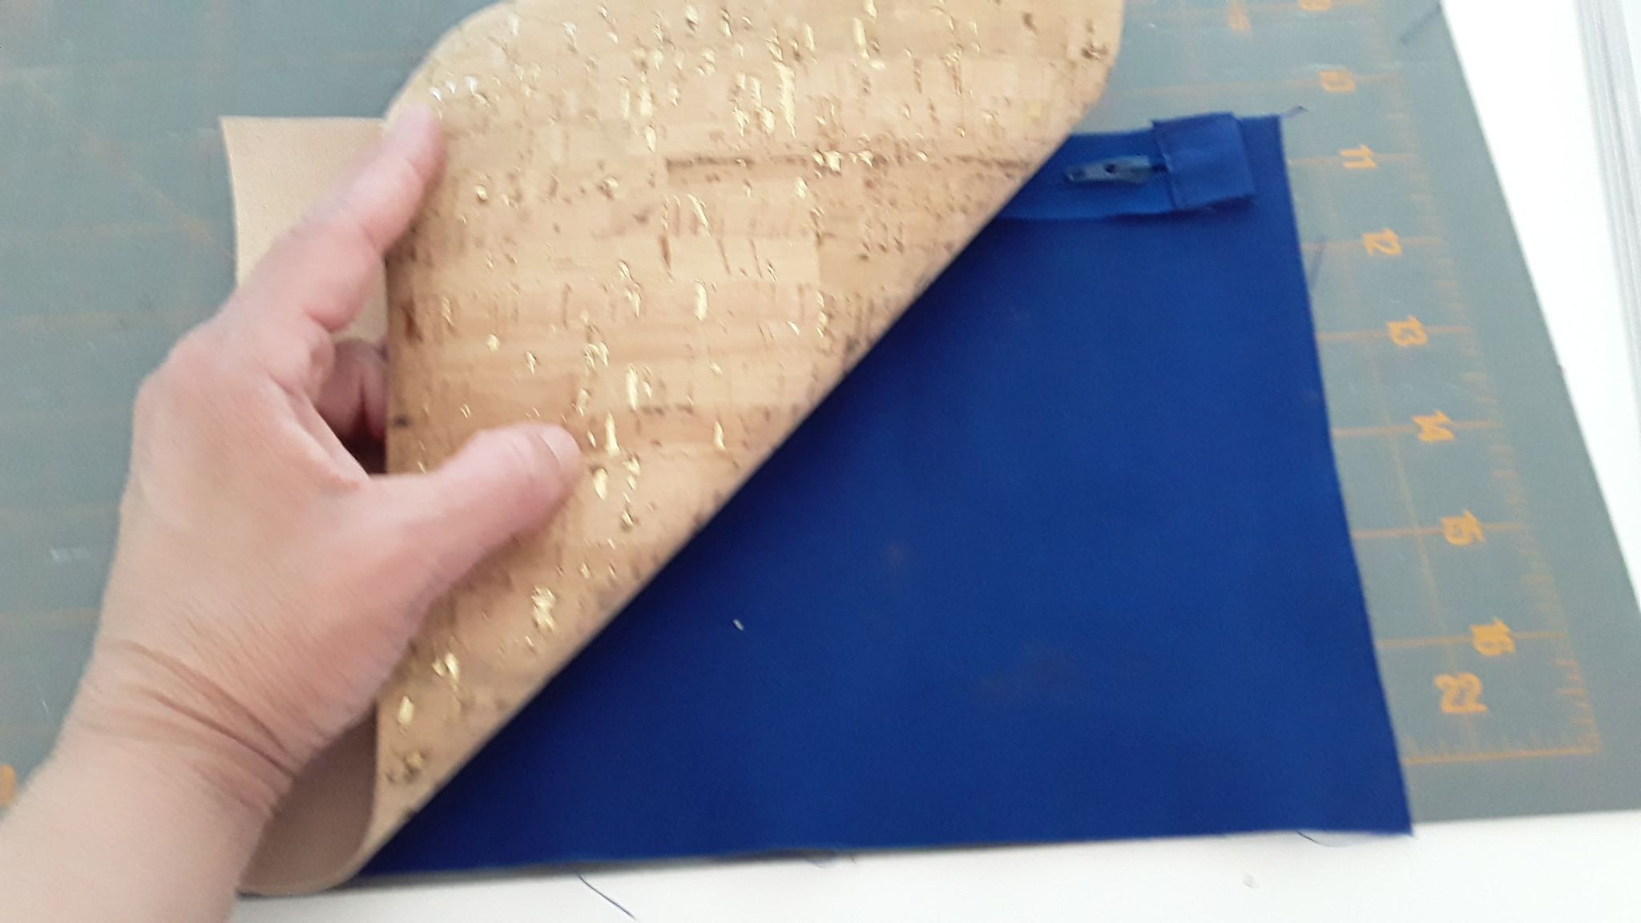
Place exterior cork right side down and align with raw edges of other piece. You may want to use wonder clips to hold pieces together..
Using zipper foot, sew a seam close to the zipper teeth.

Slide 21
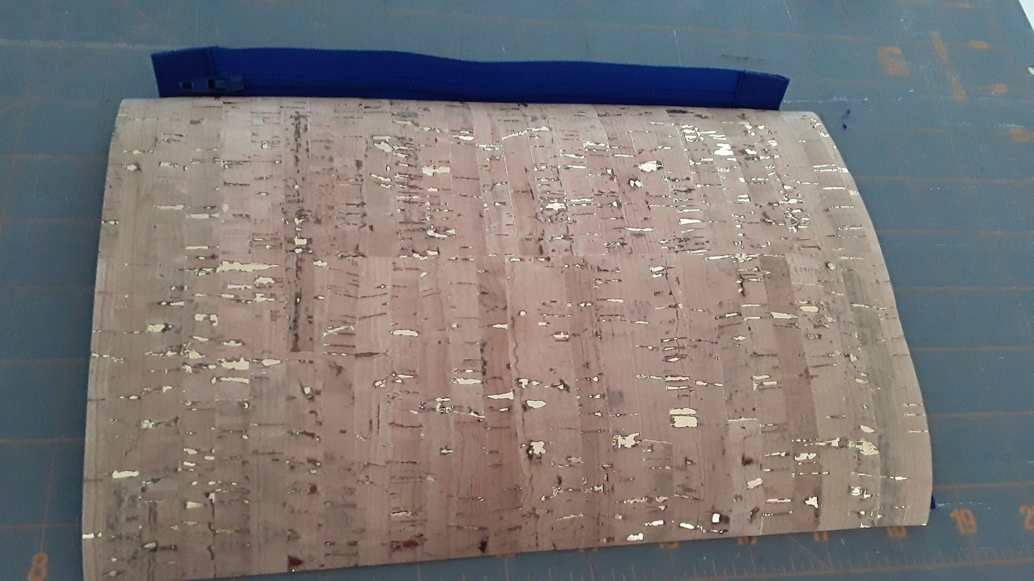
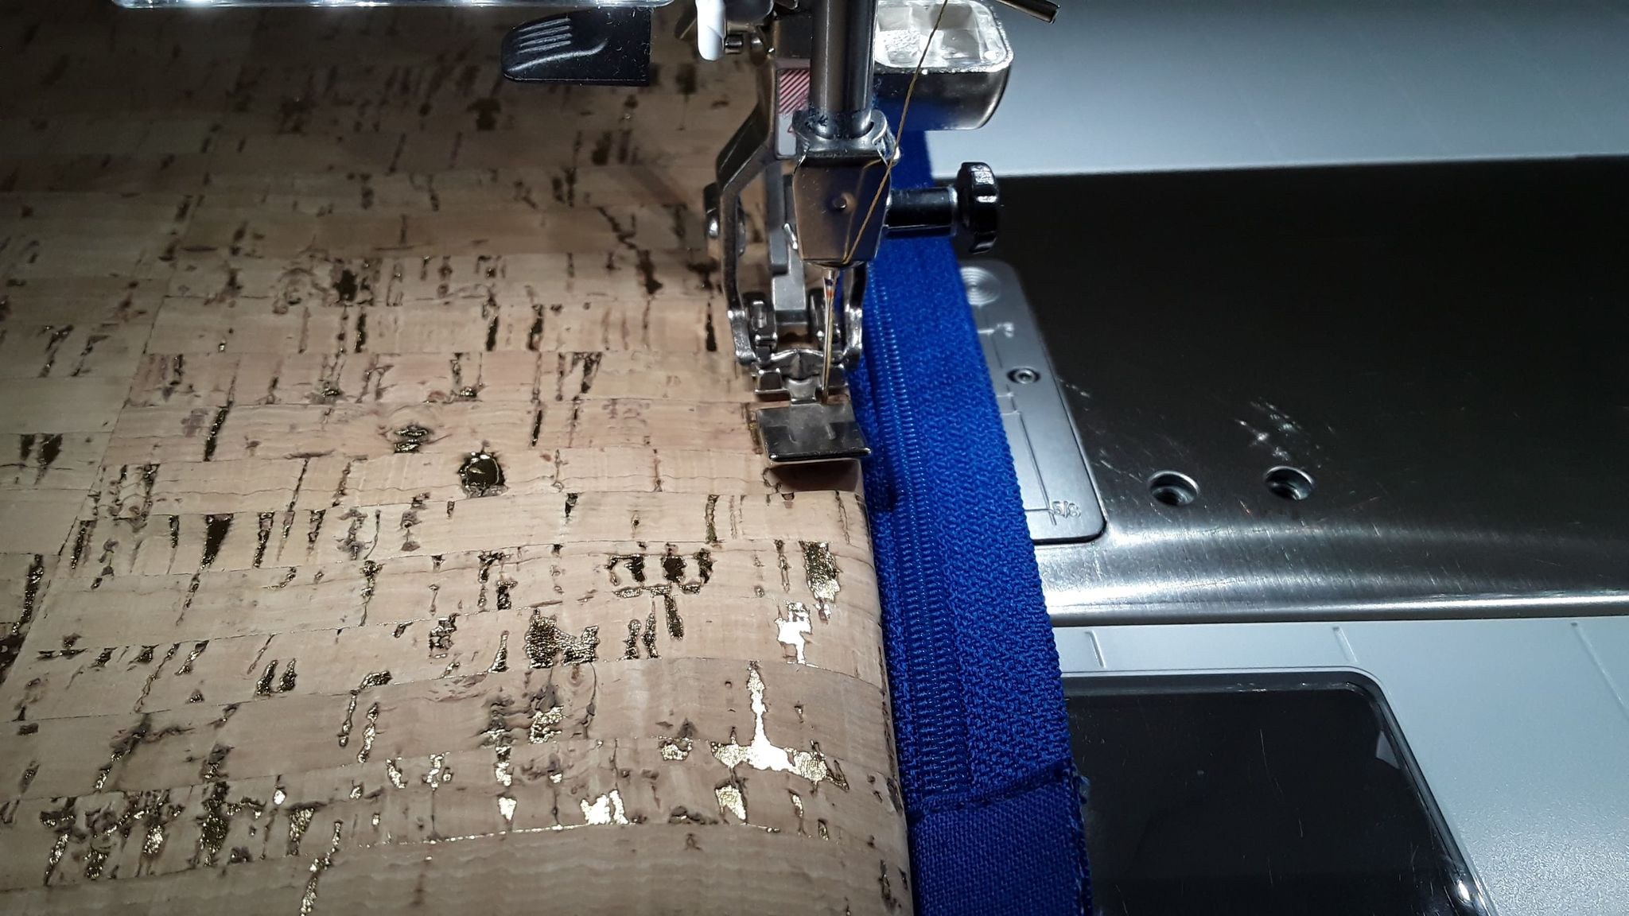
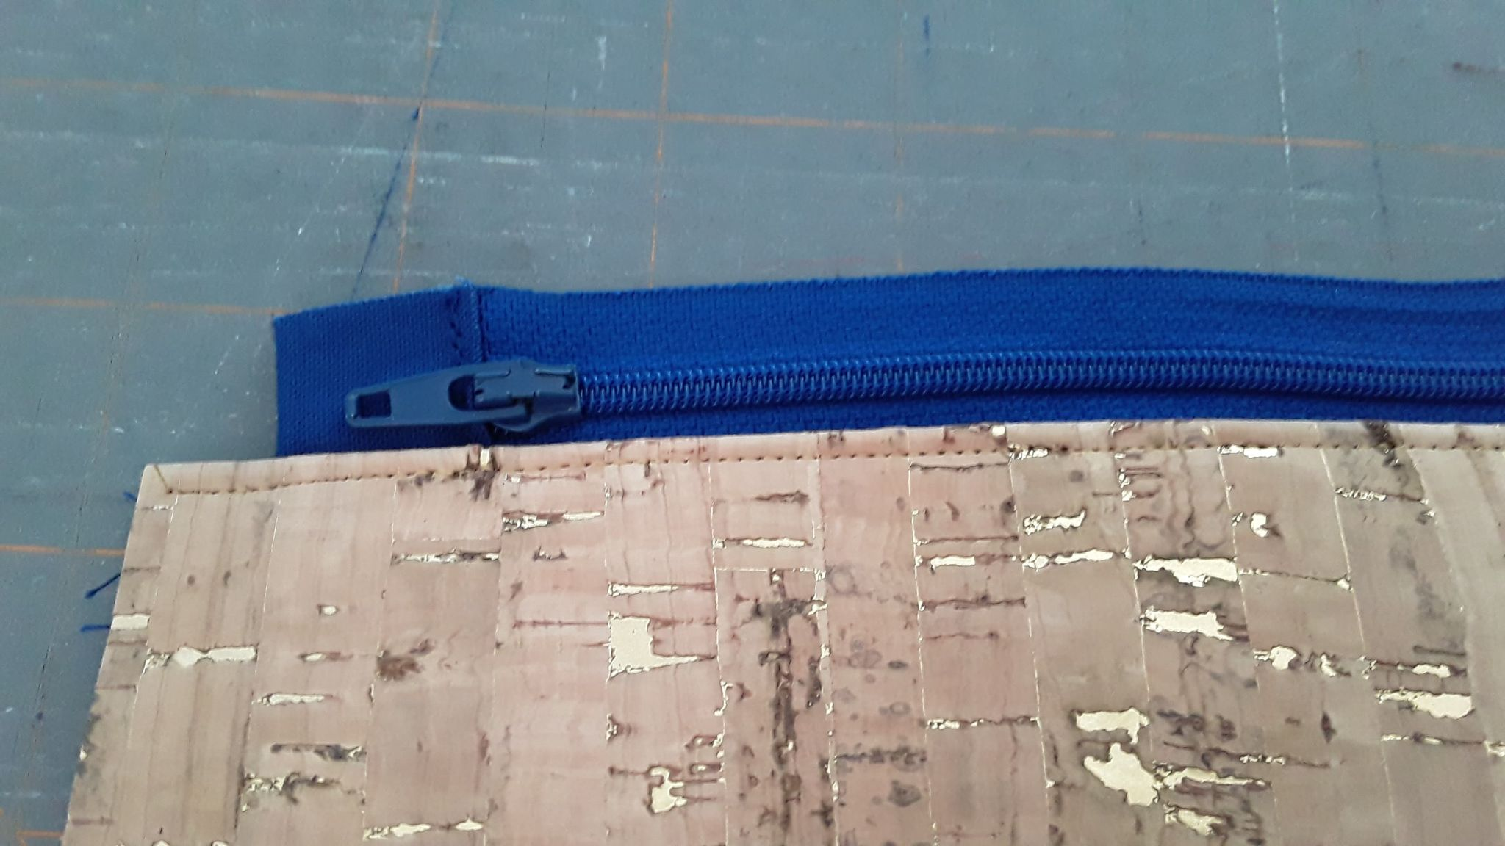
Open cork and lining fabric away from zipper, putting wrong sides together. Finger press.
Top stich thru all layers.

Slide 22
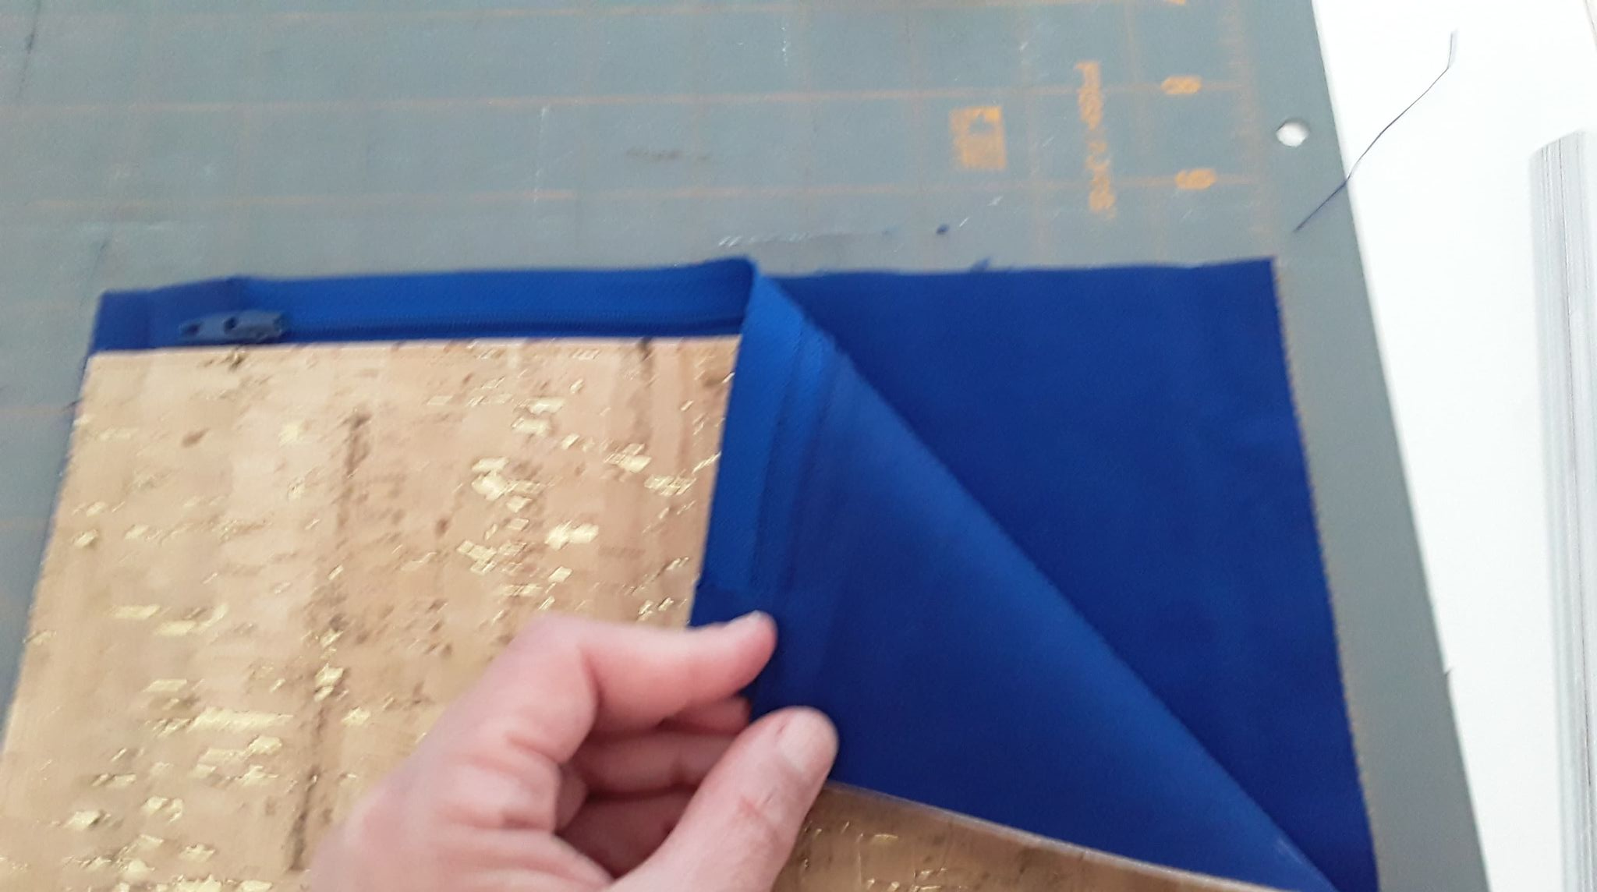
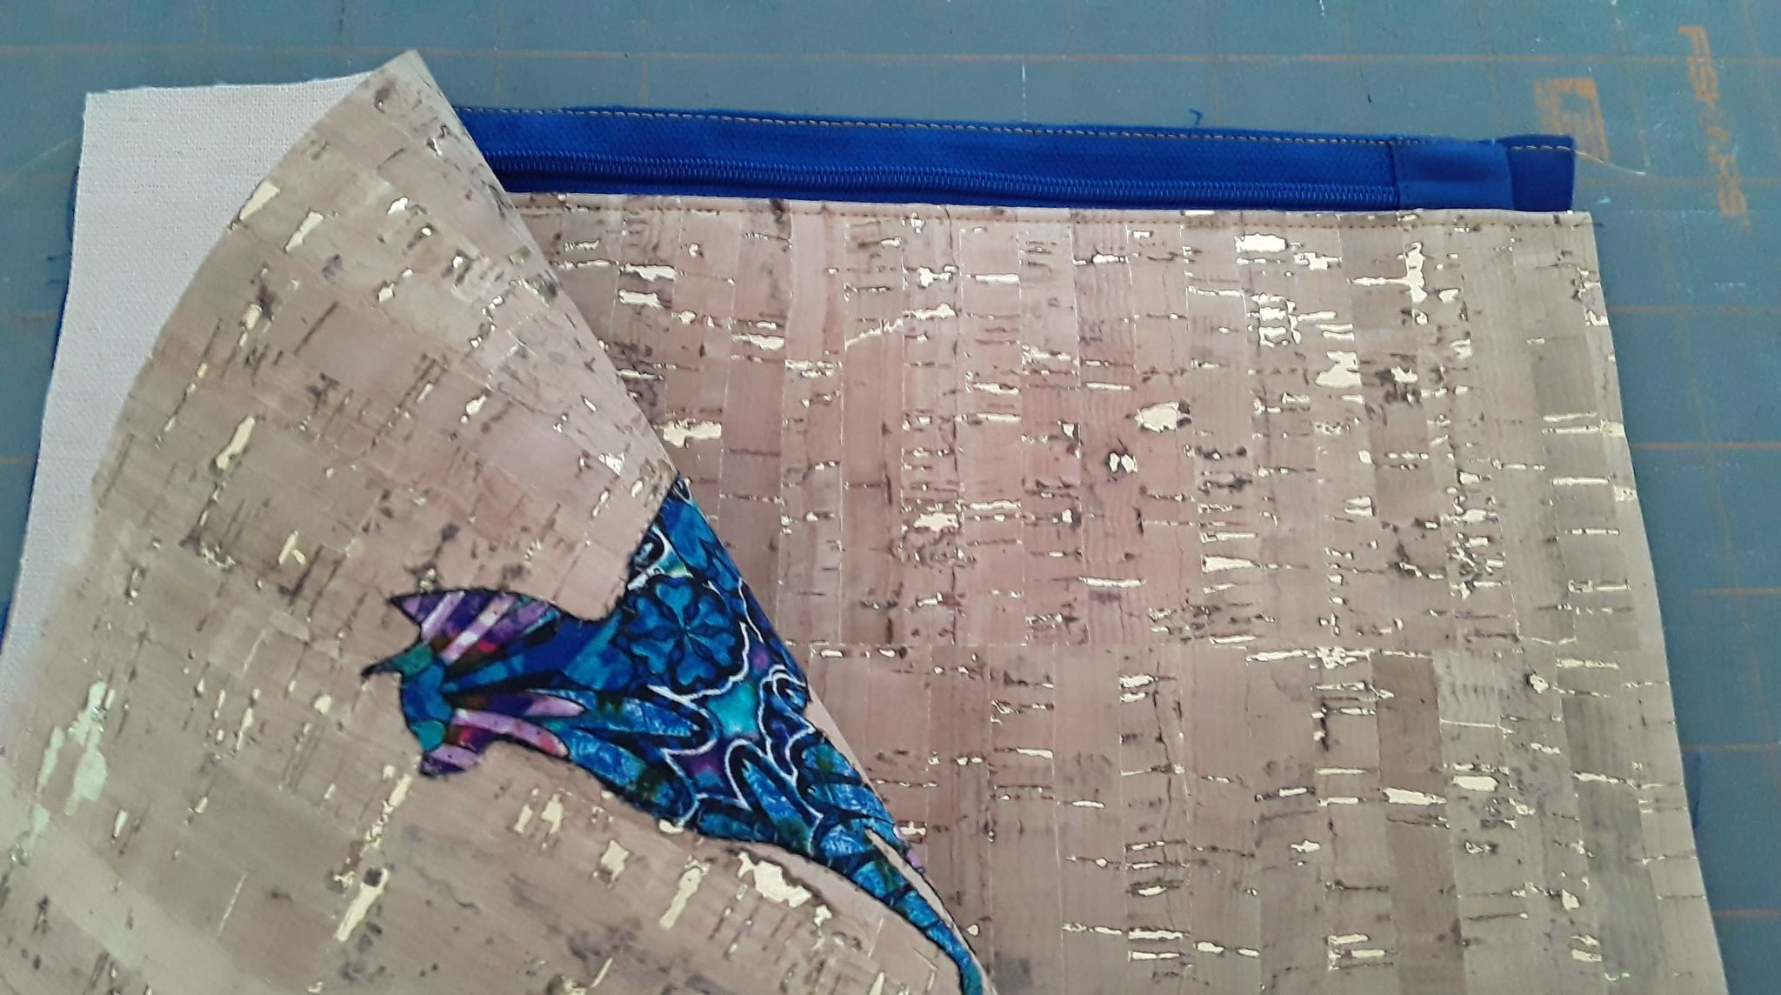
Place finished section from previous step on top of remaining piece of lining. Lining fabrics will face each other with right sides together. Align top edges. Using zipper foot, baste along top 1/8” from top edge.
Place remaining piece of cork right side down on top of finished section from previous step. Align top edge. Using zipper foot, sew a seam close to zipper teeth..

Slide 23
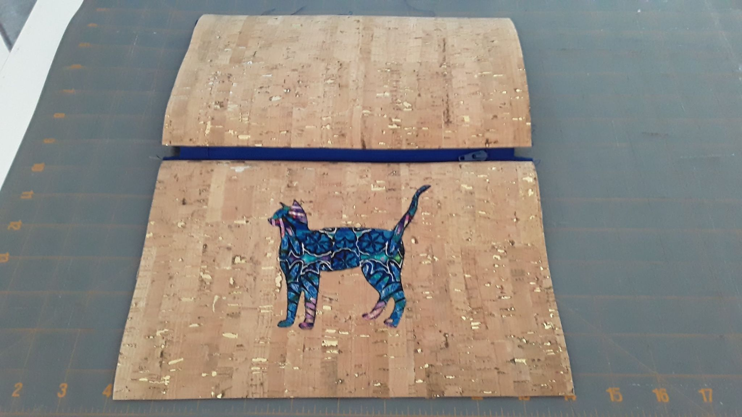
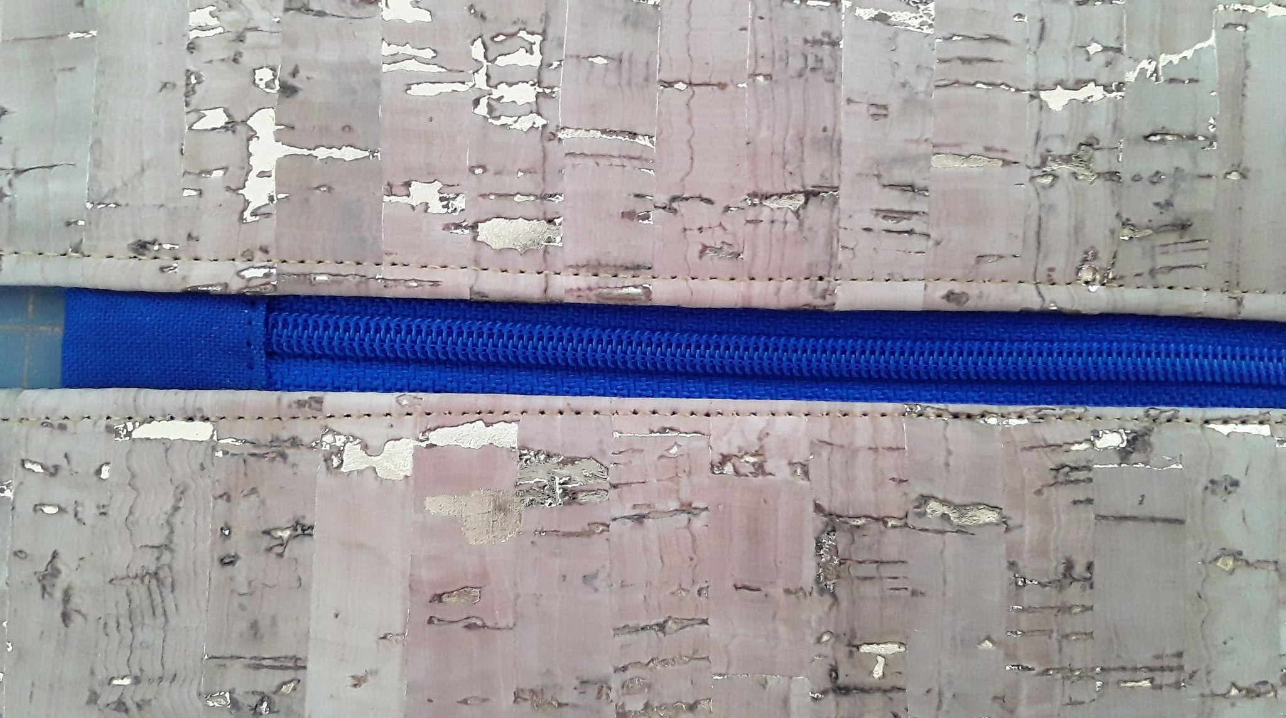
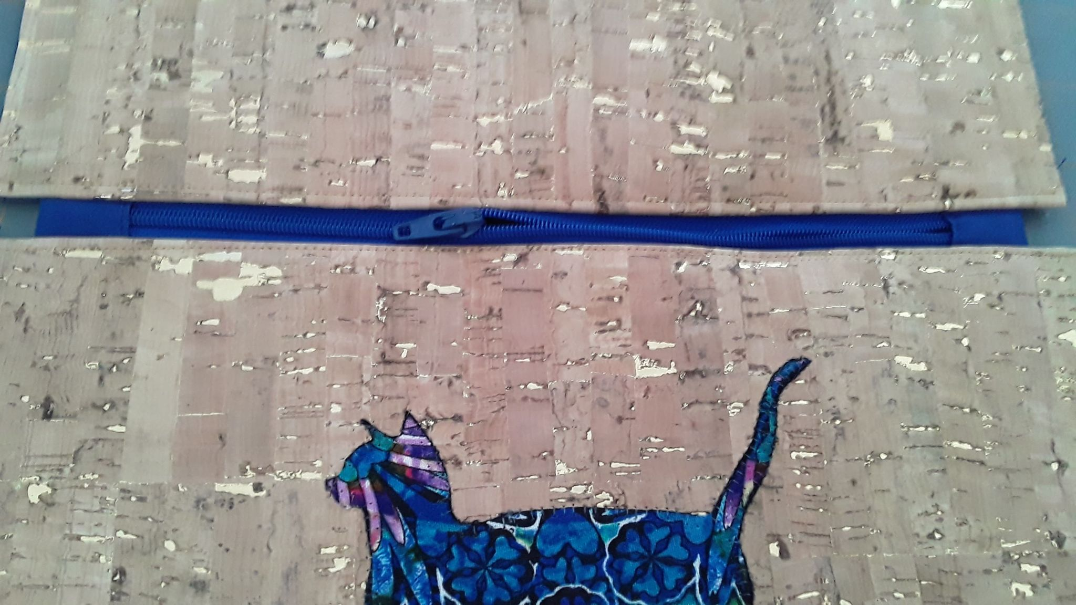
Open cork and lining fabric away from zipper, putting wrong sides together. Finger press.
Top stich thru all layers. Now OPEN ZIPPER AT LEAST 1/2 WAY

Slide 24
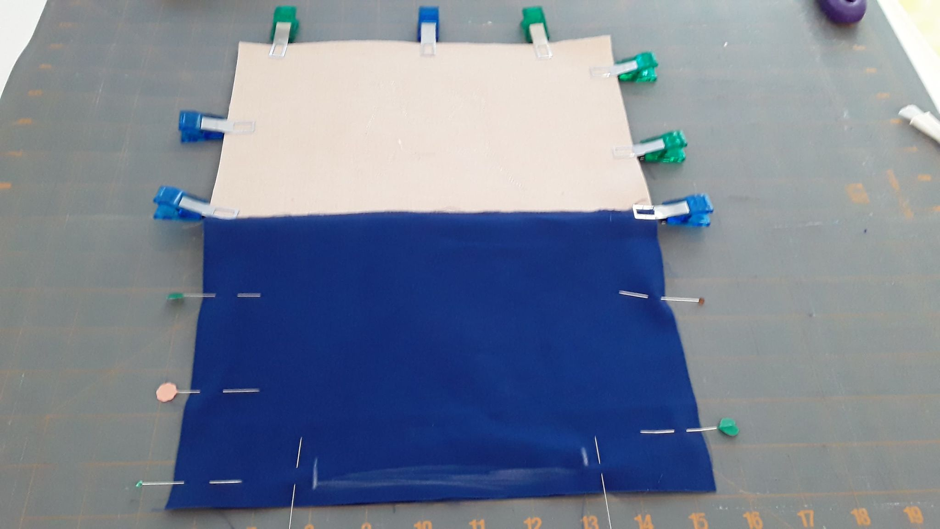
Ensure zipper is open at least ½ way. Match cork to cork and lining to lining. Finger press zipper tabs toward lining side. Use wonder clips and pins to hold together.
Mark a 4’’– 5” opening at bottom of lining

Slide 25
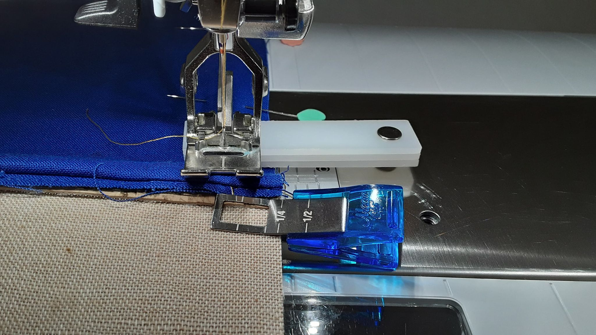
Sew around entire piece using approximately ½” seam…but leave the 4”-5” section at the bottom of the lining OPEN. You need this hole to right side out the bag.
Be sure to catch the edge of the zipper tabs in the seam. Use a hump jumper to sew over the bulk at the zipper tabs.
Mark a 4’’– 5” opening at bottom of lining

Slide 26
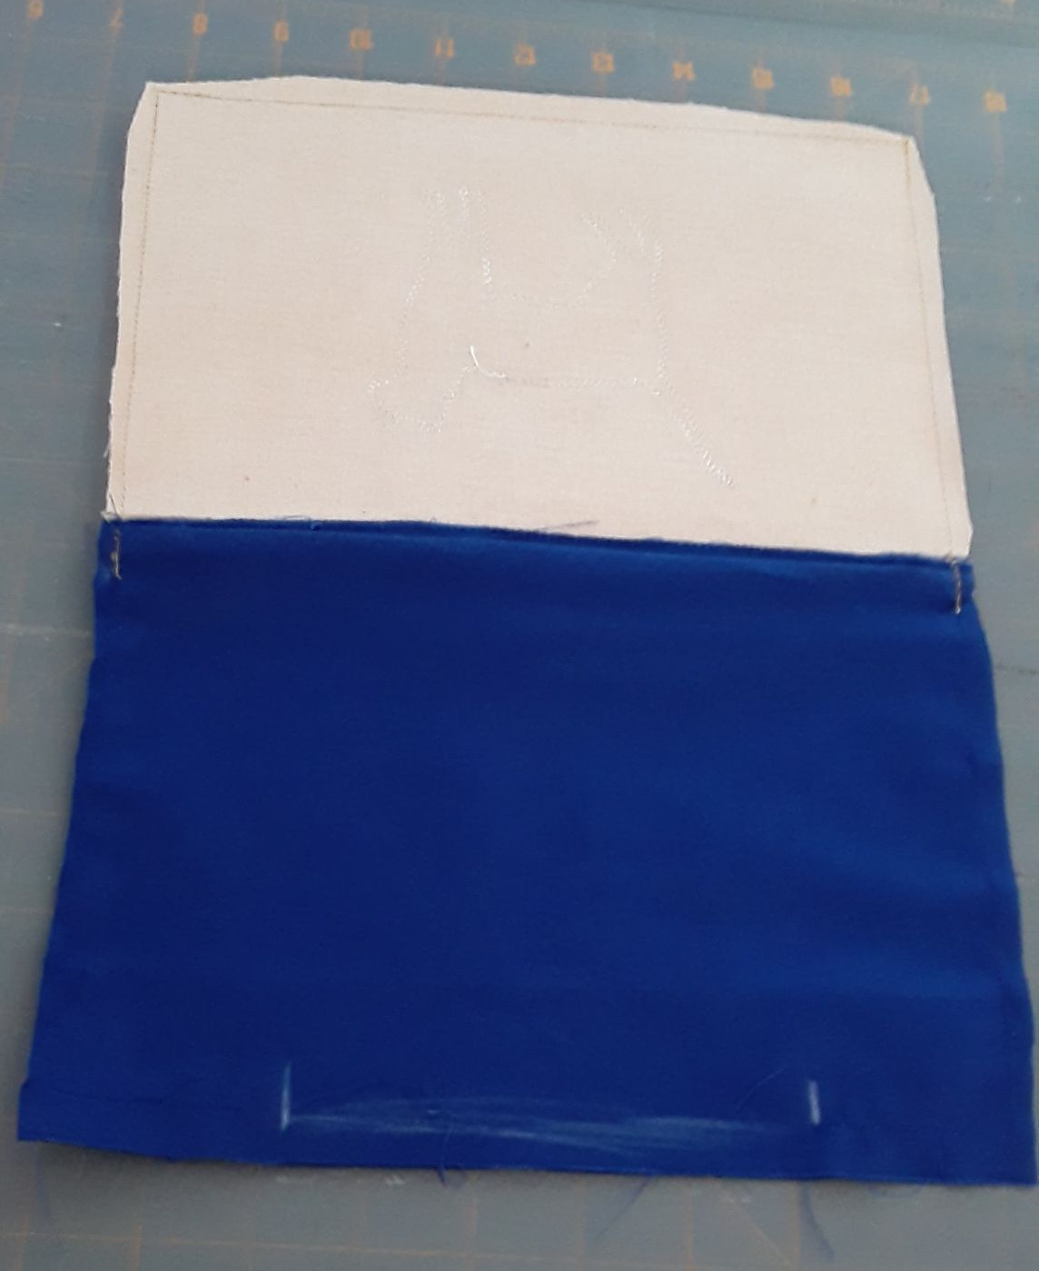
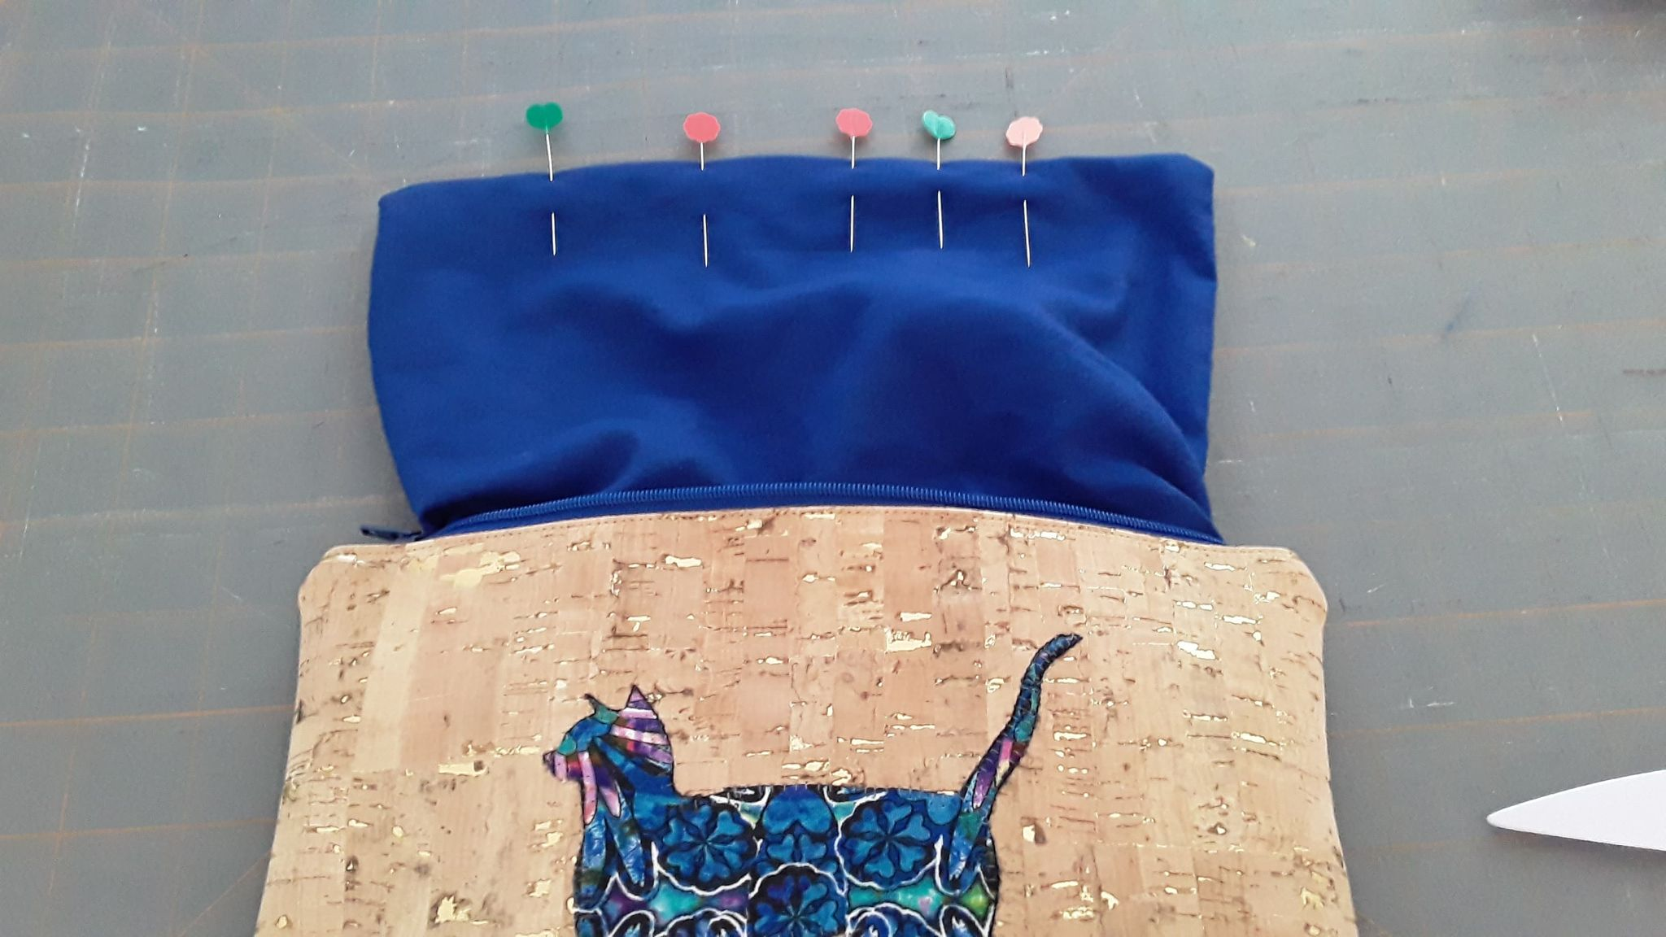
Clip and taper corners. Trim excess fabric and cork away from zipper tab area. Right side out the bag.
Tuck in seam allowance at the opening on the lining and top stitch closed. Push lining to inside of bag.

Slide 27
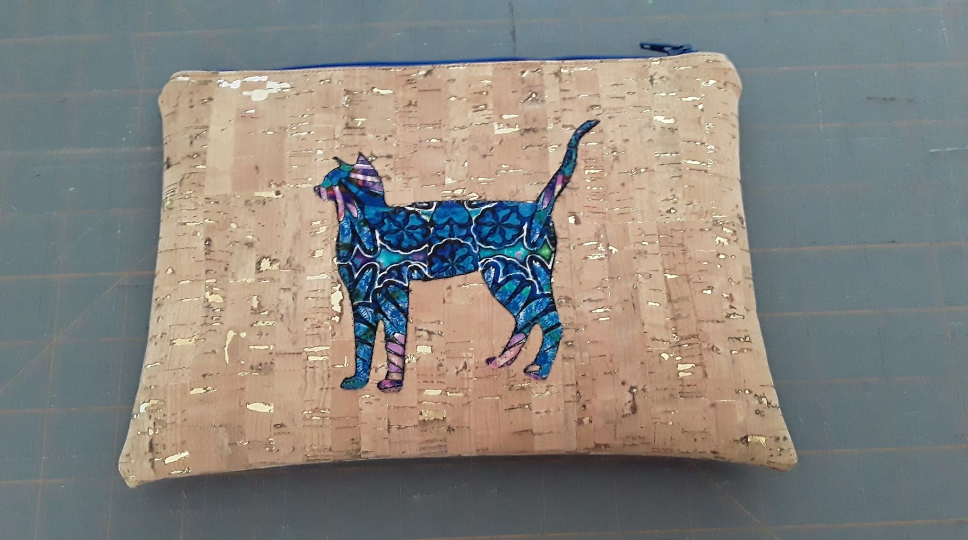

Slide 28
FOR MORE ADVENTURE – Machine EmbroIdery on CORK
Sulky has a good tutorial on doing machine embroidery on cork:
https://blog.sulky.com/machine-embroidery-series-cork-fabric-free-project/

